Slide 1


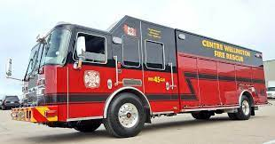
CWFR is…….
(Centre Wellington Fire Rescue)
Fire Chief, Tom Mulvey
November 29th, 2022
1 | CWFR

Slide 2

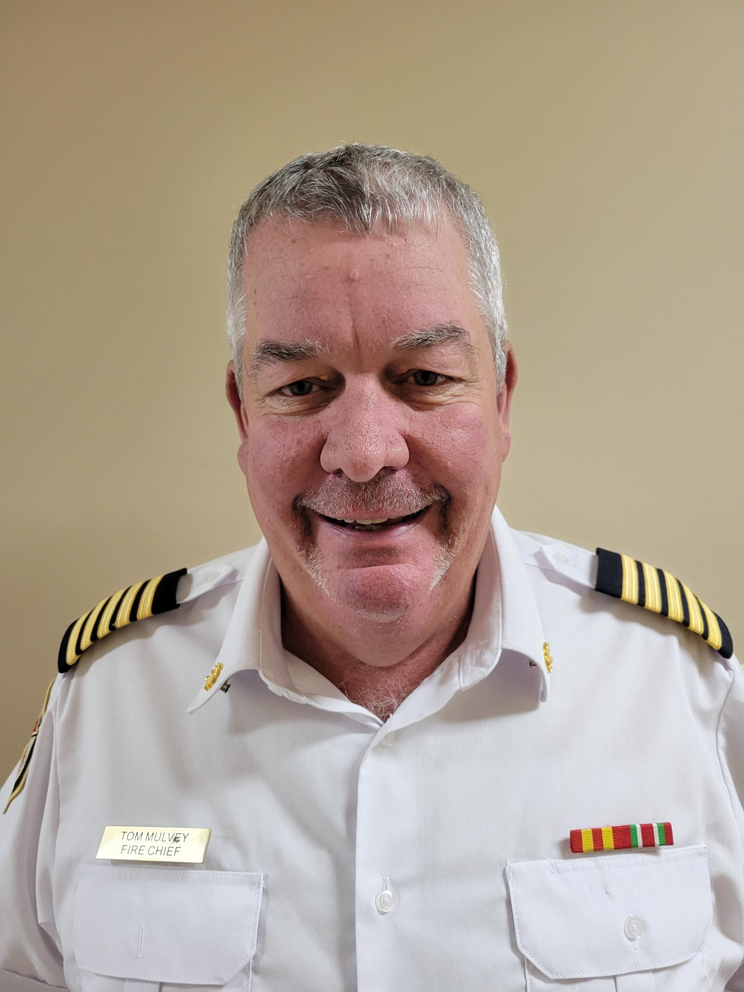
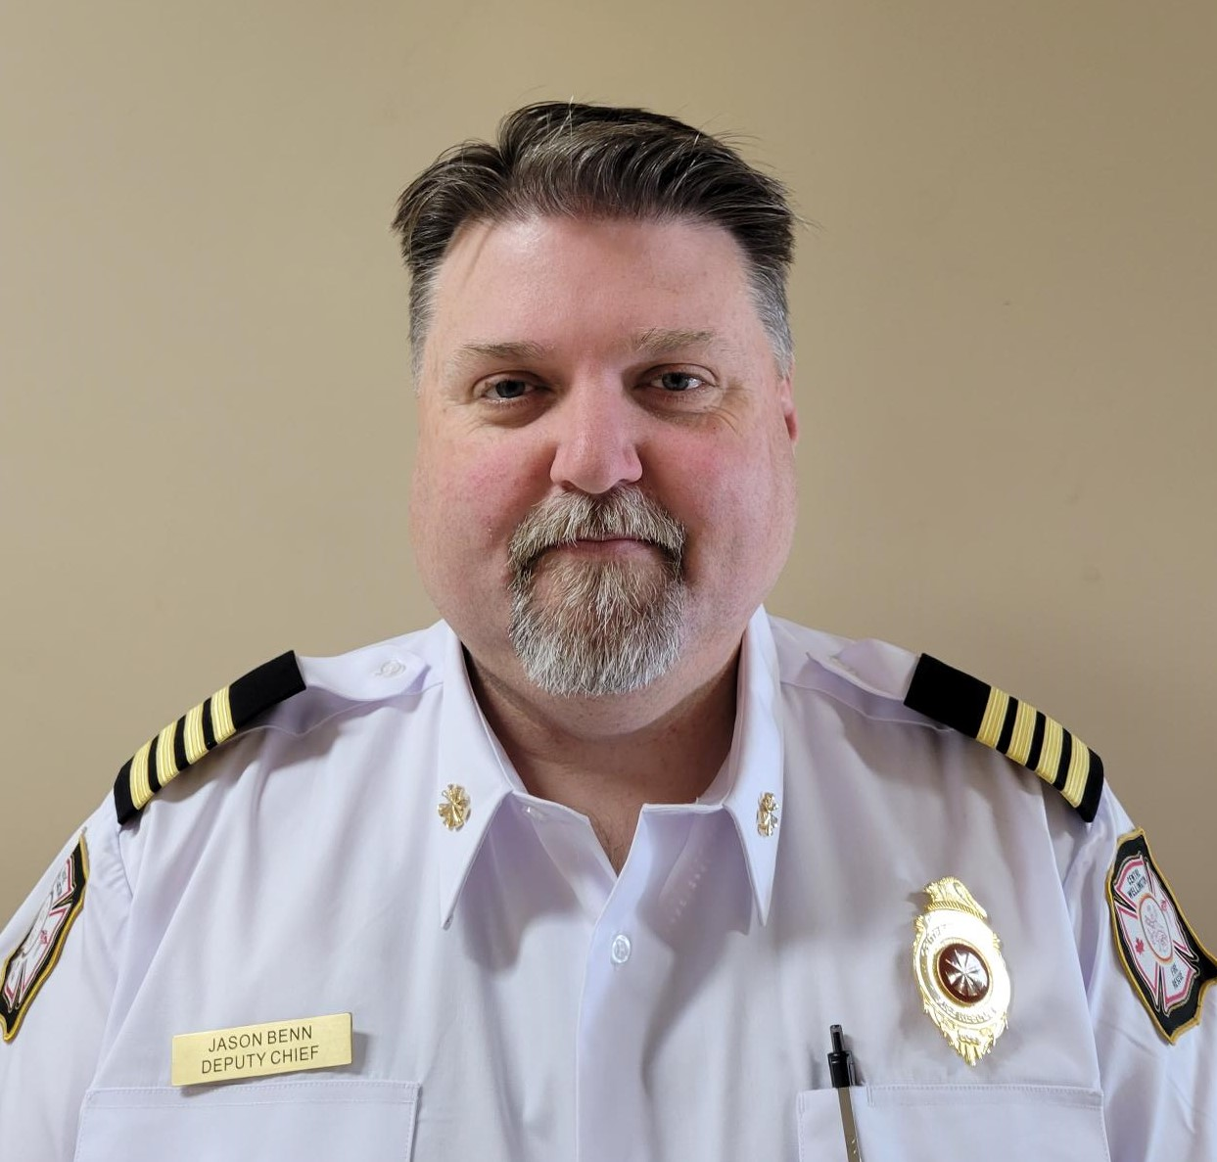
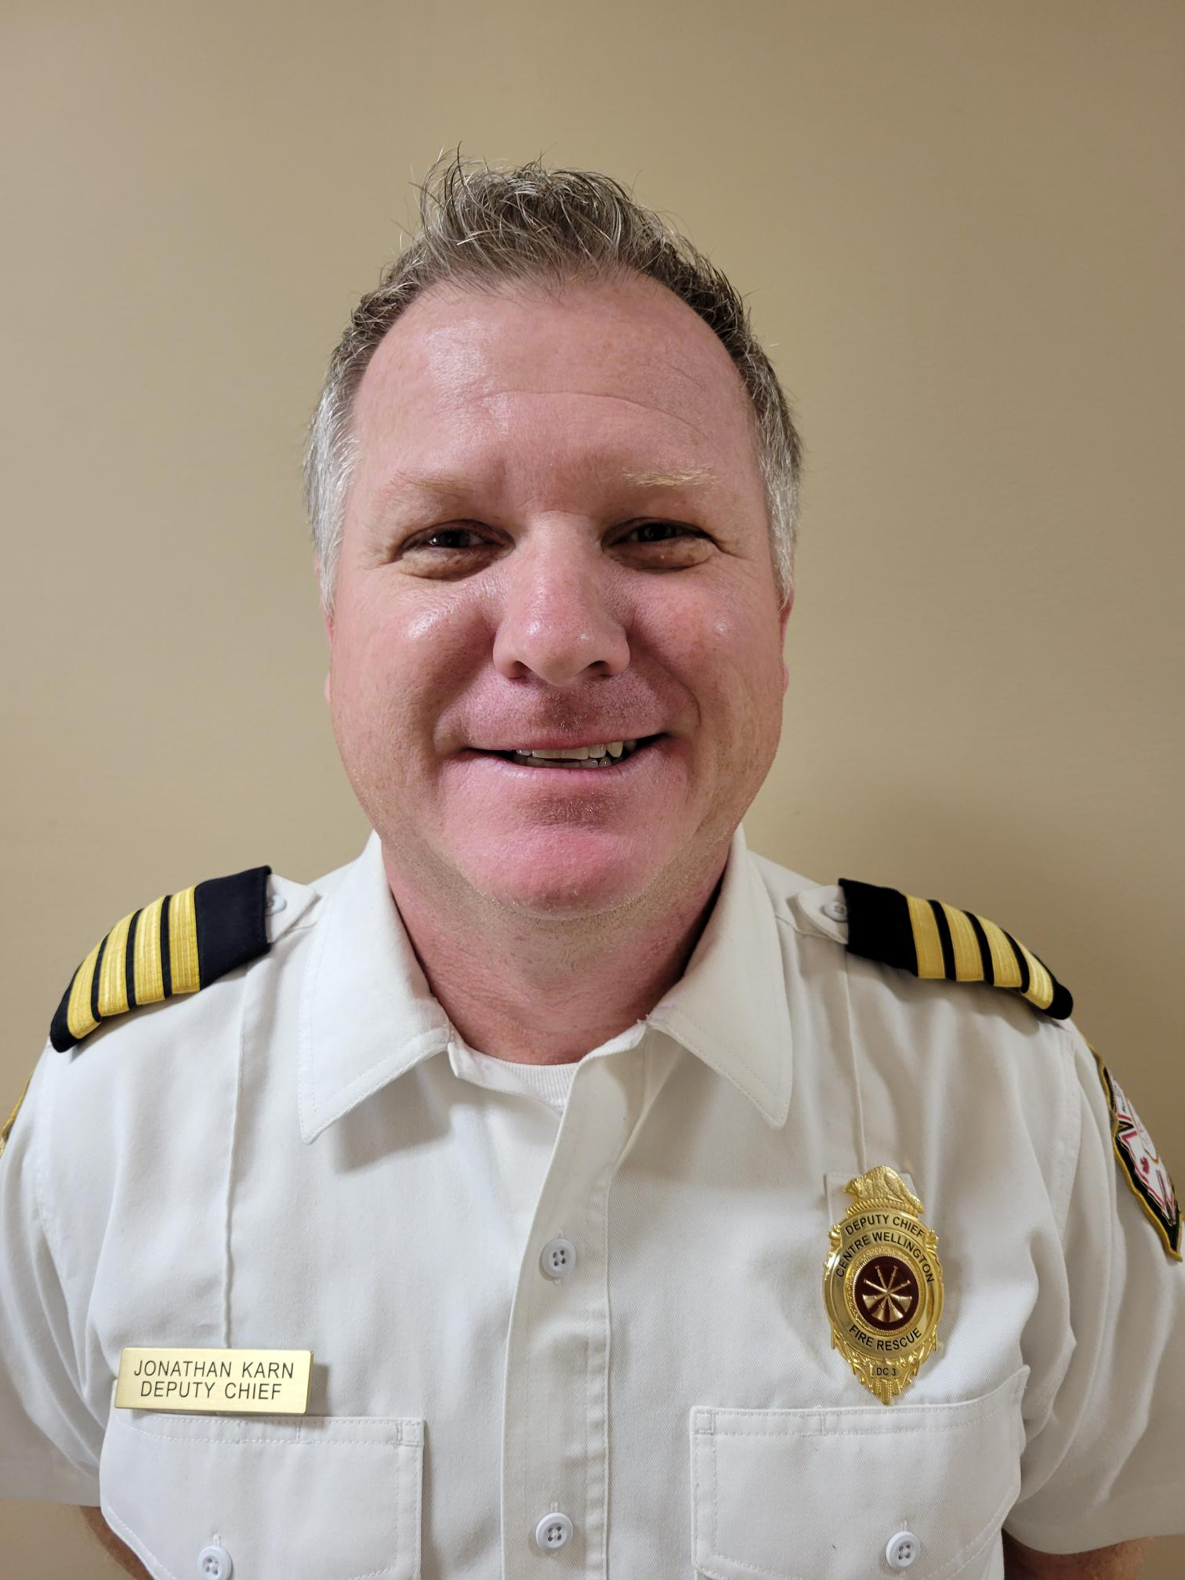

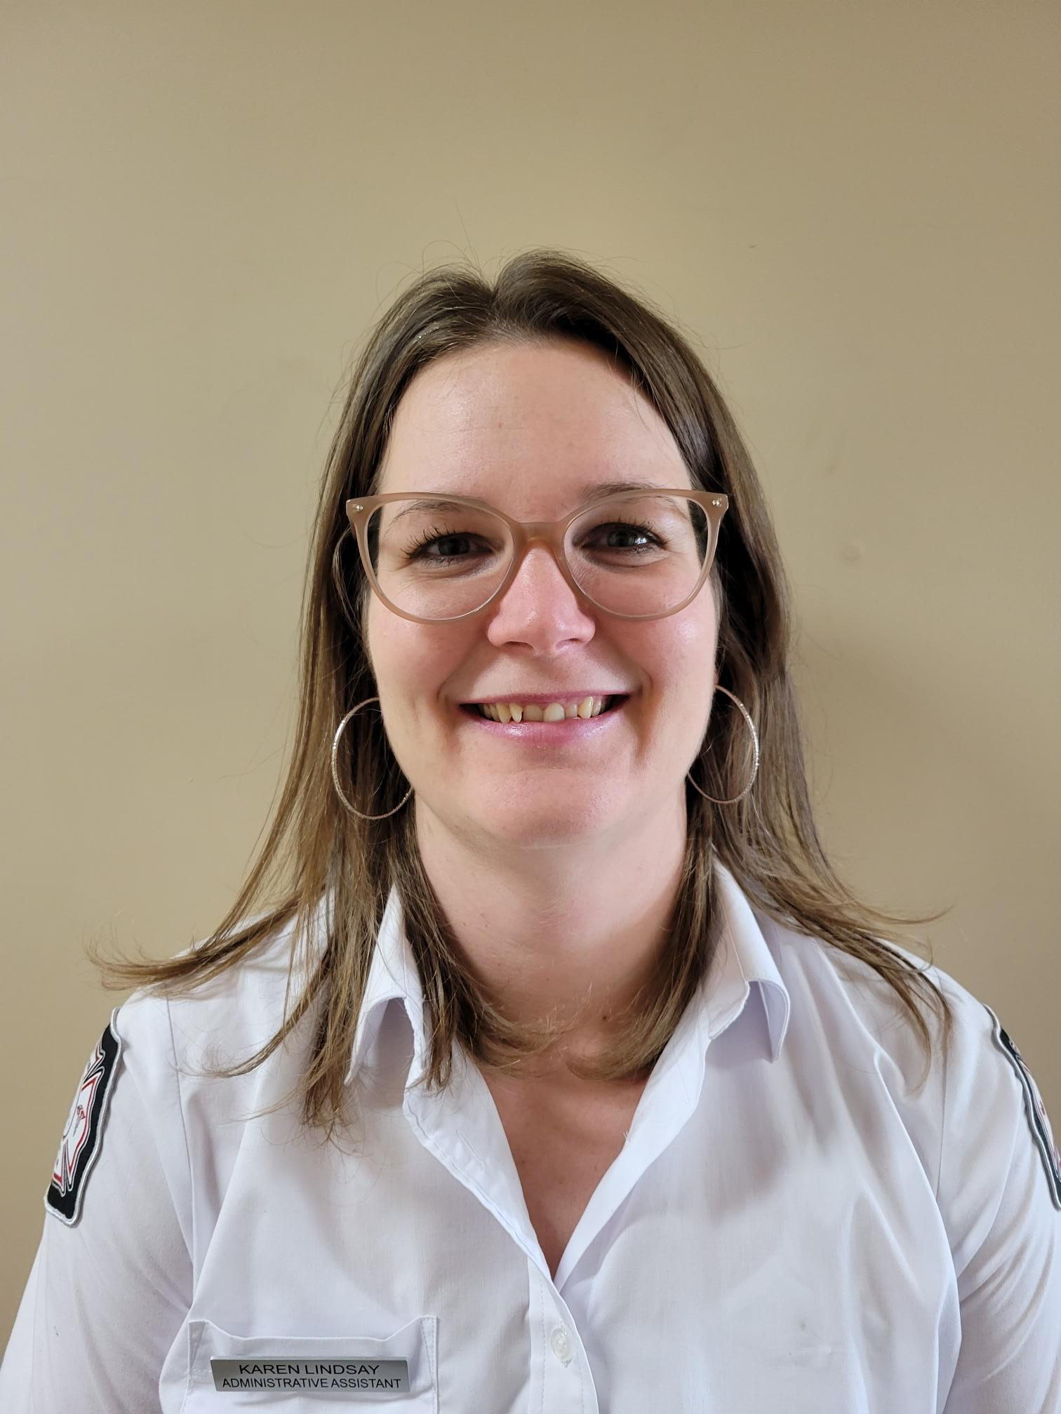
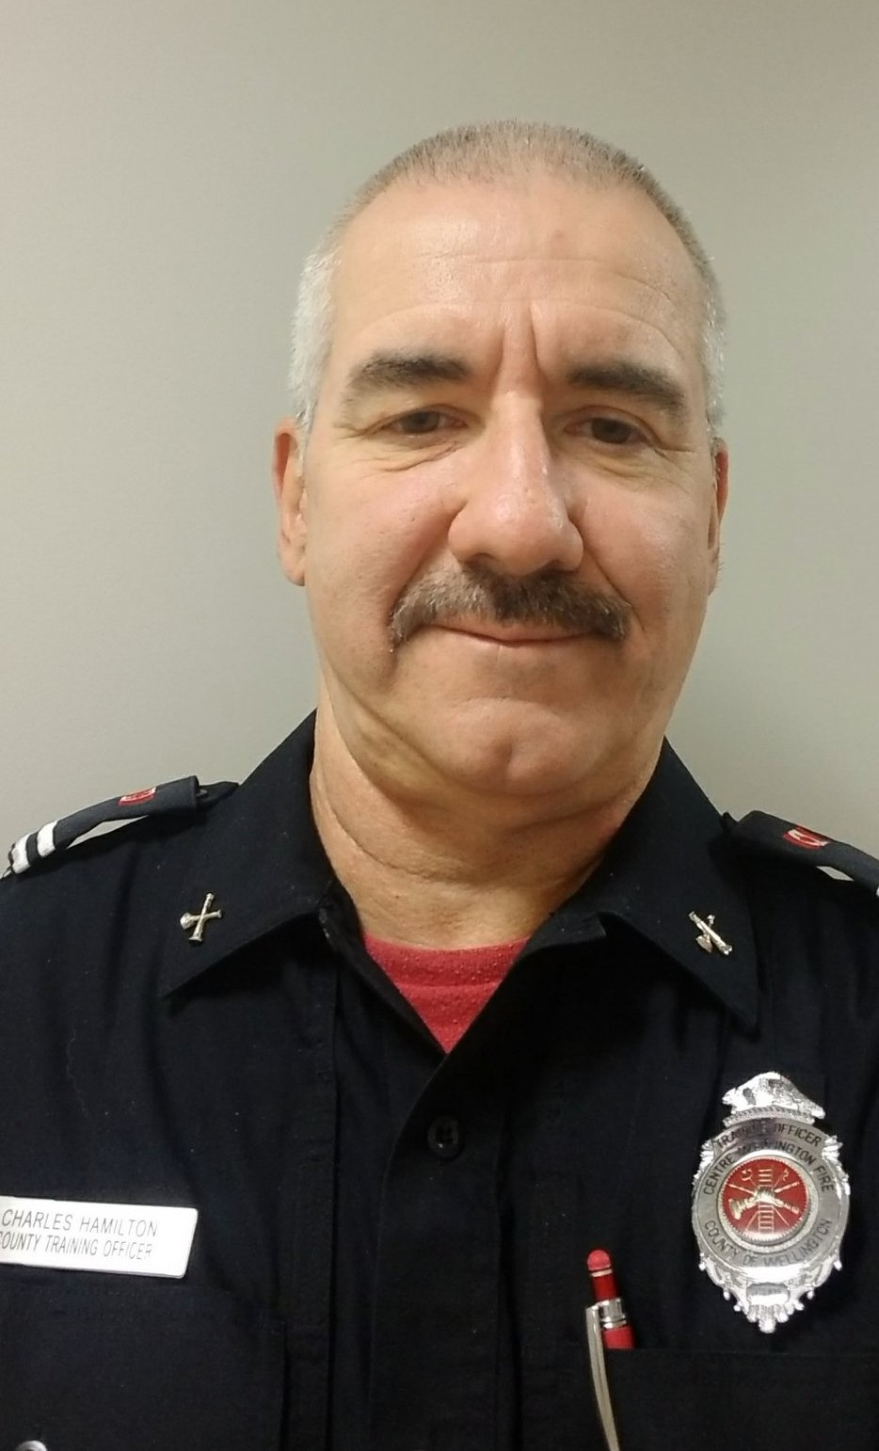
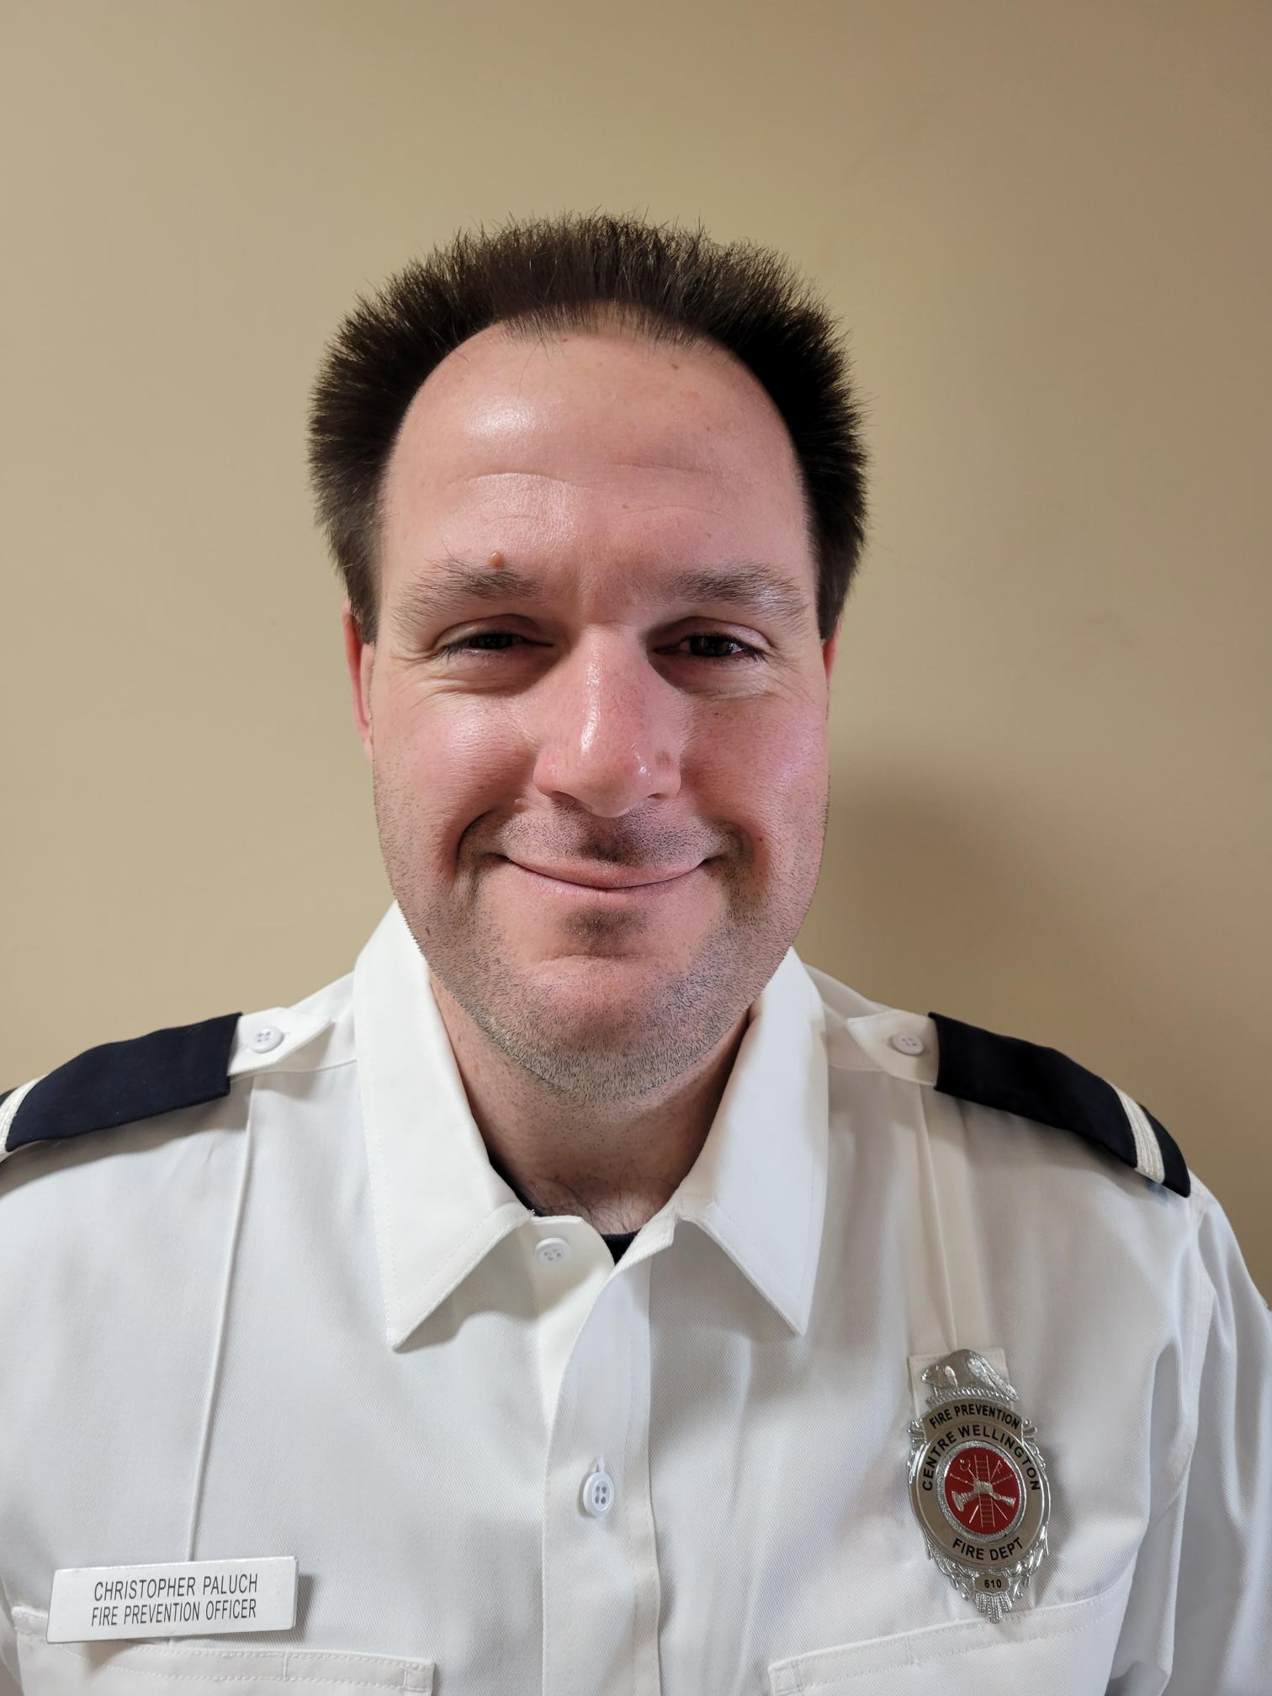
Personnel
Thomas Mulvey
Fire Chief
There are 6 Full time CWFR staff
Jonathan Karn –
Deputy Fire Chief –
Training & Suppression
Jason Benn Deputy Fire Chief – Fire Prevention, Public Education and Investigations
Charles Hamilton-Wellington County Training Officer
Christopher Paluch – Fire Prevention/Public Education Officer
Karen Lindsay – Administrative Assistant

Slide 3
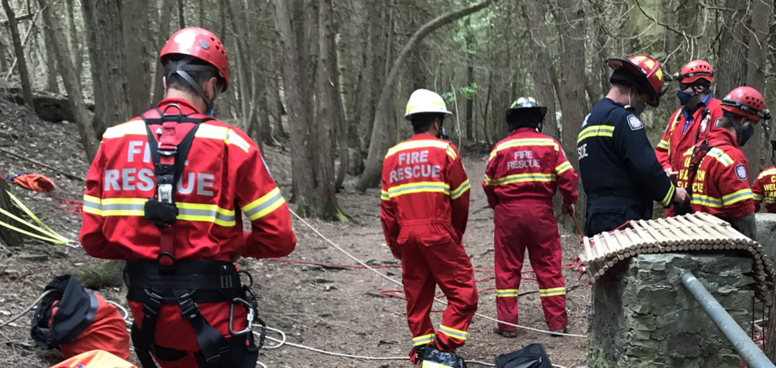

Agenda
Brief synopsis of CW Fire Rescue
Buildings, Personnel, Apparatus
General Information
Training
Fire Prevention, Public Education & Investigations
3 | CWFR

Slide 4


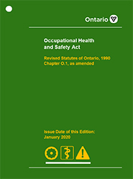

Applicable Legislation’s and Standards
Fire Protection & Prevention Act 1997, S.O. 1997, c. 4 (FPPA)
Emergency Management & Civil Prot. Act
CW E&R By-Law 2006-083
CWFR Standard Operating Guidelines
Ontario Section 21 Guidance Notes
CWFR Fire Prevention, Public Education & Investigation Policies
O.Reg 213/07 – Ontario Fire Code
O.Reg 332/12: Building Code
NFPA Standards
OHSA & Standards
Notes:
There are many legislative requirements which the fire service must follow,
FPPA: Establishes the powers of the Ontario Fire Marshal Mandates a Municipal Fire Chief or equivalent  Mandates specific public safety & education programs  Mandates certain types of inspections, authorizes others, Authorizes the establishment of a suppression service, Regulates Labour relations with full-time firefighters, The Ontario Fire Code is the regulation attached to the Act.
E&R bylaw: By-law 2012-65 Municipal By-law which sets out what services we provide, Establishes the Level of Service – exactly what we do, Establishes staffing, programs, etc, Revision of the E&R By-law may be recommended as part of the scheduled Fire Master Plan process, which is due to be renewed in 2024

Slide 5
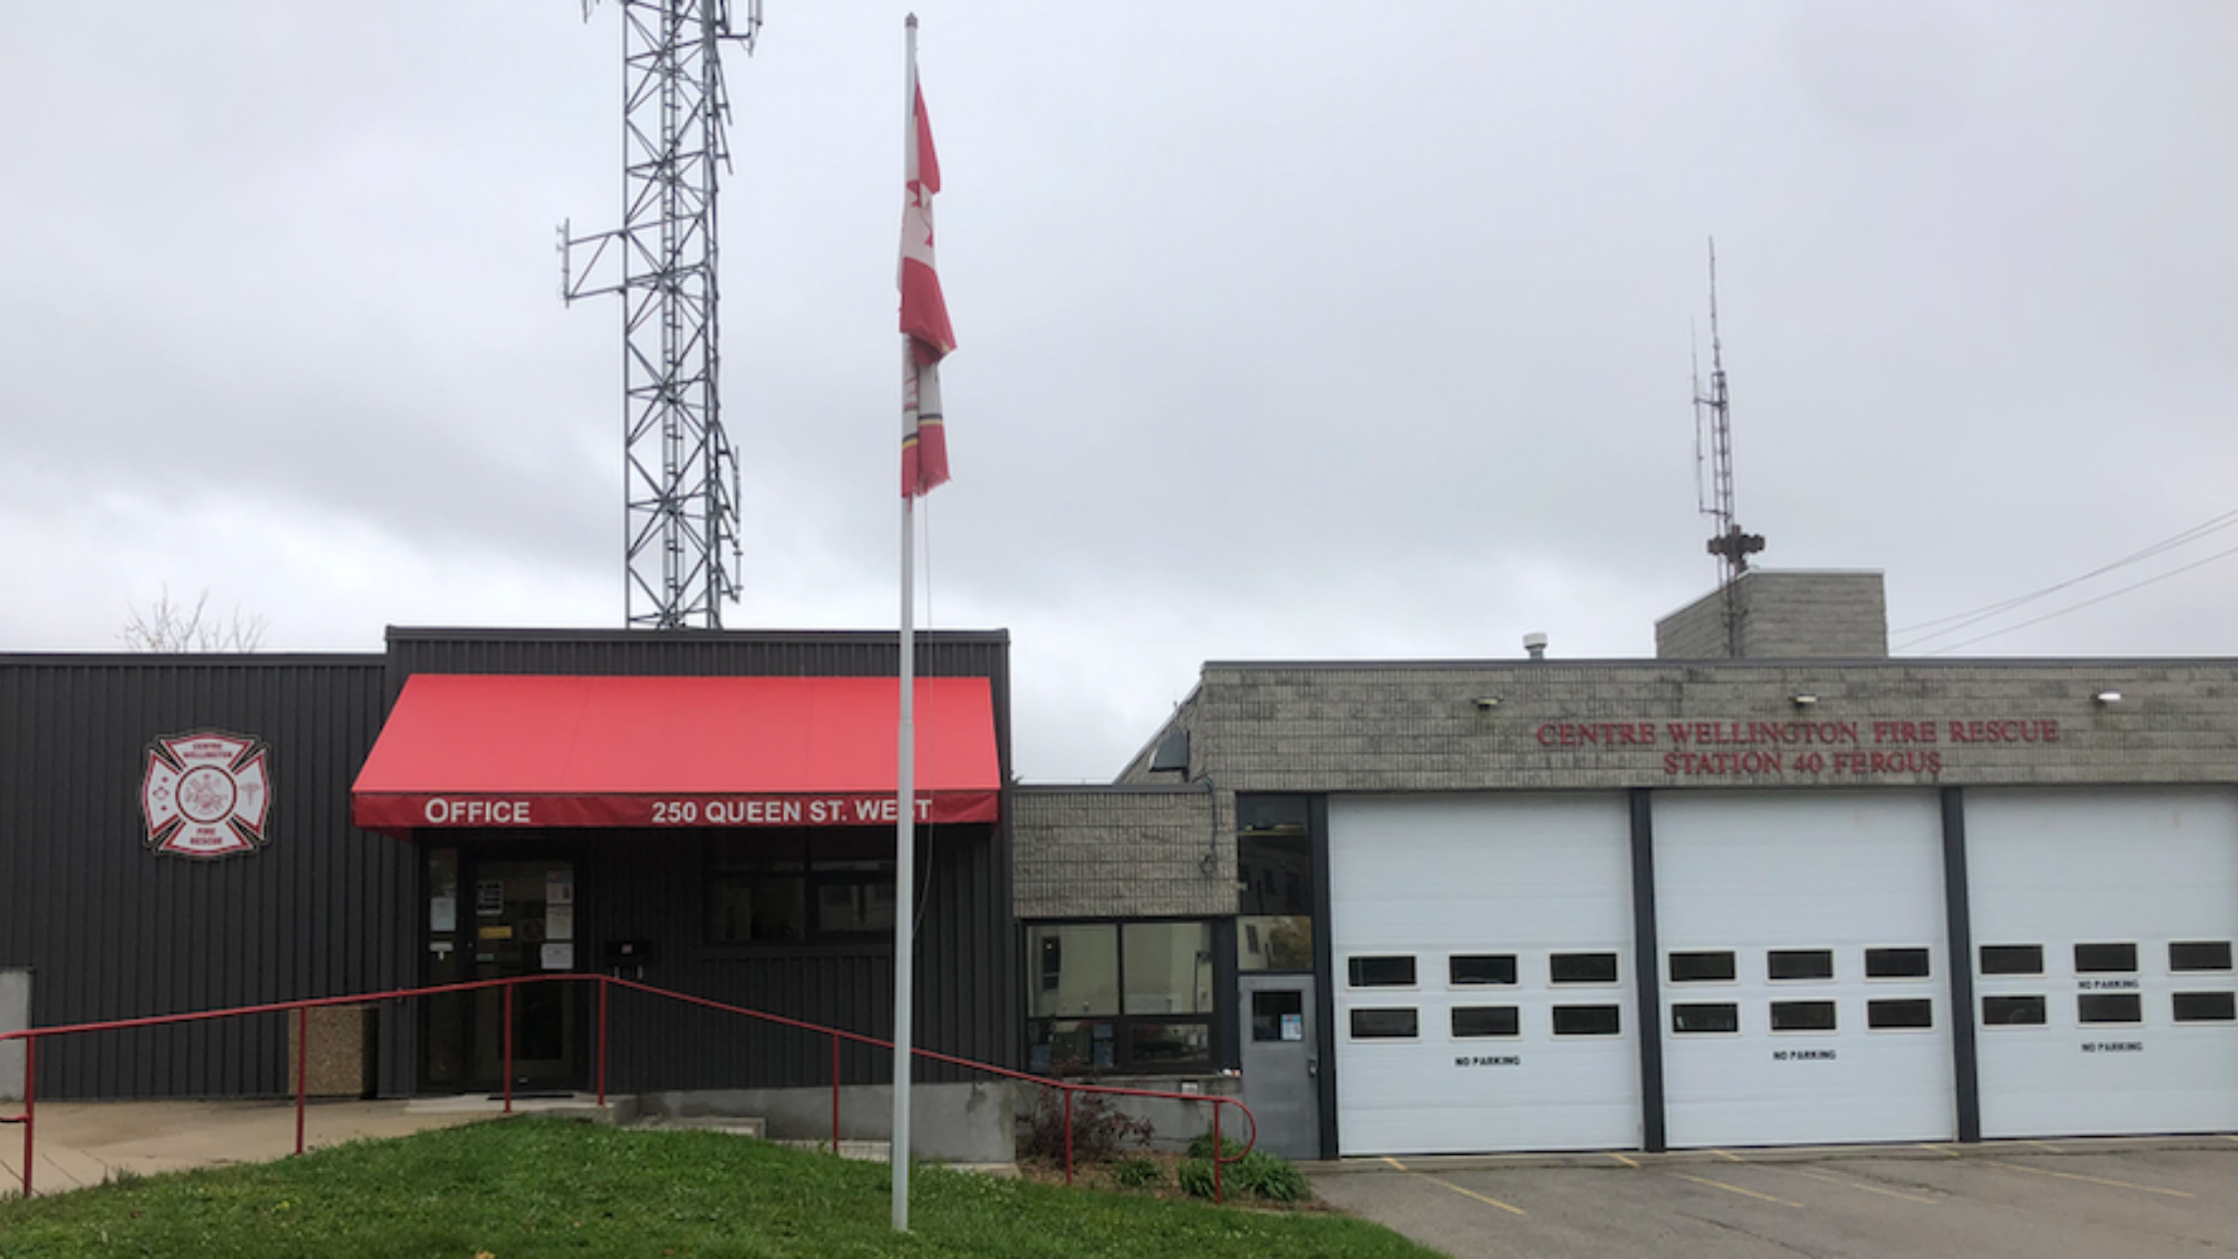
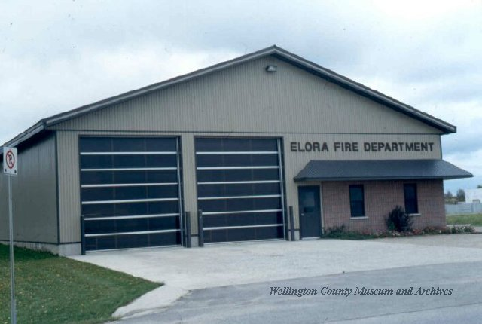
Buildings
CWFR is comprised of two stations
Station 40 is in Fergus, on Queen Street Station 60 is in Elora on County Road 7
A third station is to be built in the future as per the Fire Master Plan
CWFR responds 24/7/365 to over 500 Emergency Calls Annually

Slide 6
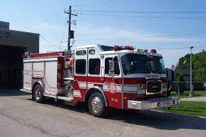
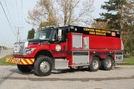
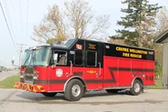
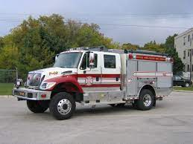
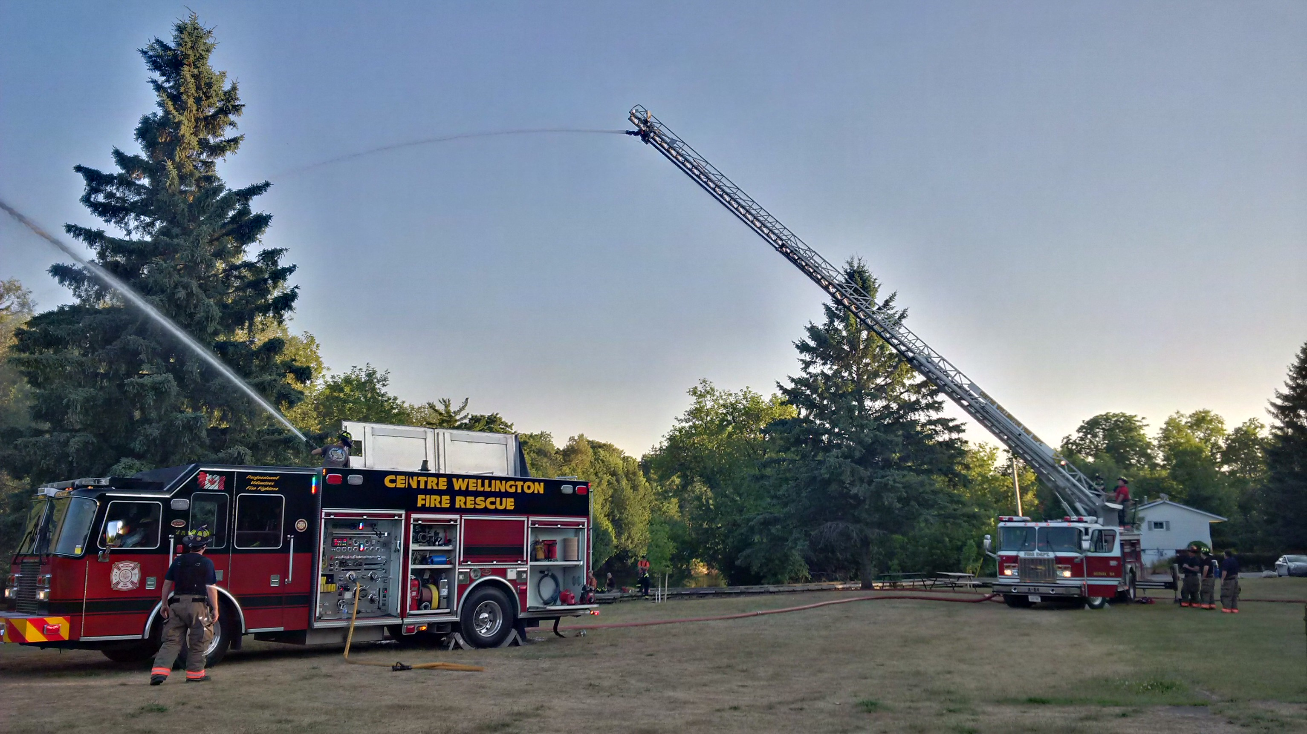
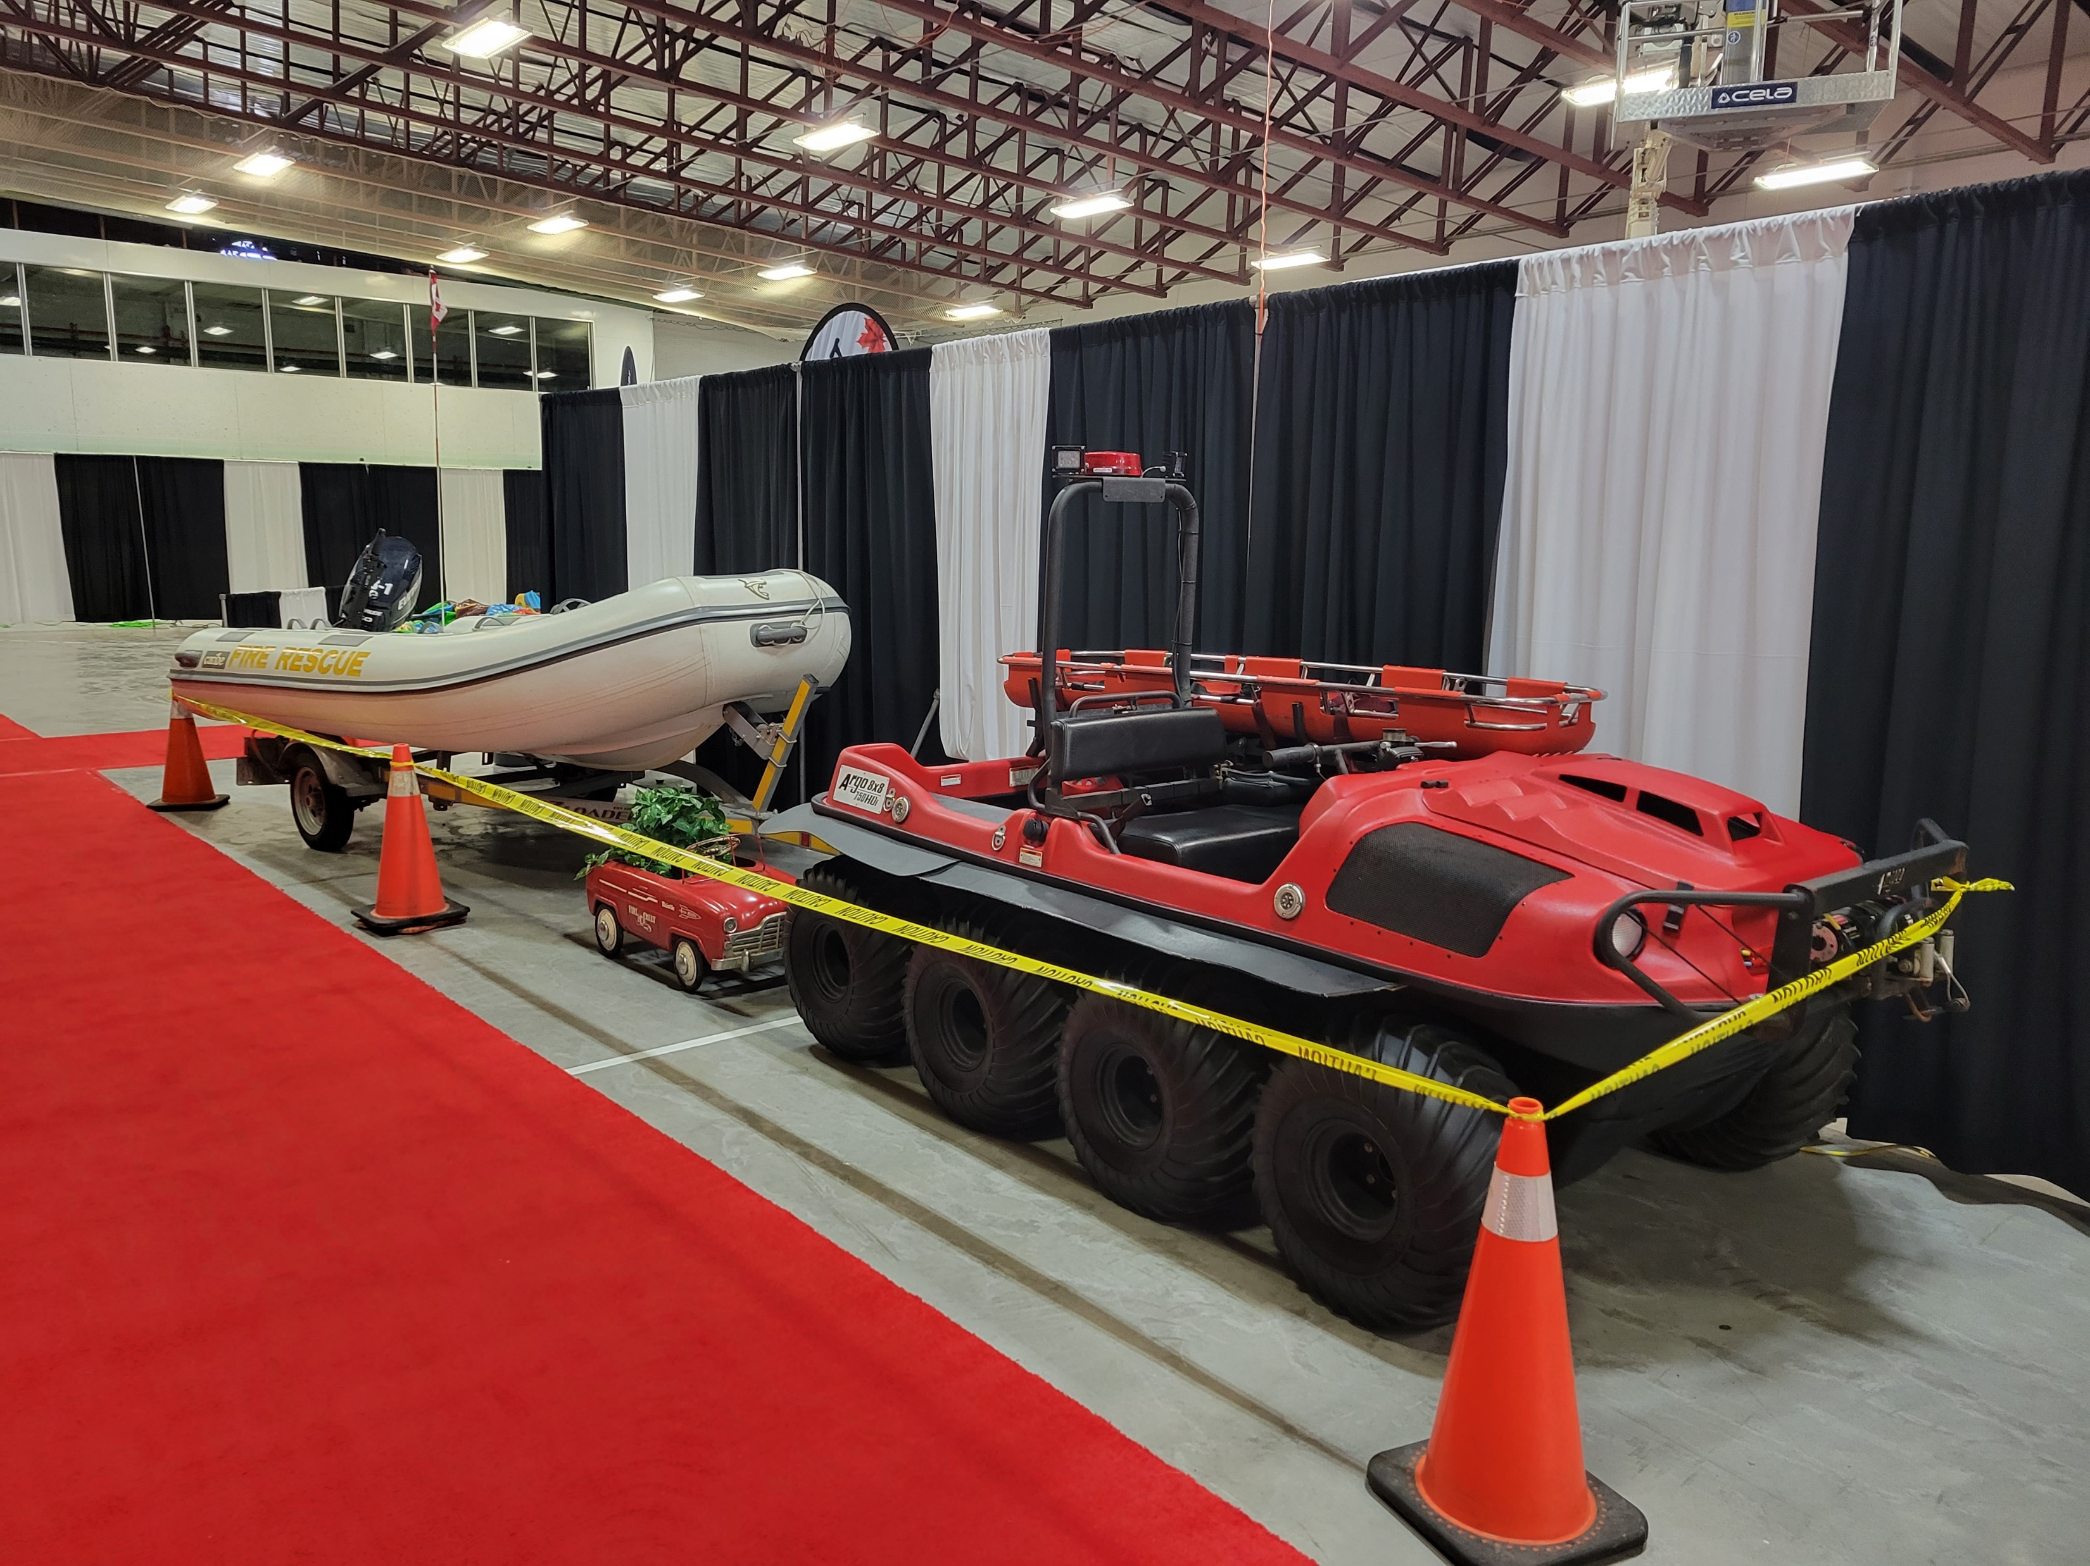
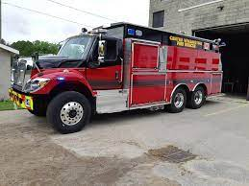
Current Apparatus
CWFR

Slide 7
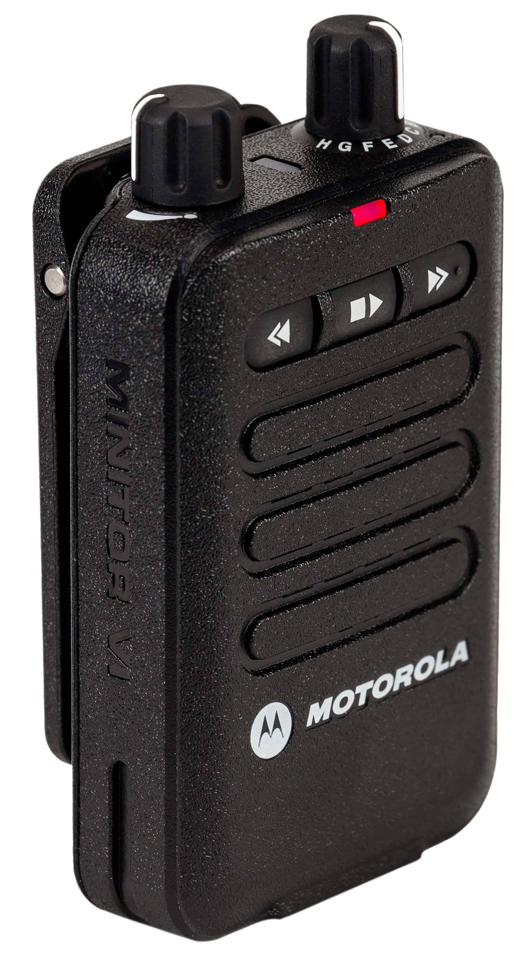
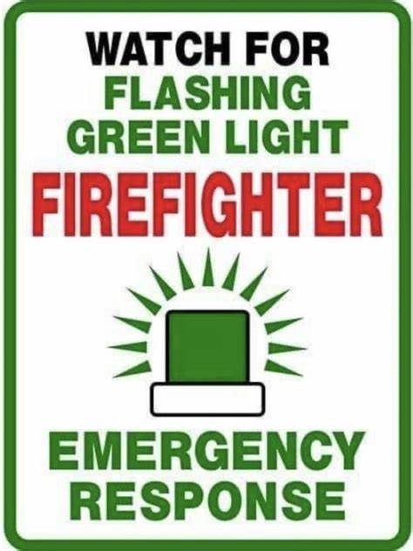
General Information
CWFR employs 66 Paid On-call firefighters when at full strength
Firefighters carry pagers in order to receive alarms
Firefighters respond from home or work to their respective station
EMERGENCY CALLS HAPPEN AT ANY TIME OF THE DAY

Slide 8
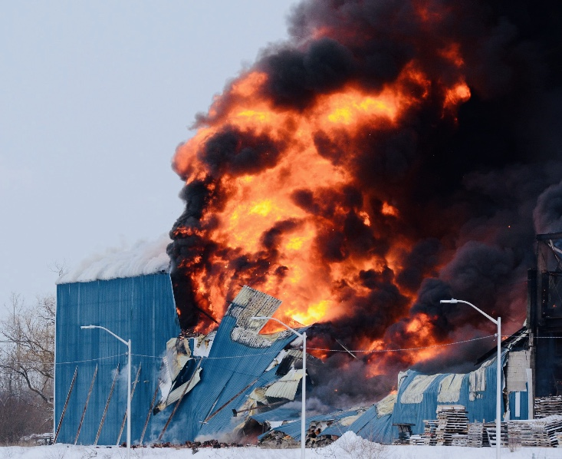
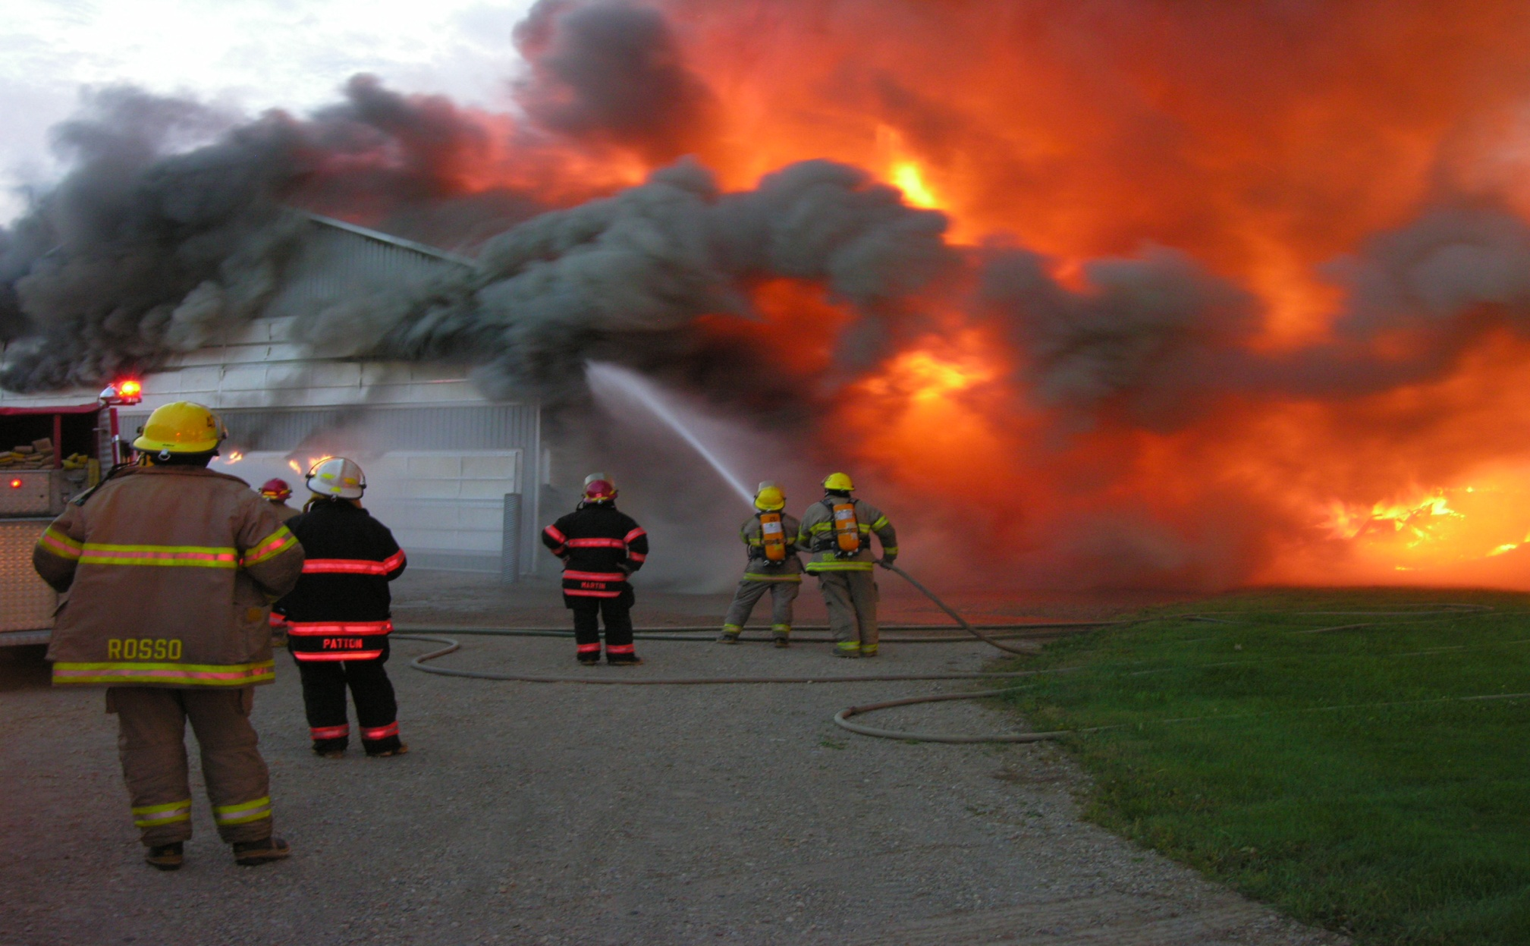
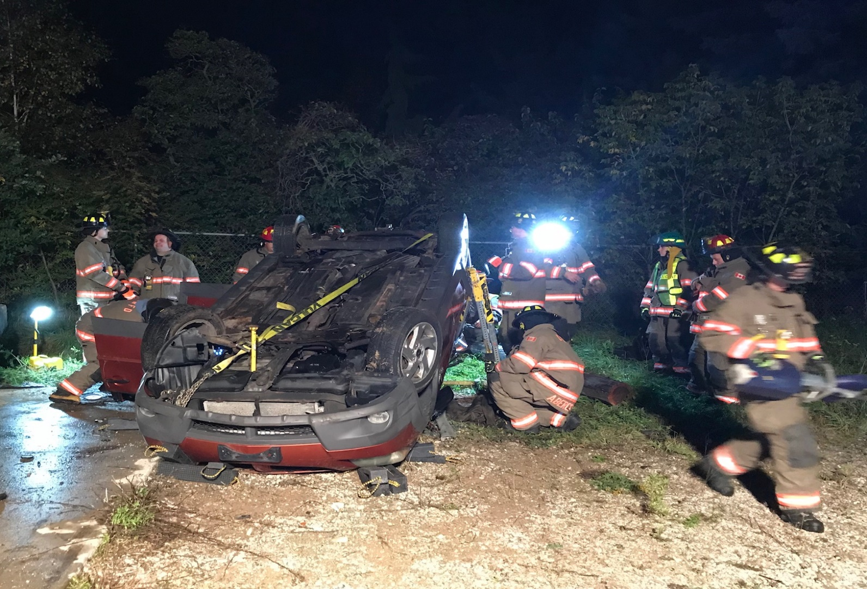
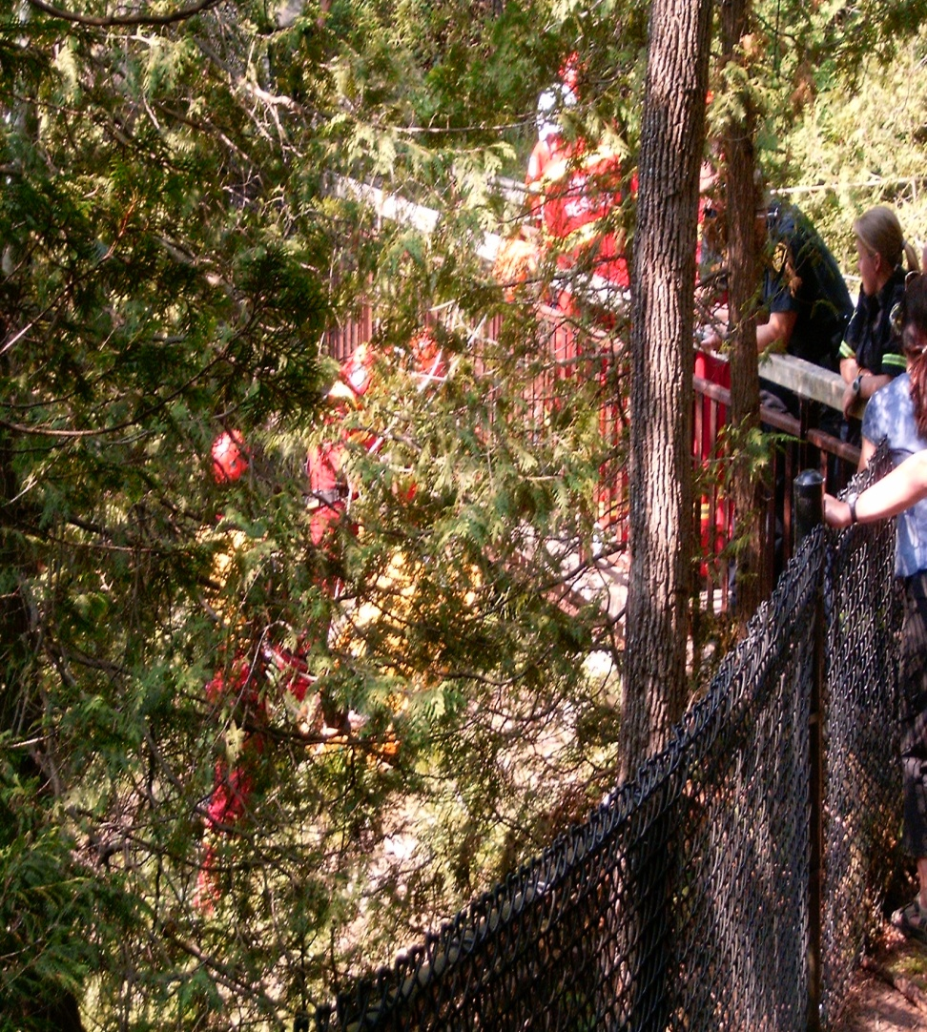
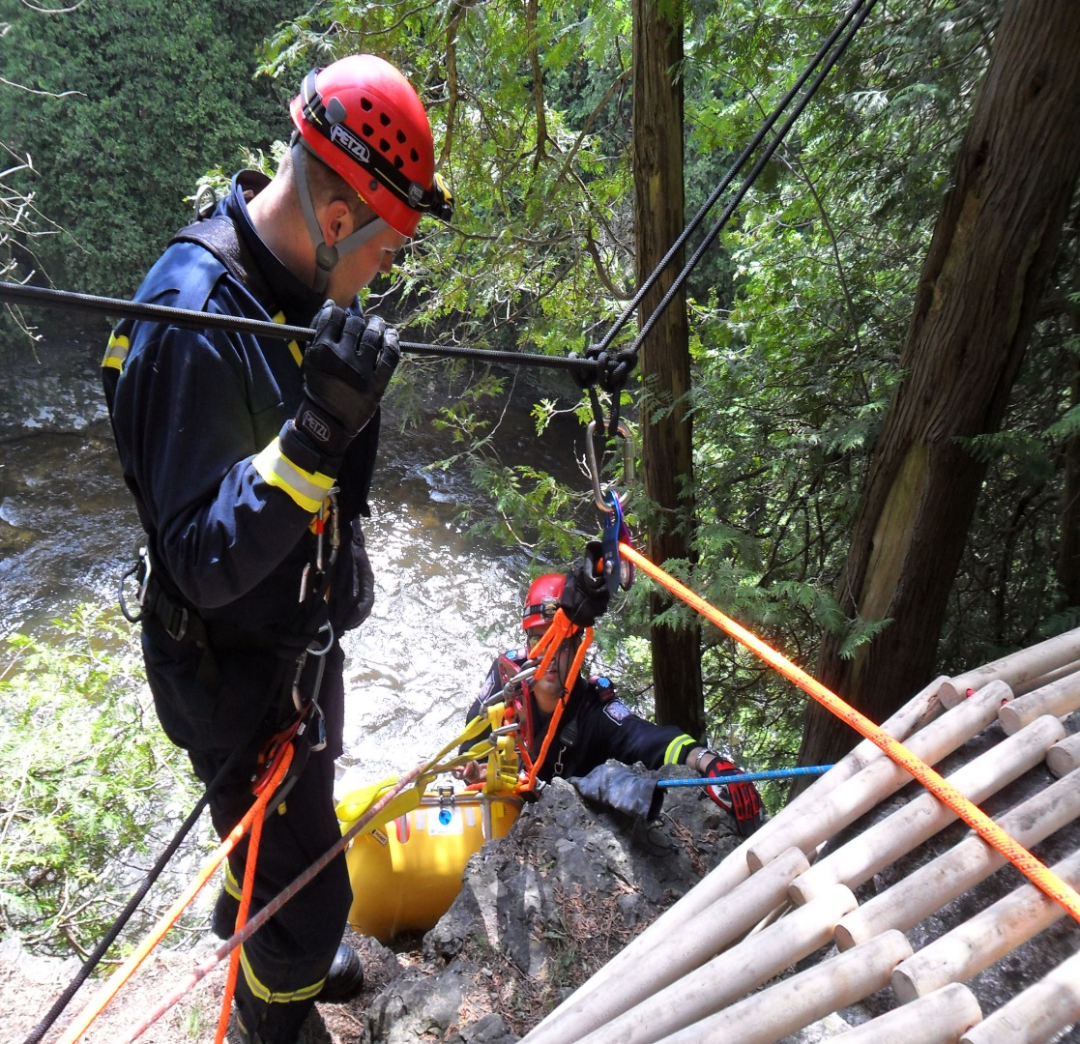
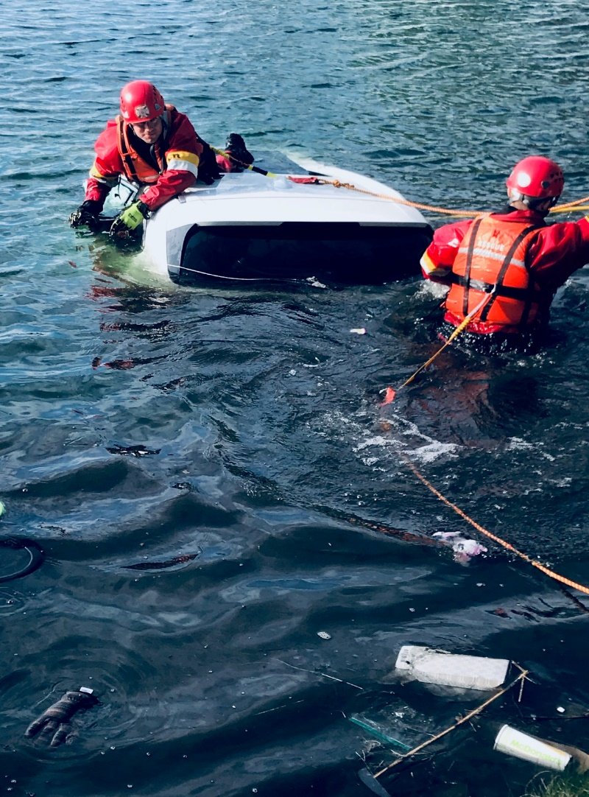
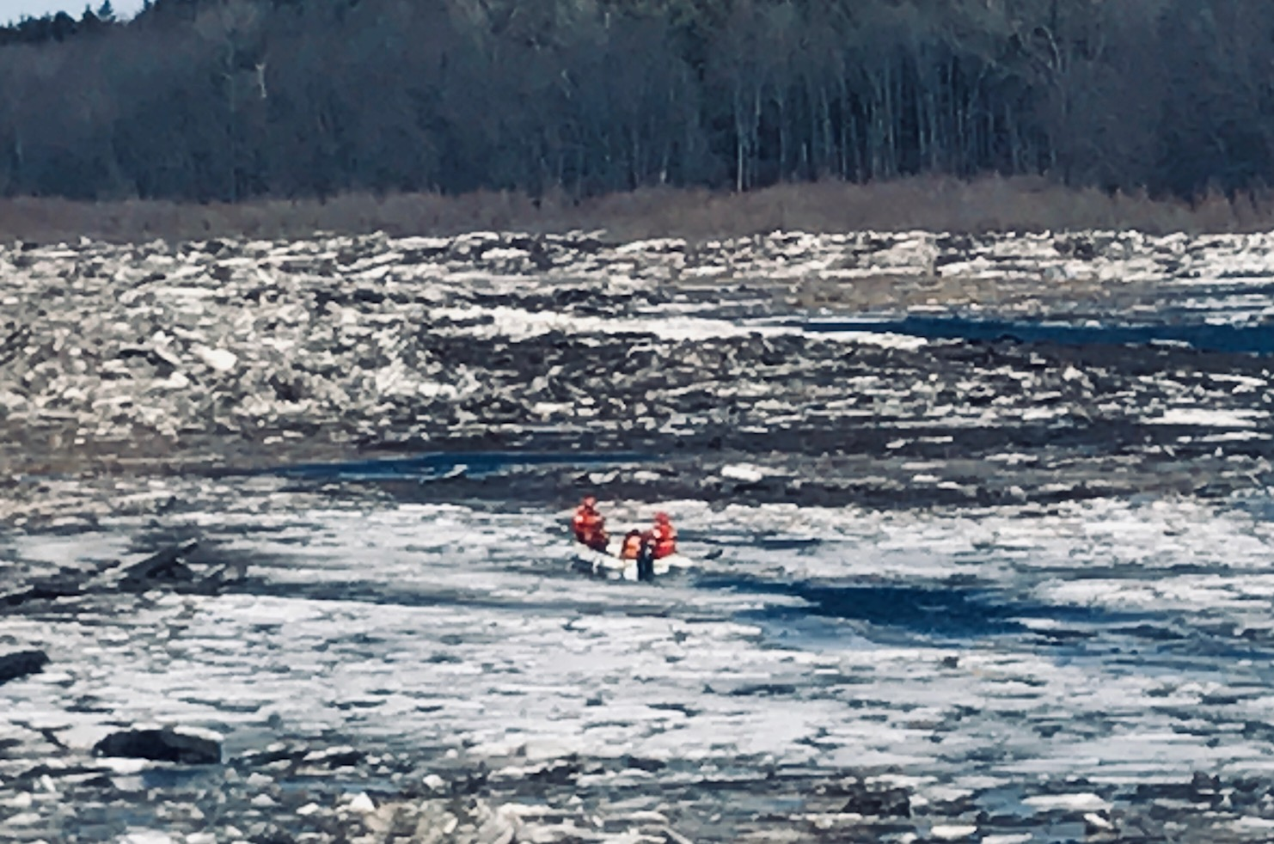
Centre Wellington Fire Rescue Responds to…..
STRUCTURE FIRES
MOTOR VEHICLE COLLISIONS
MEDICAL ASSIST CALLS
Medical calls vary in nature, and they may include:
VSA’s (vital signs absent/CPR req’d)
Patients with breathing problems
Unresponsive patients
Drowning, Blunt Trauma…
HIGH ANGLE/GORGE RESCUES
WATER / ICE RESCUE
OTHER CALLS
Carbon Monoxide Investigations
Automatic Fire Alarm Activations
Grass/Brush/Wildland Fires
Fluid Leaks (gas/propane/oil etc.)
Hazardous Materials Spills
Public Assistance Calls (lock-outs)
AND ANY OTHER SITUATIONS THE PUBLIC MAY NEED ASSISTANCE OR BELIEVES
IT’S AN EMERGENCY

Slide 9
Responses - 427 calls for service as of September 30, 2022
Notes:
At present we are at 561

Slide 10
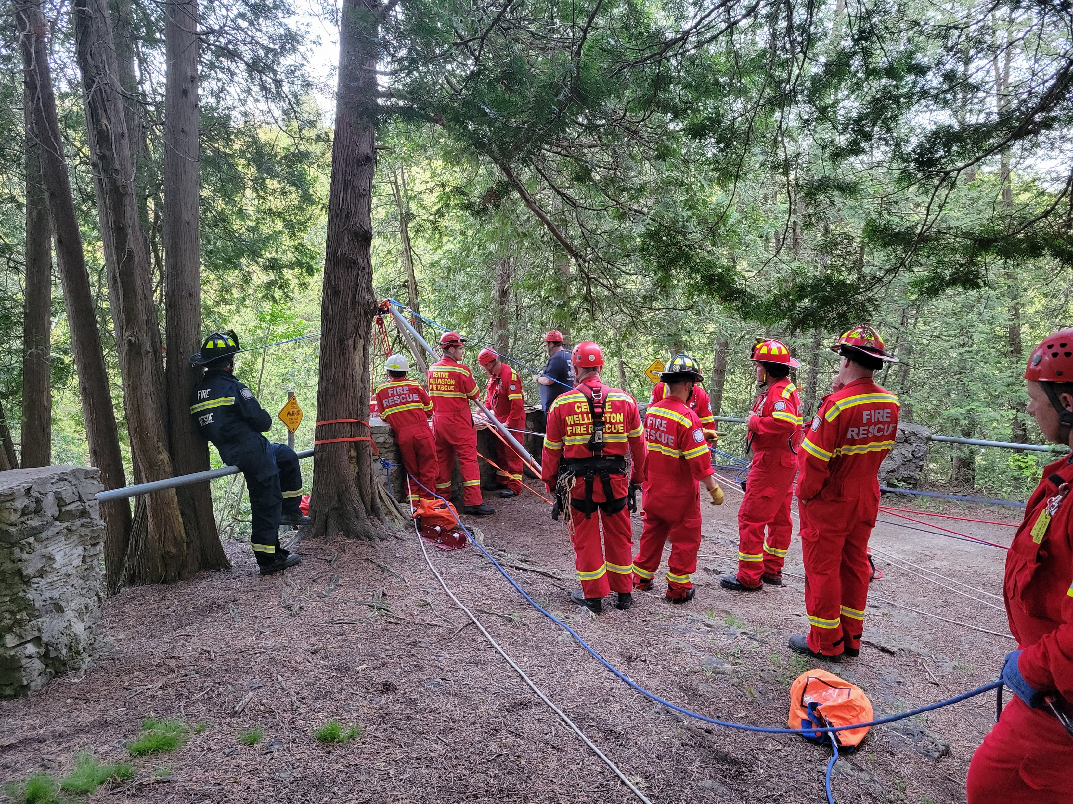
Training
WEEKLY TRAINING SESSIONS
On-going training continues for firefighters throughout their career.
CWFRS Firefighters train on a weekly basis.
Firefighters train on a variety of different topics each week .
Scheduled Training nights are:
FERGUS: Wed Nights starting at 7pm to 9pm (approx)
ELORA: Mon Nights starting at 7 pm to 9 pm (approx)
Some Specialized Training is scheduled on Saturdays throughout the year

Slide 11
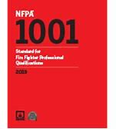
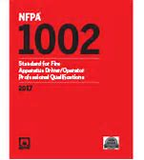



Training
All firefighters are fully certified under NFPA 1001,1002, 1072 & 1006
1001: Standard for Fire Fighter Professional Qualifications
1002: Standard for Fire Apparatus Driver/Operator
Professional Qualifications
1072: Standard for Hazardous Materials/
Weapons of mass Destruction Emergency Response Professional Qualifications
1006: Standard for Technical Rescue Personnel
Professional Qualifications
National Fire Protection Association

Slide 12
Wellington County Training
Charles Hamilton is the training officer for the county. He ensures all fire services with in Wellington County are training to the standard and is the lead for all training events during the county firefighter recruitment, annually. He ensures training programs and paperwork are to the standard as well following all health and safety guidelines.
Charles is also the lead for the Wellington County Regional Training site, approved by the government to provide regional training courses.

Slide 13
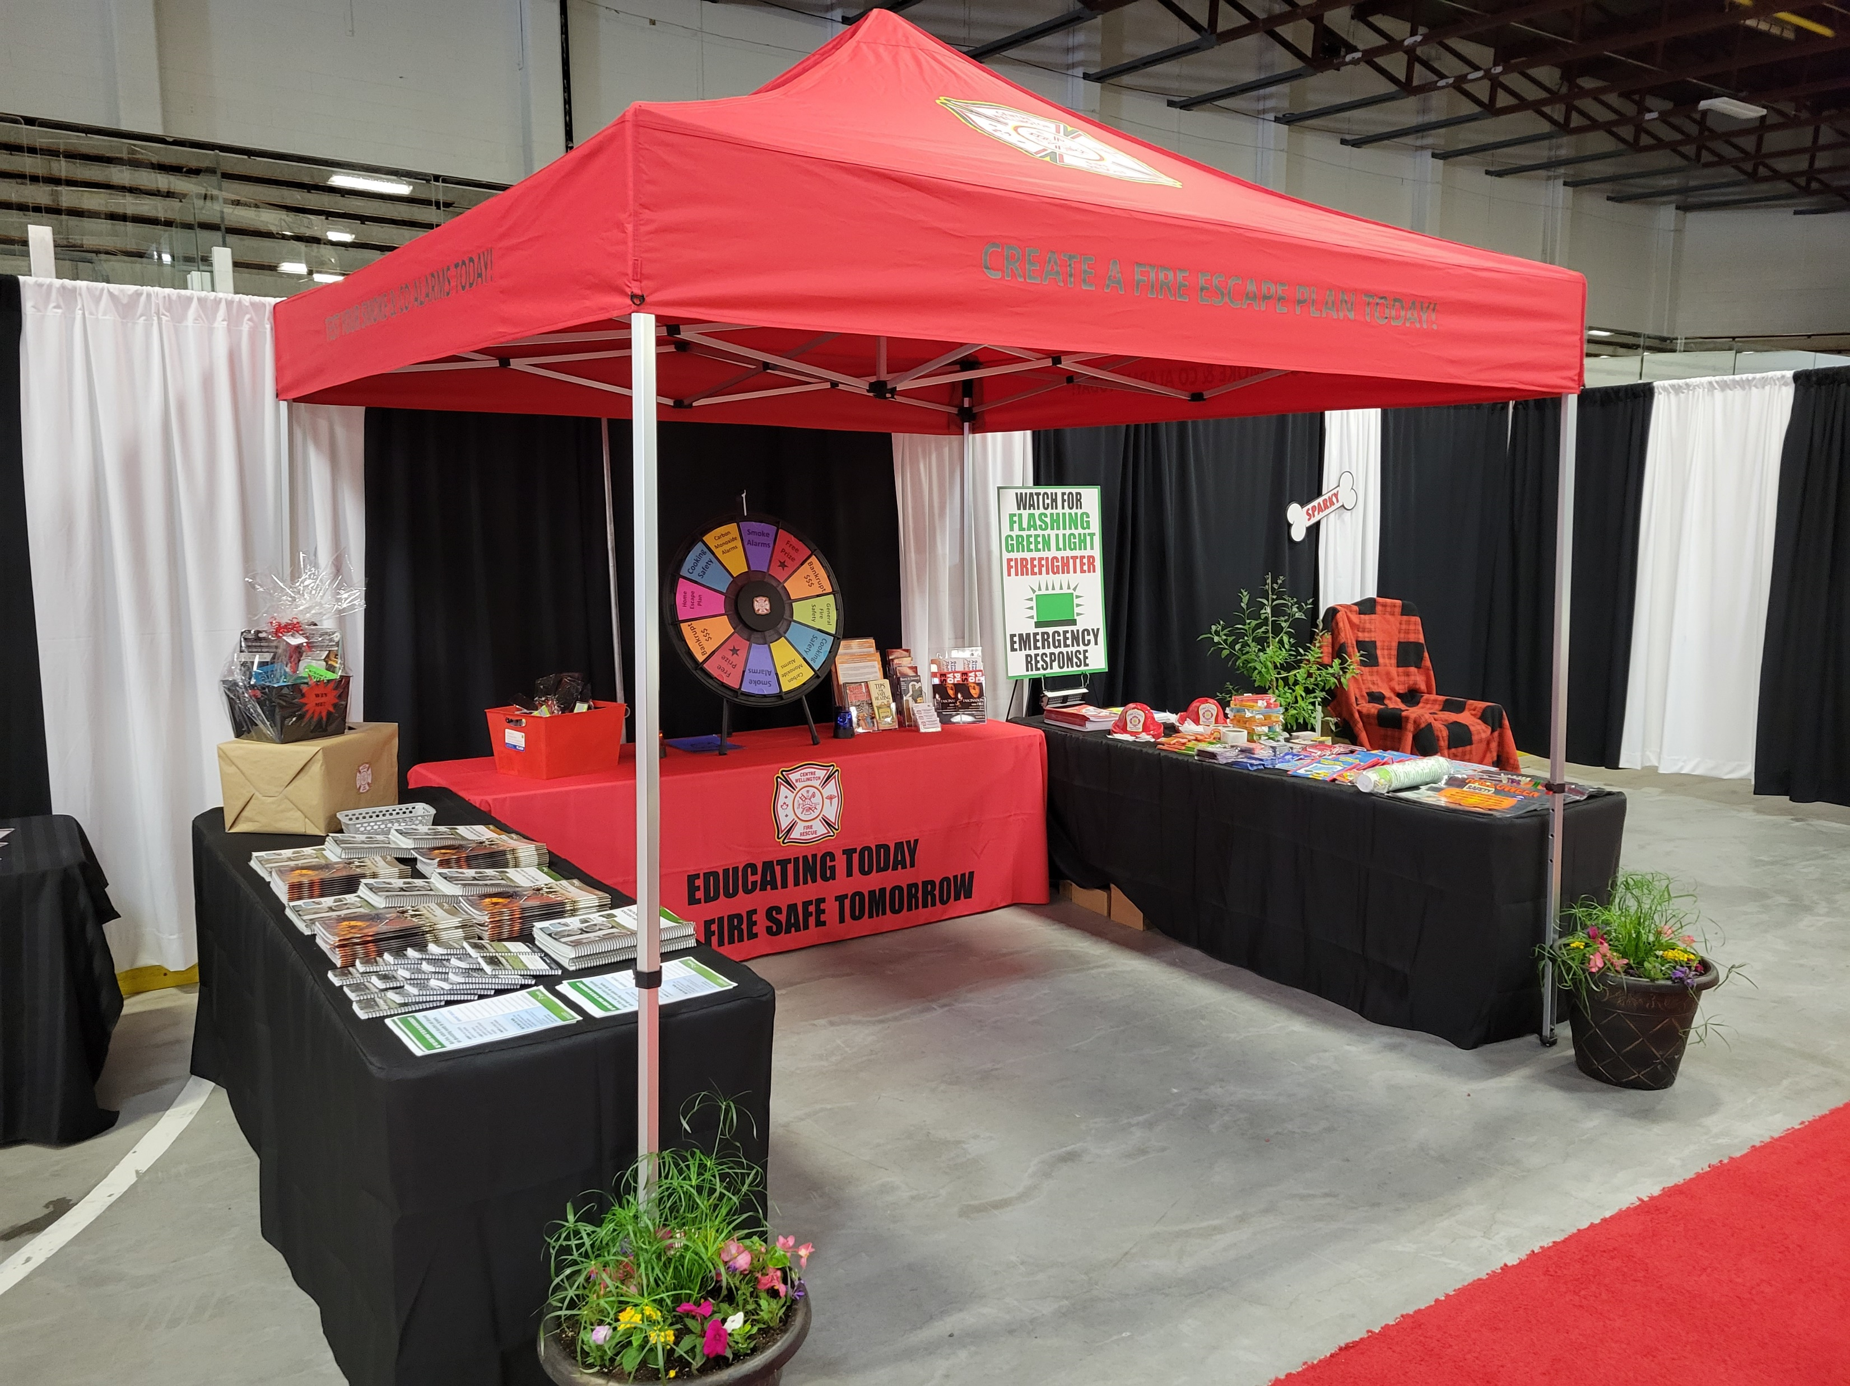
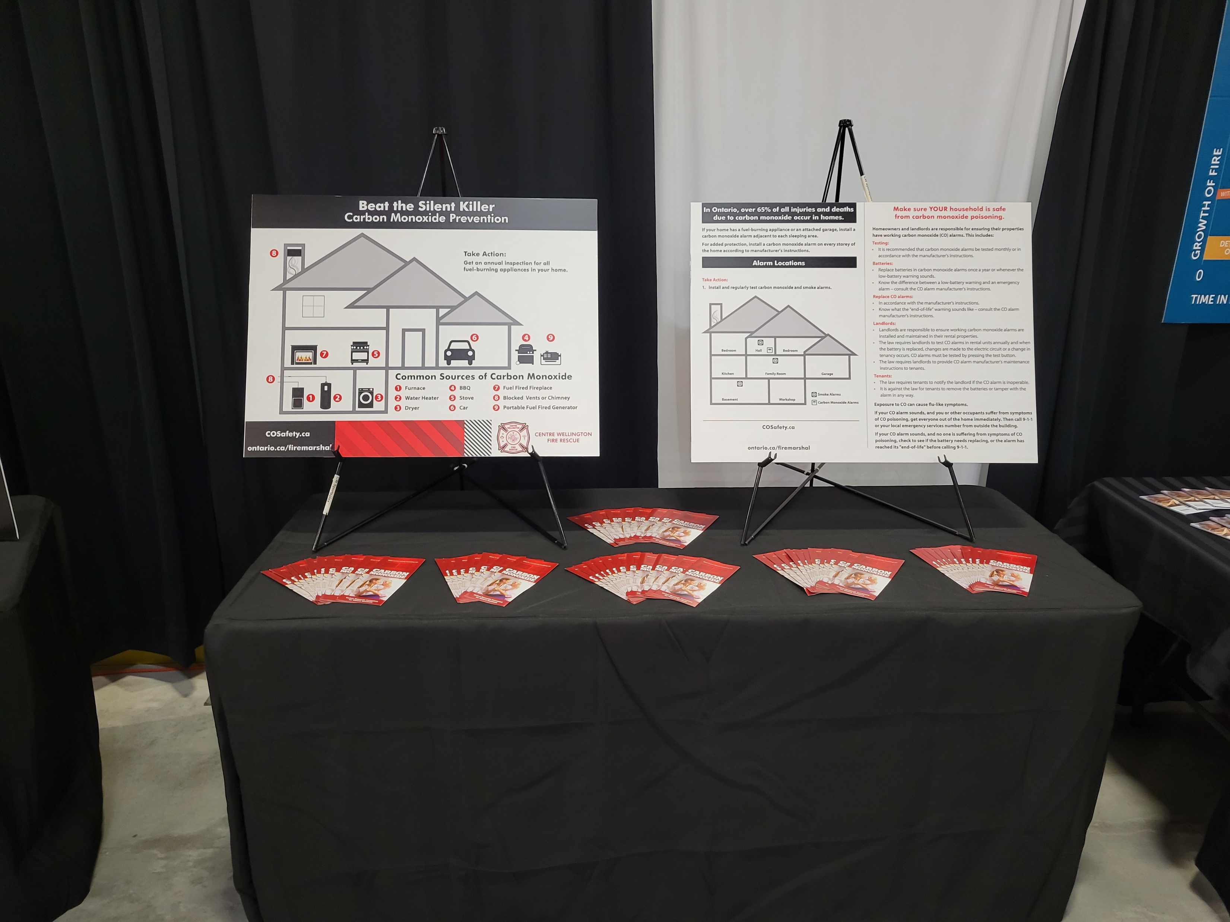
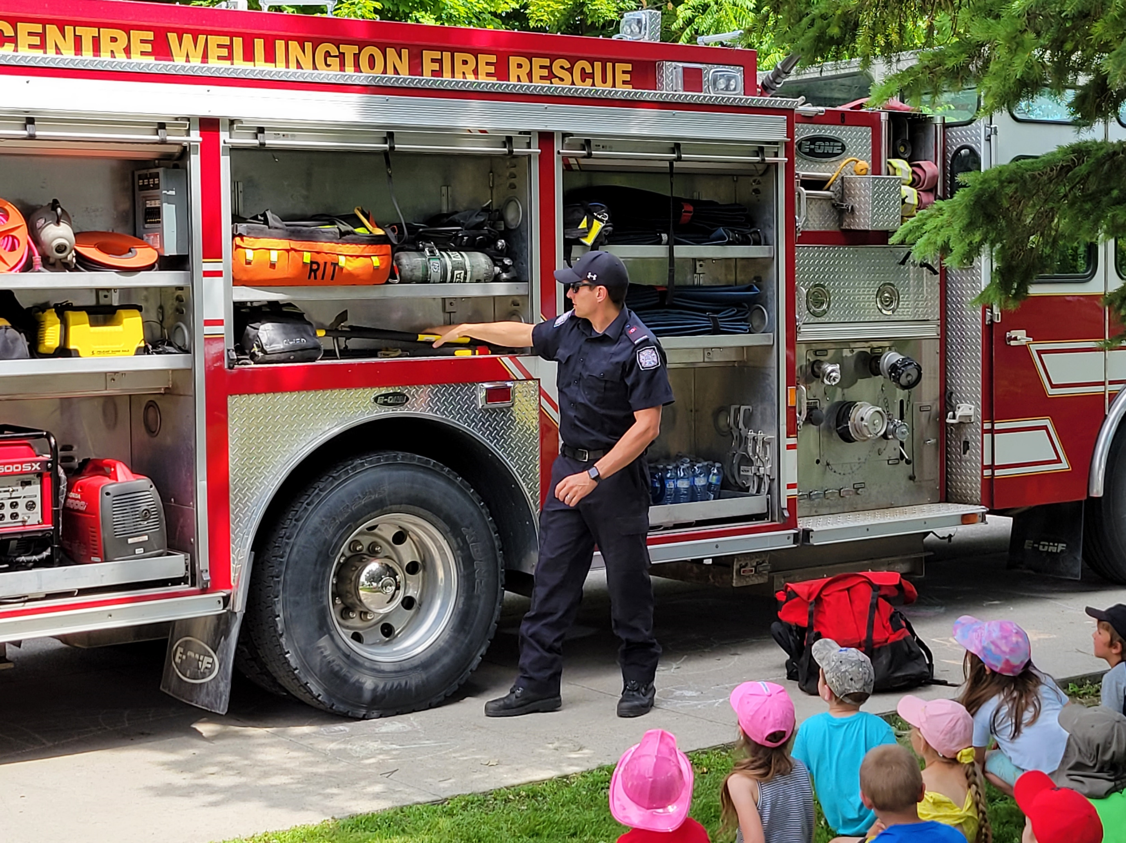
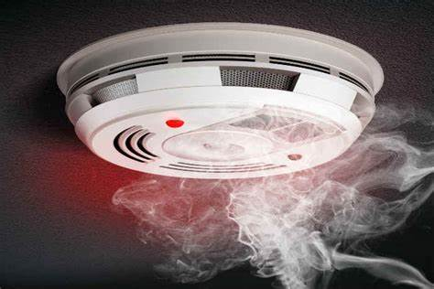

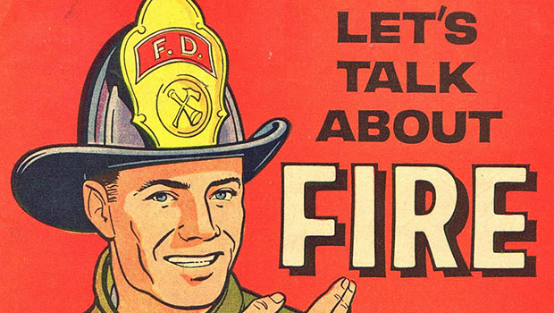
Fire Prevention & Public Education
Inspections- routine, request, complaint
Enforcement of the Ontario Fire Code
Public Education programs-presentations, talks, displays and community engagement
Maintain the smoke alarm program
Distribution of fire & life safety information

Slide 14
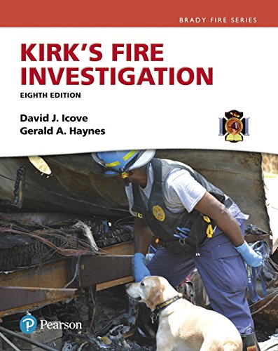
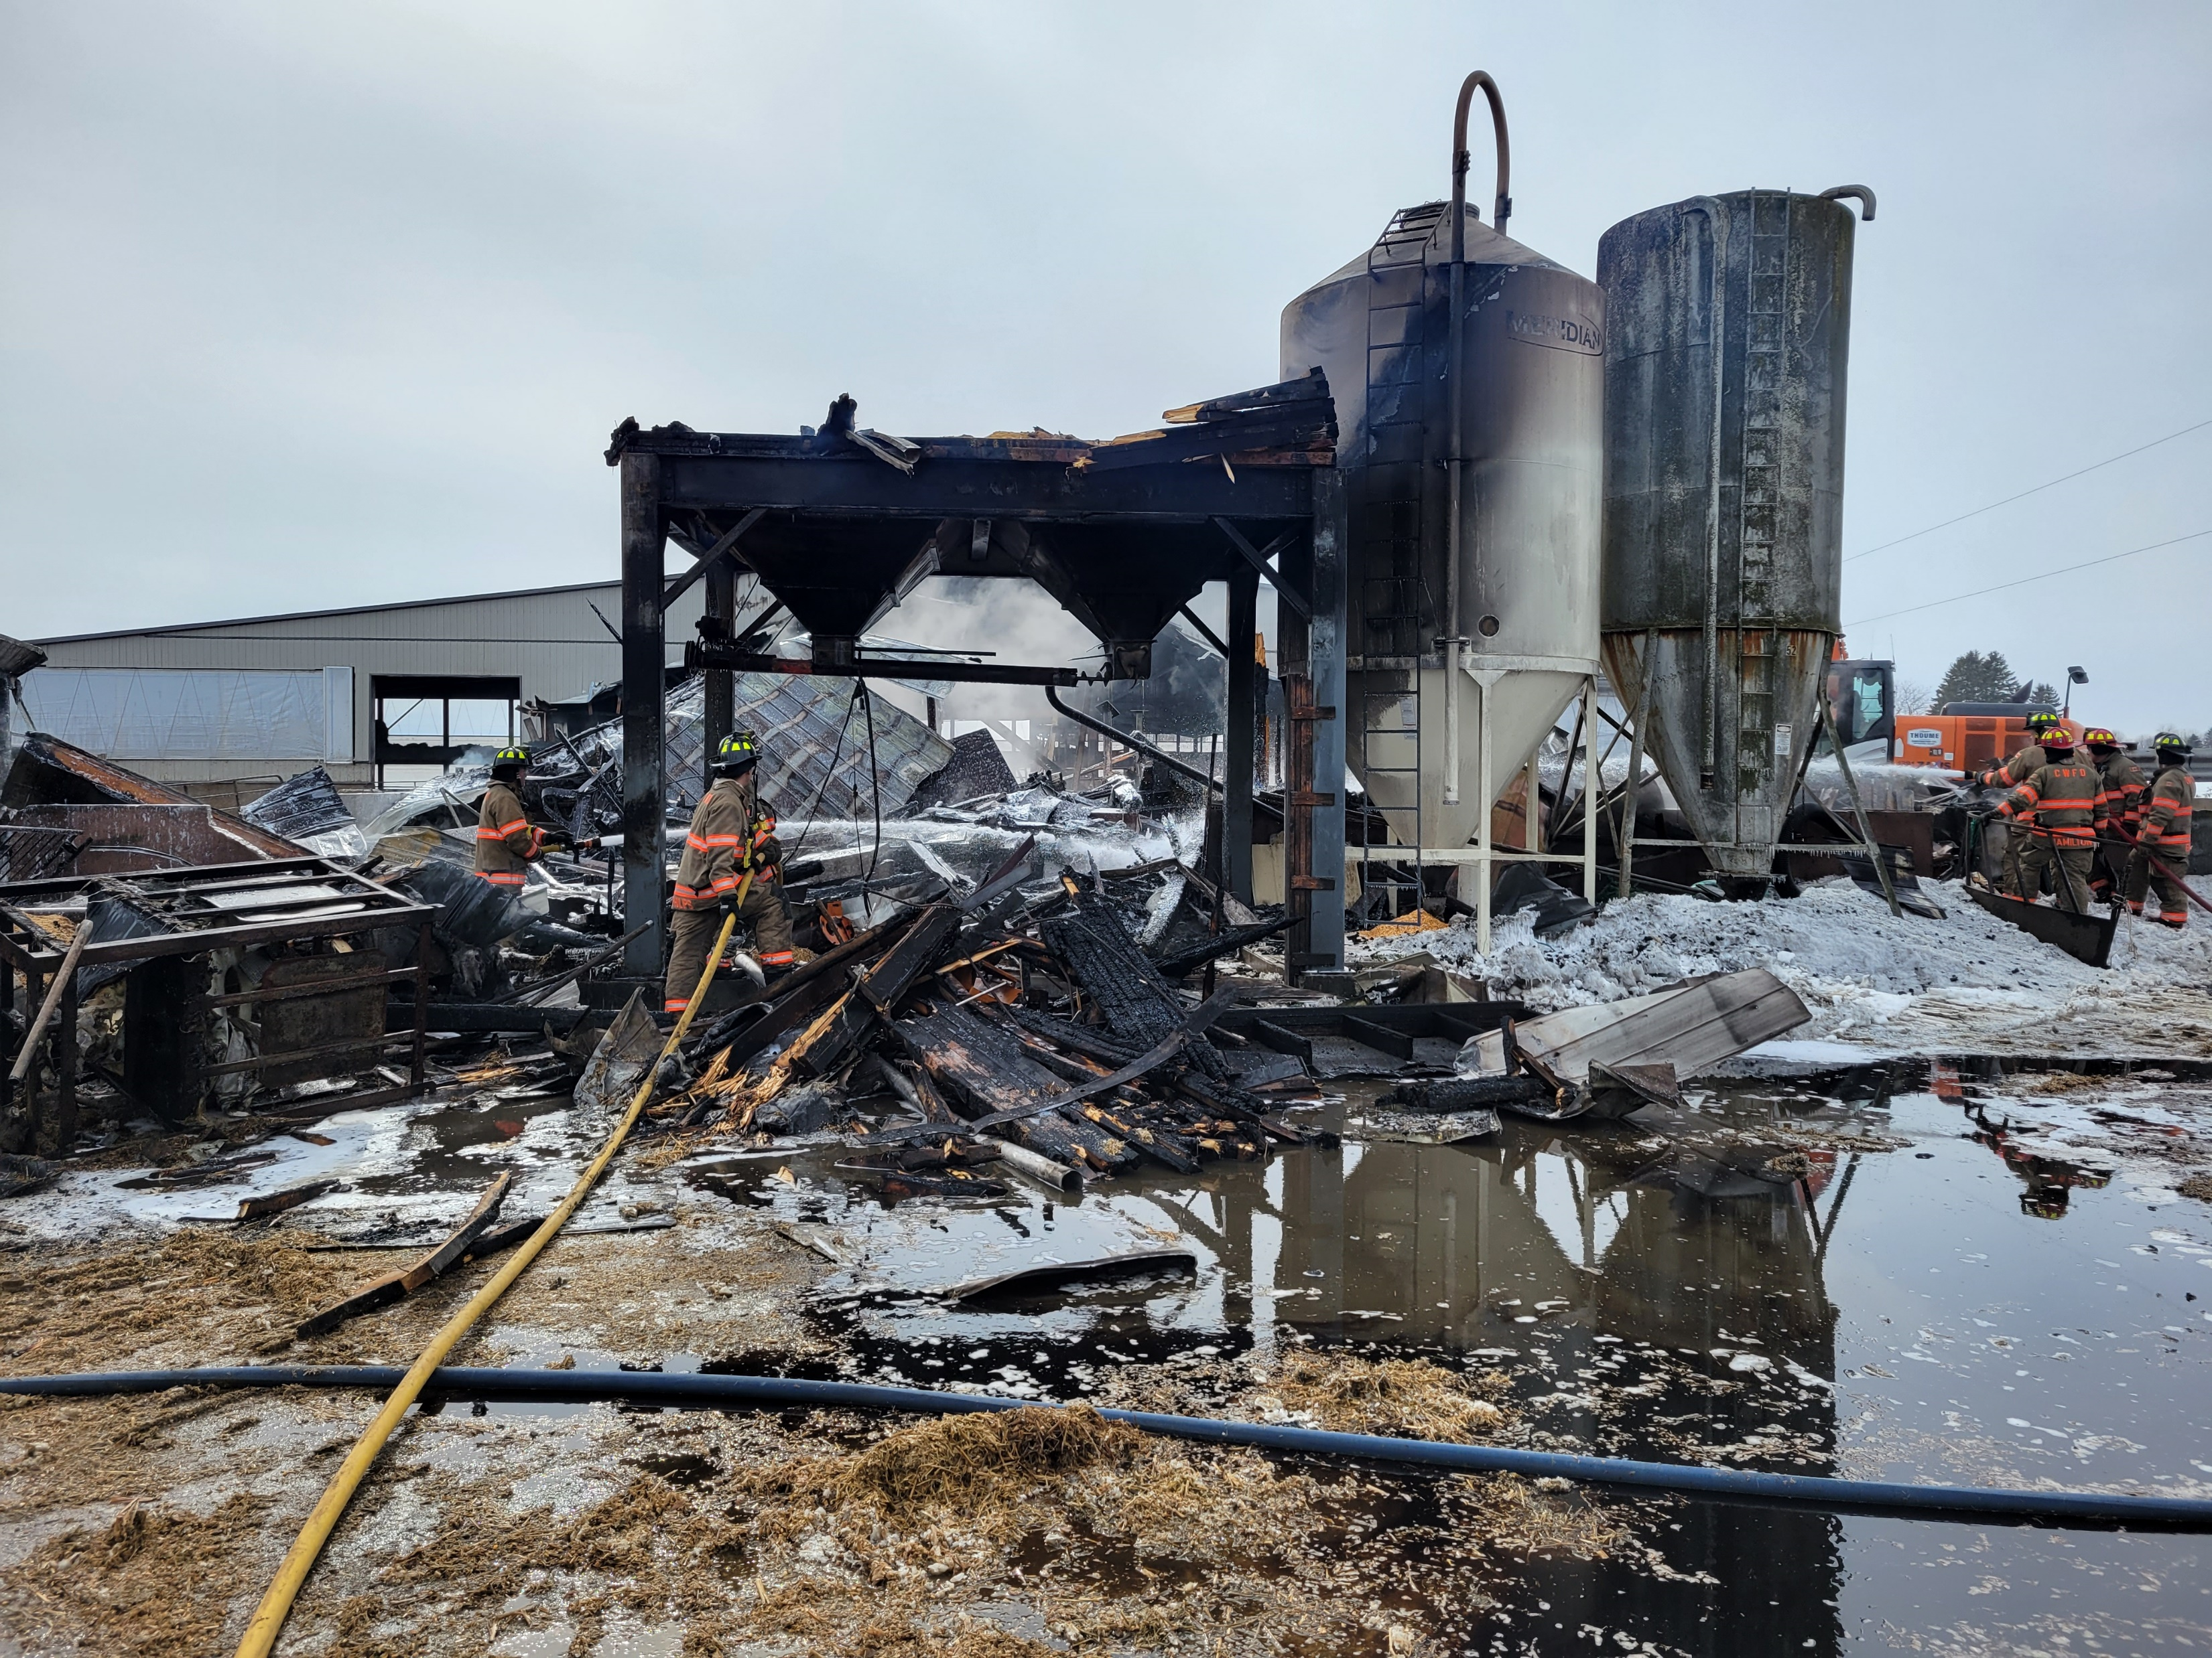
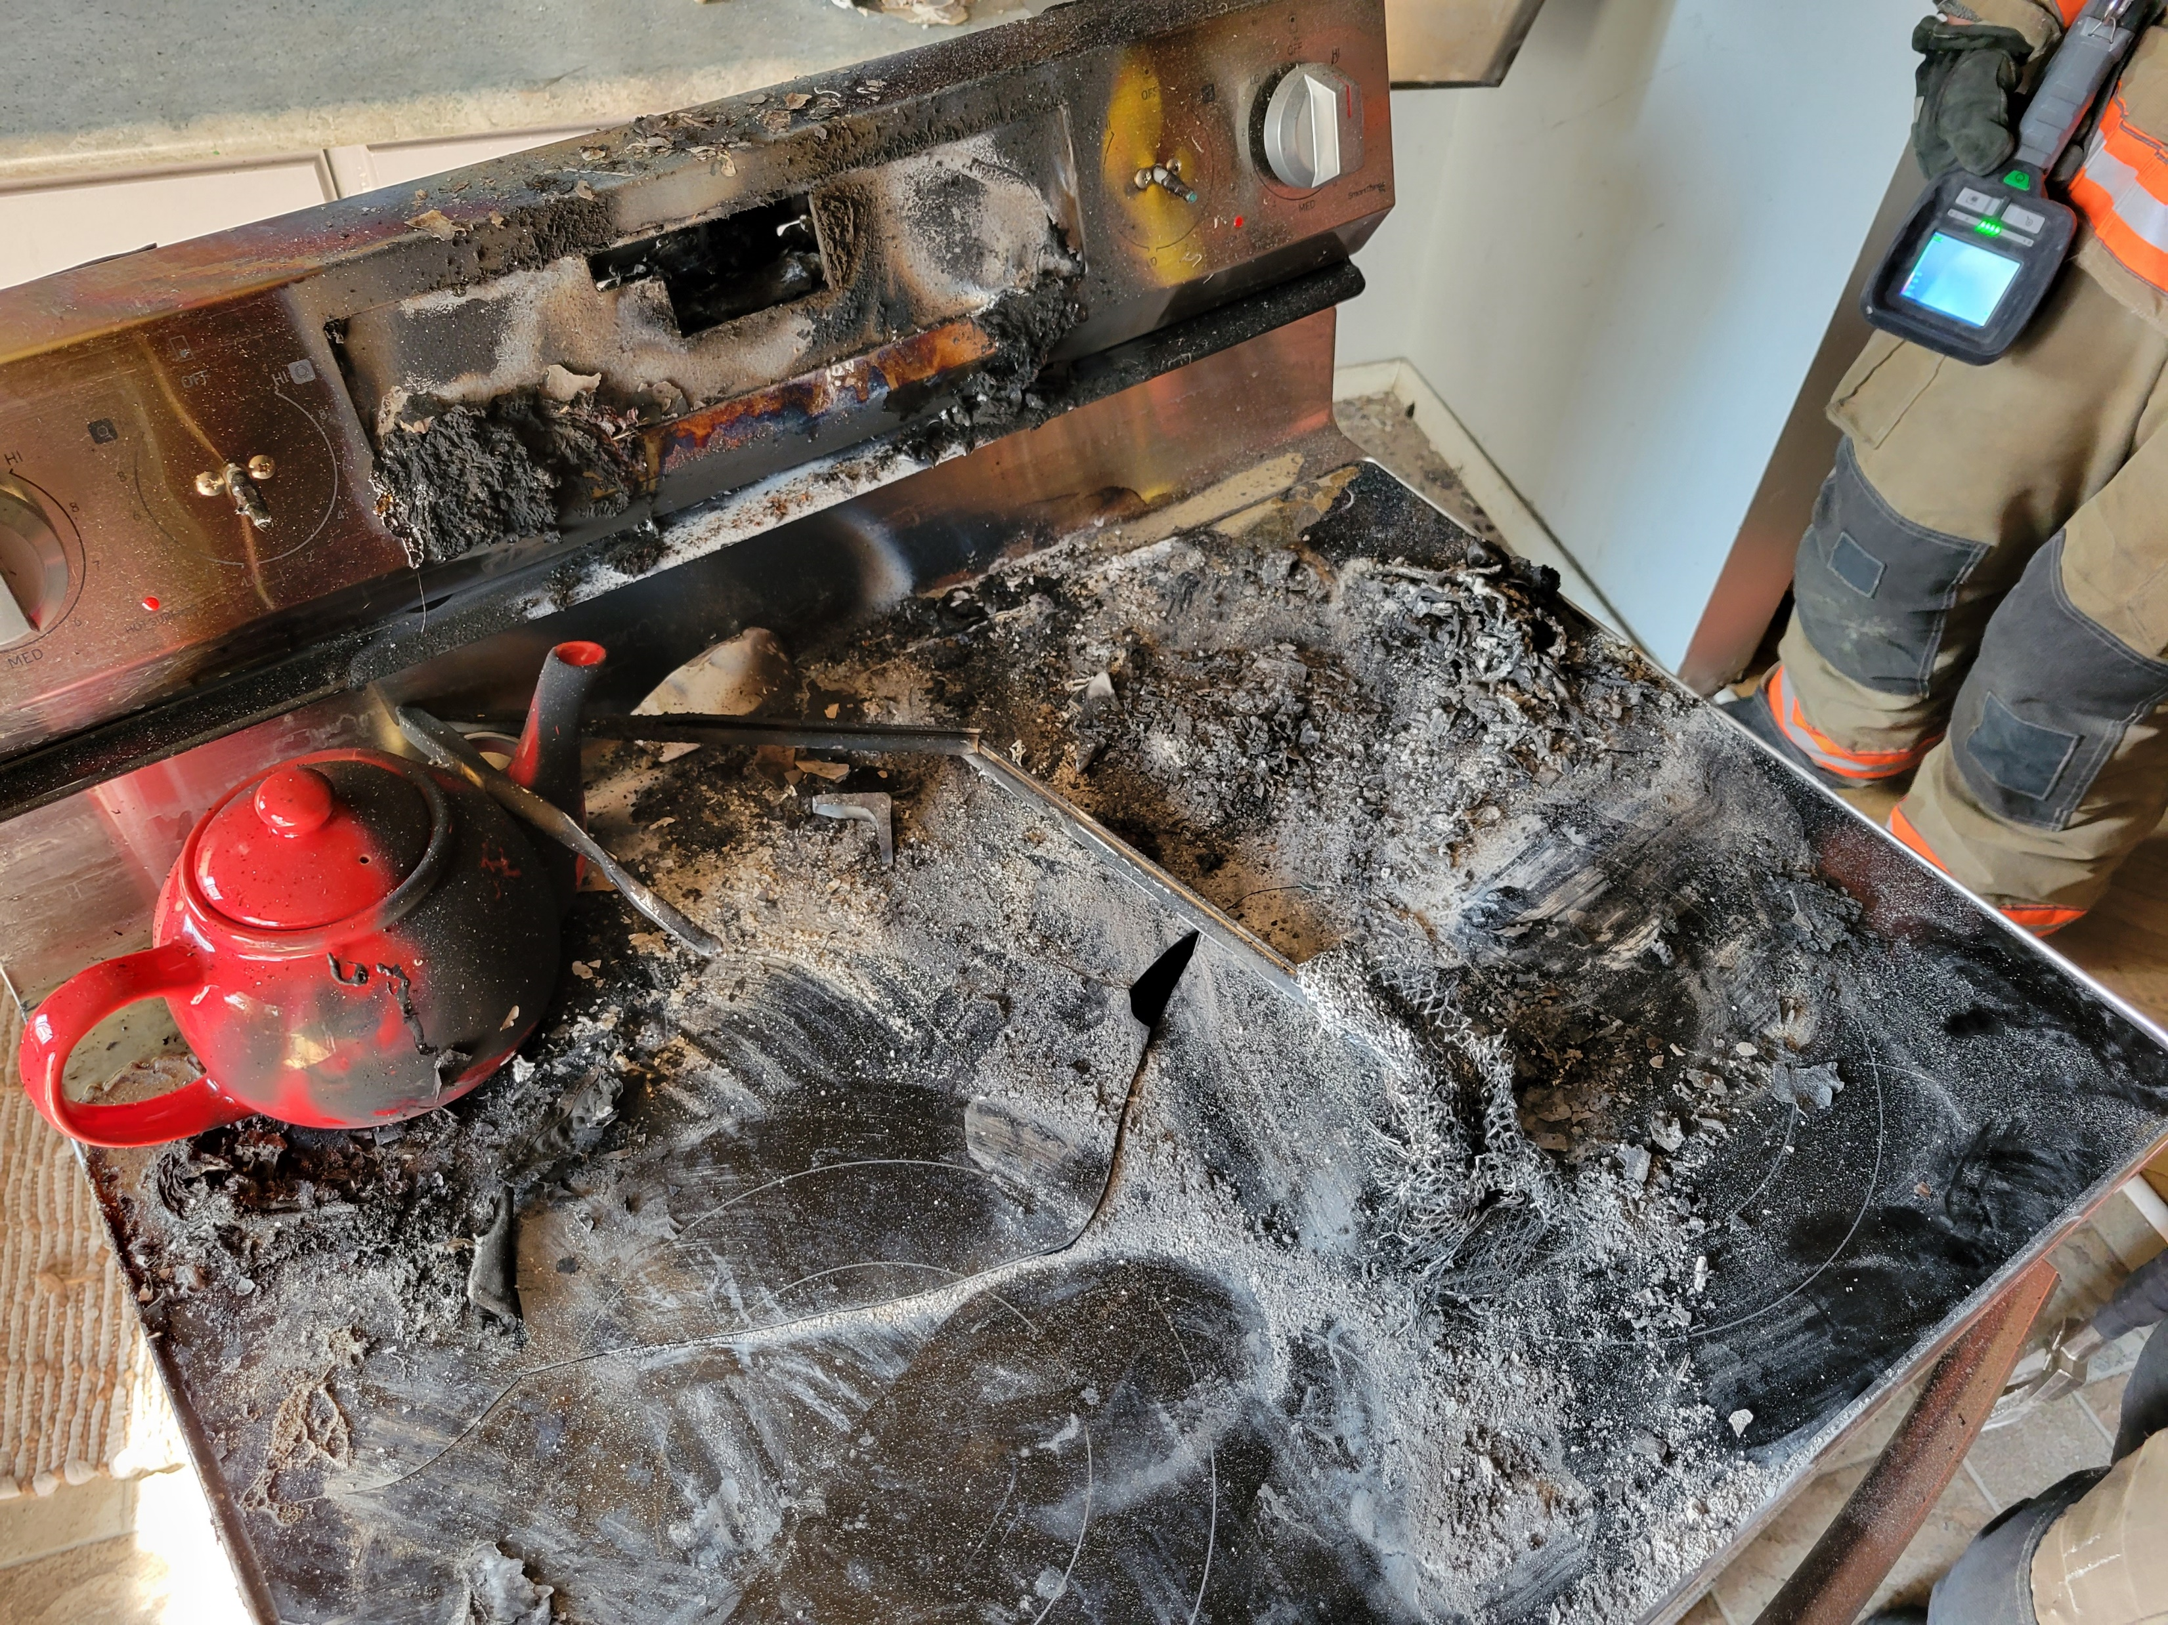
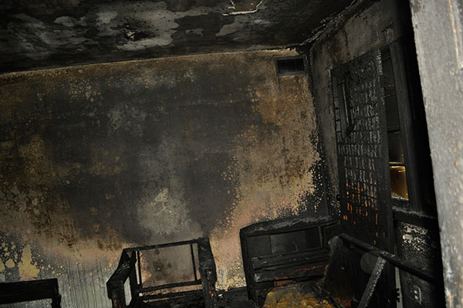
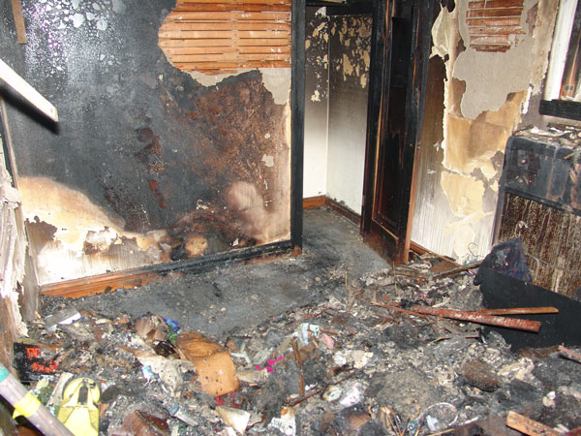
Fire Investigations
Fire Investigations is another mandated service that CWFR must perform. We investigate all fires within our coverage area and in some circumstances, a call for the assistance of the Ontario Fire Marshal’s Office must be made as per
Provincial requirements.

Slide 15
Thank you
The members of
Centre Wellington Fire Rescue
wish you the very best during your term on Council.
We are here to answer any questions you may have.
Enjoy your day.

