Slide 1
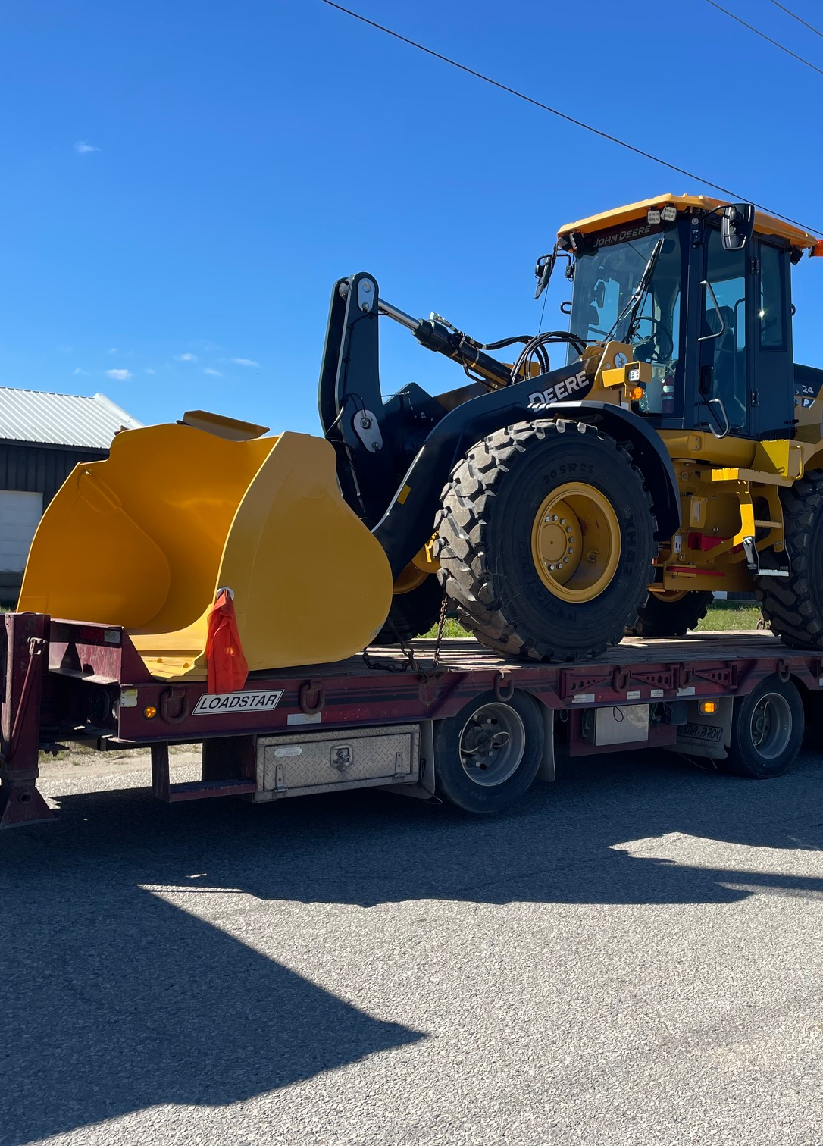

Introduction to
Public Works & Engineering Services
Council Orientation Session
Adam Gilmore, P.Eng., Manager of Engineering
John Gaddye, C.E.T., Manager of Public Works
November 29, 2022
Notes:
Welcome to the Public Works and Engineering booth at the 2022 New Council Orientation Session. This presentation will provide an overview of these important Township divisions and the services they provide to the community.

Slide 2
Agenda
Overview of Public Works and Engineering Services
Bridge Rehabilitation and Replacement
Road Reconstructions
New Water Supply Well Drilling and Exploration
Speeding and Traffic Calming
New Township Operations Centre
Minimum Maintenance Standards
Fleet Repair and Maintenance
Ditching and Stormwater Drainage
Gravel Road Maintenance
Winter Maintenance
Cemeteries
Notes:
In this presentation, we will provide:
An Overview of Public Works and Engineering Services
As well as Details on:
Bridge Rehabilitation and Replacement
Road Reconstructions
New Water Supply Well Drilling and Exploration
Speeding and Traffic Calming
The New Township Operations Centre
Minimum Maintenance Standards
Fleet Repair and Maintenance
Ditching and Stormwater Drainage
Gravel Road Maintenance
Winter Maintenance
And Cemeteries

Slide 3

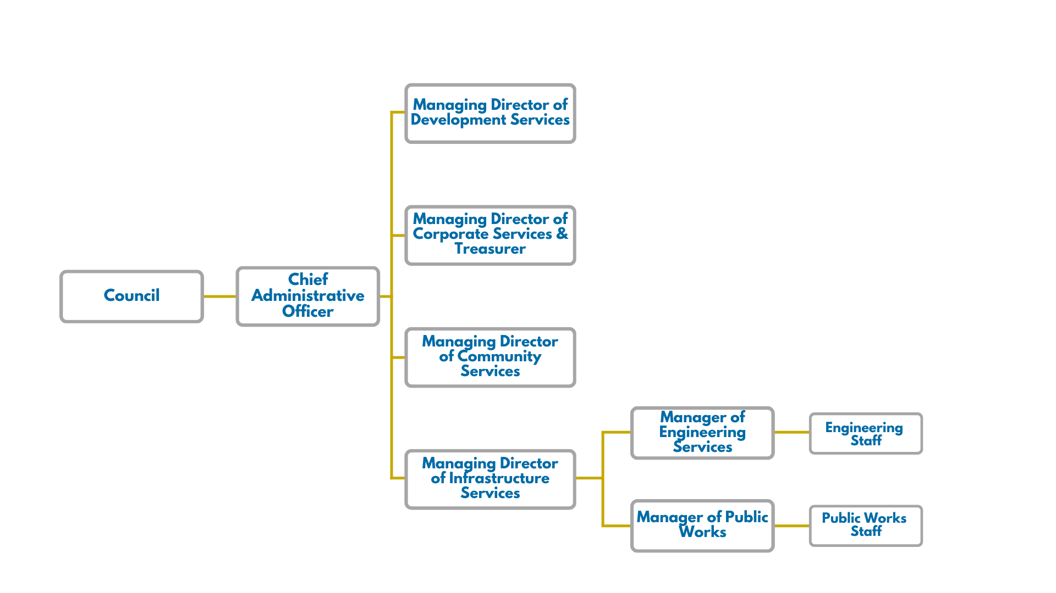
Infrastructure Services: Public Works & Engineering Services
Notes:
As illustrated in this organizational chart, the Public Works and Engineering Services Groups are both within the Infrastructure Services Department, reporting to the Managing Director of Infrastructure Services. The two groups are led by the Manager of Public Works, and the Manager of Engineering, respectively.

Slide 4
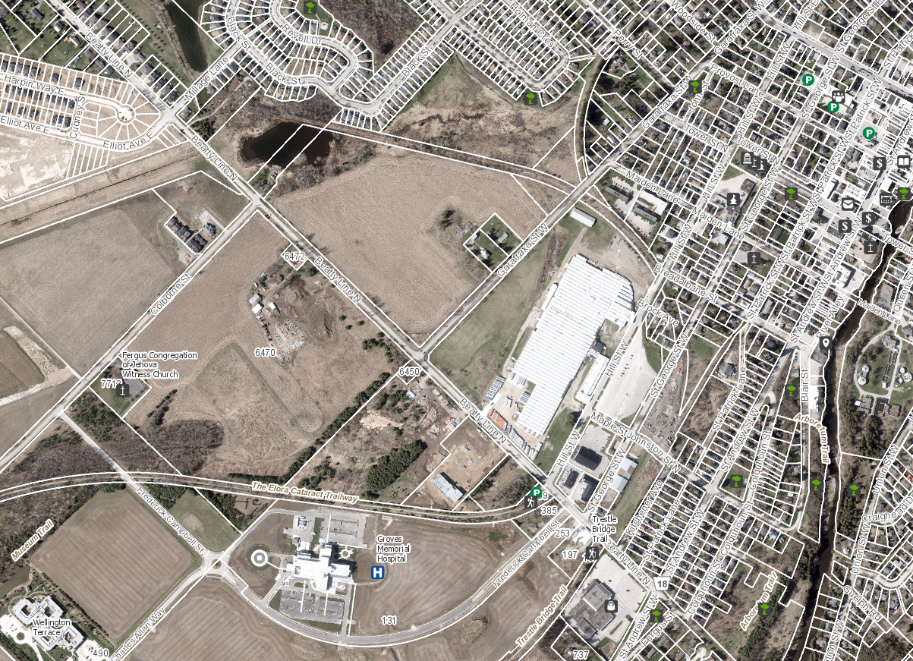
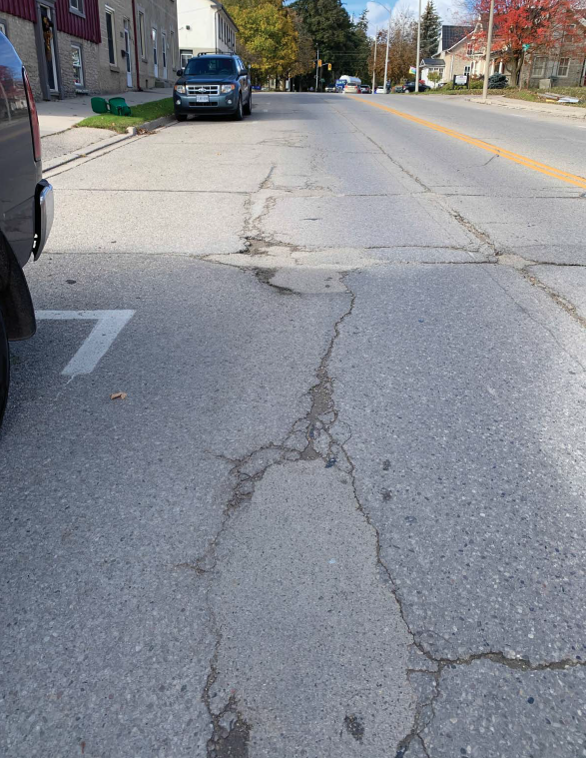
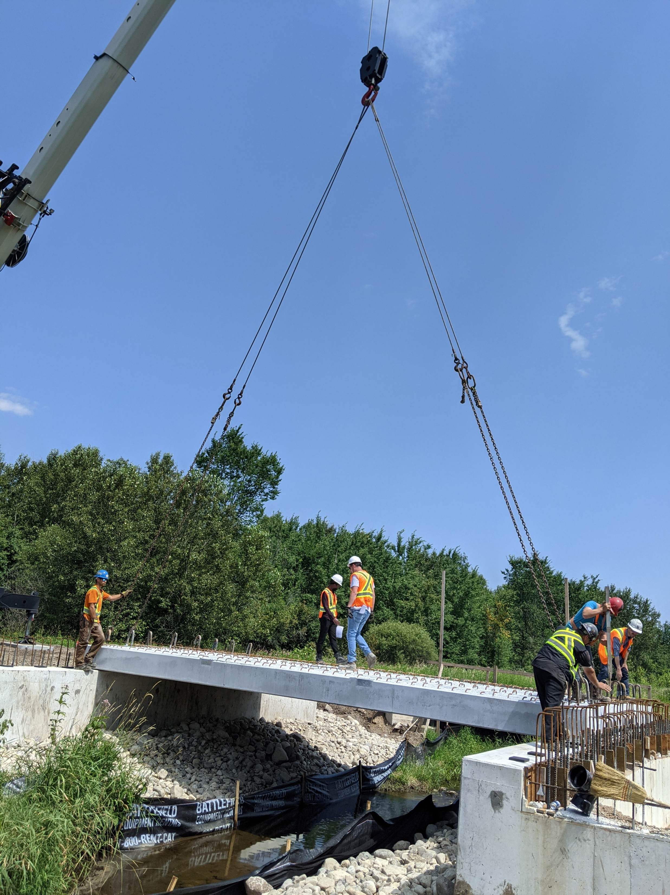
Engineering Services
From concept to construction, the Engineering Services team is responsible for ensuring that the Township’s bridges, roads, water systems, and sewer systems are safe, functional, and sized to meet current and future needs of the community.
Notes:
Engineering Services.
From concept to construction, the Engineering Services team is responsible for ensuring that the Township’s bridges, roads, water systems, and sewer systems are safe, functional, and sized to meet current and future needs of the community.
The team includes the Manager of Engineering, two Capital Project Managers, two Technologists, and the GIS Technician.

Slide 5
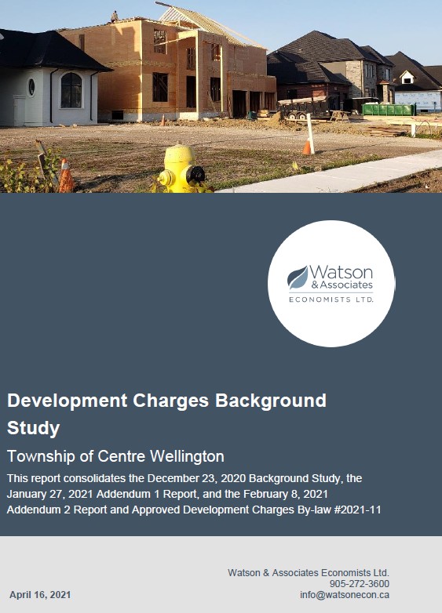
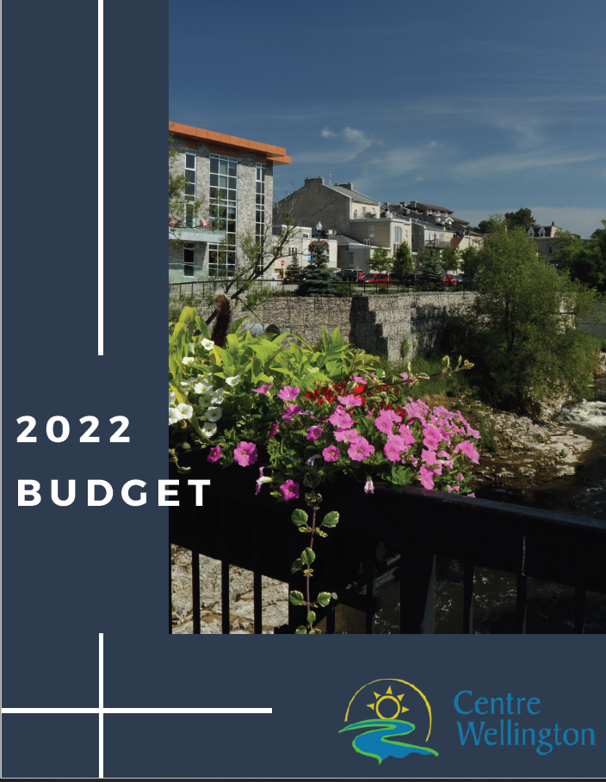
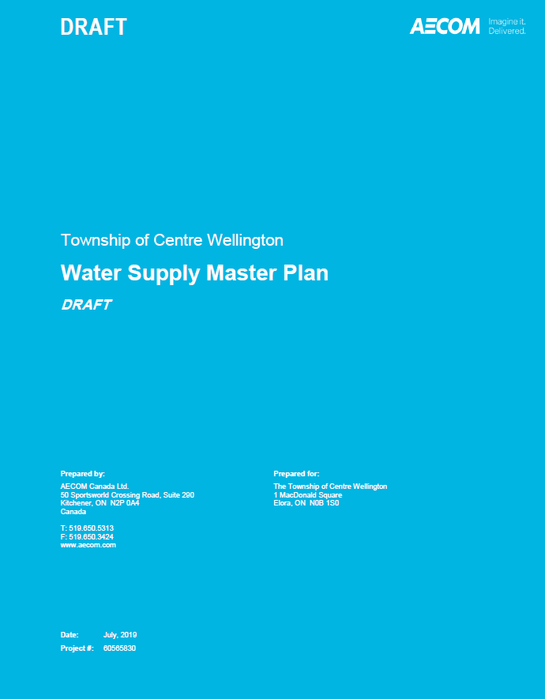
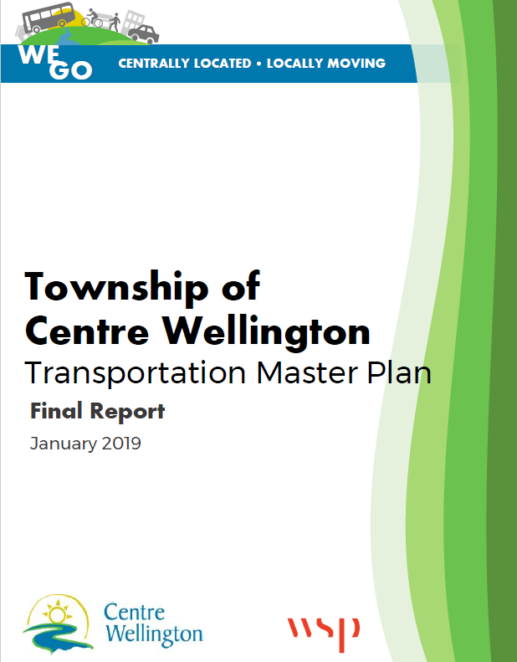
How do we plan and build infrastructure?
Plans and studies identify infrastructure needs to meet current demands and future growth, and serve as important inputs into the Capital Budget and Forecast
5 | Intro to Public Works and Engineering Services
Notes:
But how do we plan and build the infrastructure needed to service our community? Foundational plans and studies identify infrastructure needs to meet current demands and future growth, and serve as important inputs into the Capital Budget and Forecast. Examples of important plans and studies informing this process include the Township’s 2022 Asset Management Plan, Master Plans such as the Water Supply Master Plan and the Transportation Master Plan, and the Development Charges Backgroud Study.

Slide 6
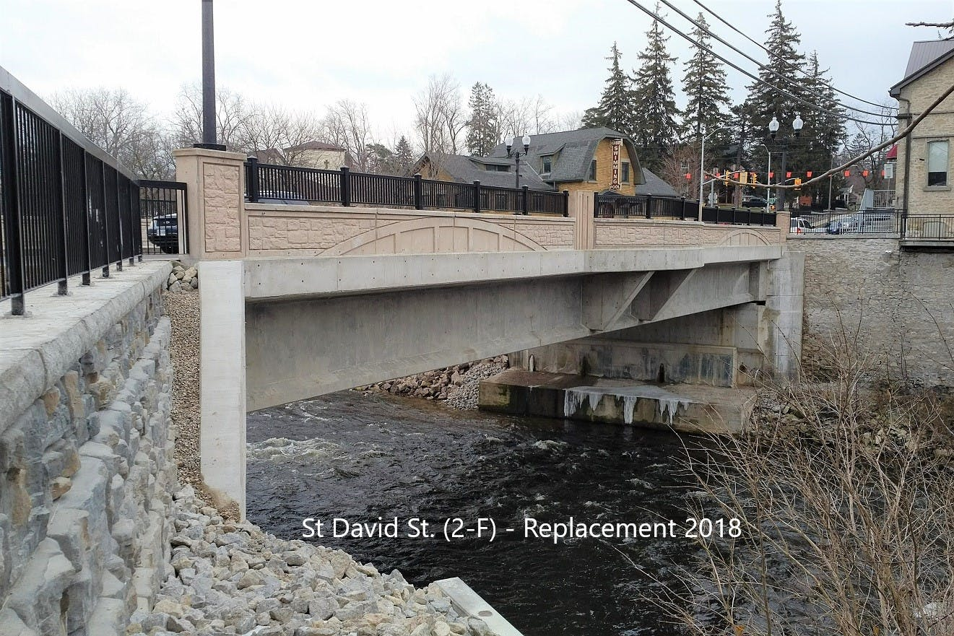
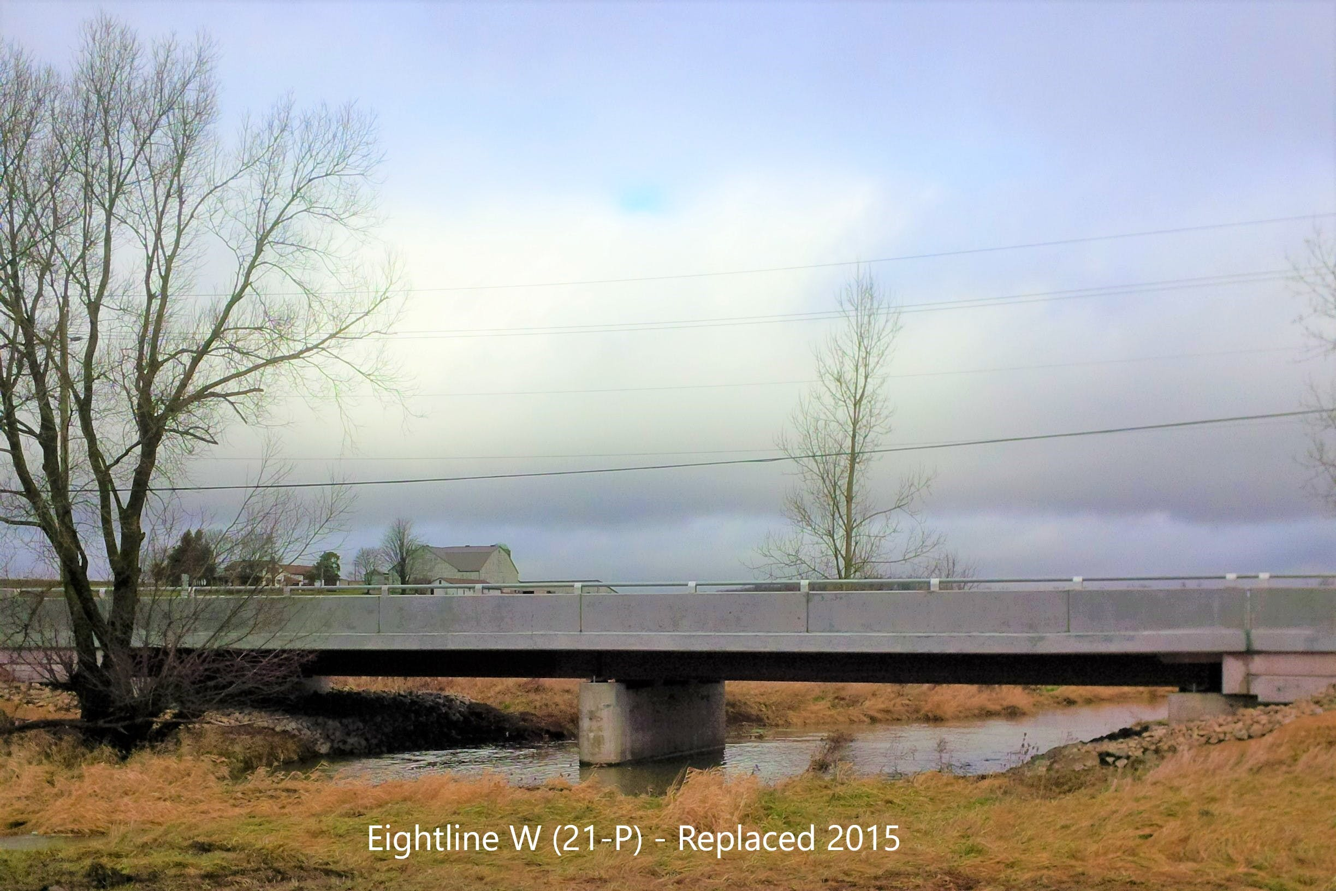
Bridge Rehabilitation and Replacement
The Township has 111 bridges (including culverts) that have a span of 3 meters or more.
In 2015, Council approved a budget that included a Dedicated Capital Levy (DCL) specific to bridges and major culverts.
The DCL, in addition to the Townships Ontario Community Infrastructure Fund (OCIF) annual allocation from the province, is directed exclusively to the Township’s Bridge Rebuilding Program.
Bridge replacements typically follow a three-year process:
  Year One – Conduct a Municipal Environment Assessment Study to establish a bridge solution
  Year Two – Detailed Design
  Year Three – Construction
Notes:
A core service of the Engineering Services team is oversight of the Township’s Bridge Rehabilitation and Replacement Program. The Township has 111 bridges, including culverts, that have a span of 3 meters or more.
In 2015, Council approved a budget that included a Dedicated Capital Levy specific to bridges and major culverts. The Dedicated Capital Levy, in addition to the Townships Ontario Community Infrastructure Fund annual allocation from the province, is directed exclusively to fund the Township’s Bridge Rebuilding Program.
Bridge replacements typically follow a three-year process:
In year one, the Township conducts a Municipal Environment Assessment Study to establish a bridge solution
In year two, detailed engineering design and permitting is completed for the replacement bridge
And in year three, the replacement bridge is constructed

Slide 7
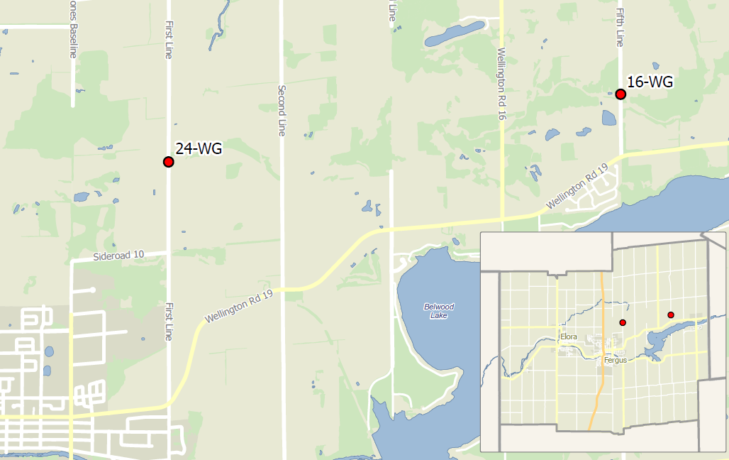
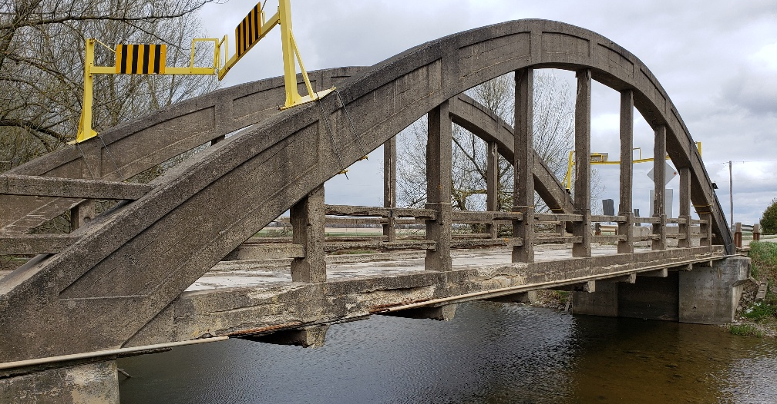
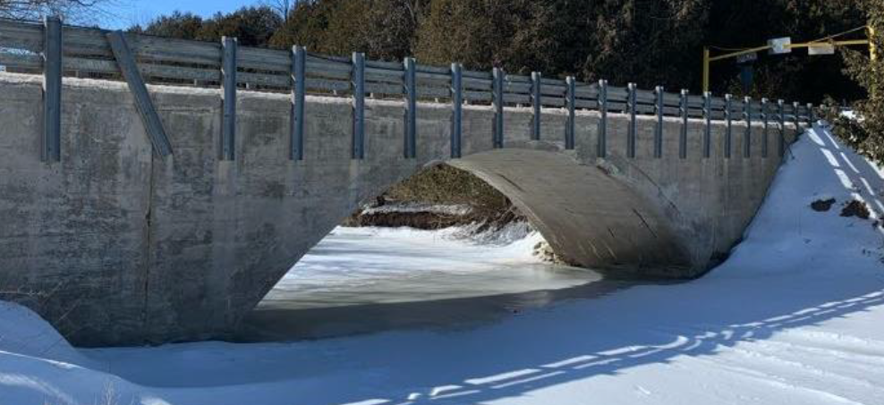
Bridge Rehabilitation and Replacement
As outlined in the Township’s Asset Management Plan, bridges are given an overall risk rating based on multiple factors (bridge condition, detour length, traffic volume, emergency response times, etc.)
Bridges with a higher risk rating are prioritized for repair or replacement within the Township’s Bridges and Major Culverts 10-Year Forecast, which is part of the annual capital budget
Two major bridge replacements are planned for construction in 2023:
  Bridge 24-WG (First Line, former West Garafraxa Twsp)
  Bridge 16-WG (Fifth Line, former West Garafraxa Twsp)
Bridge 24-WG (Closed)
Bridge 16-WG (Closed)
Notes:
As outlined in the Township’s Asset Management Plan, bridges are given an overall risk rating based on multiple factors. Examples of factors included in the risk rating calculation include bridge condition, detour length, traffic volume, and impacts to emergency response times.
Bridges with a higher risk rating are prioritized for repair or replacement within the Township’s Bridges and Major Culverts 10-Year Forecast, which is part of the annual capital budget
Two major bridge replacements are planned for construction in 2023:
Bridge 24-WG, located on the First Line, in former West Garafraxa Township
And Bridge 16-WG, located on the Fifth Line, in former West Garafraxa Township

Slide 8
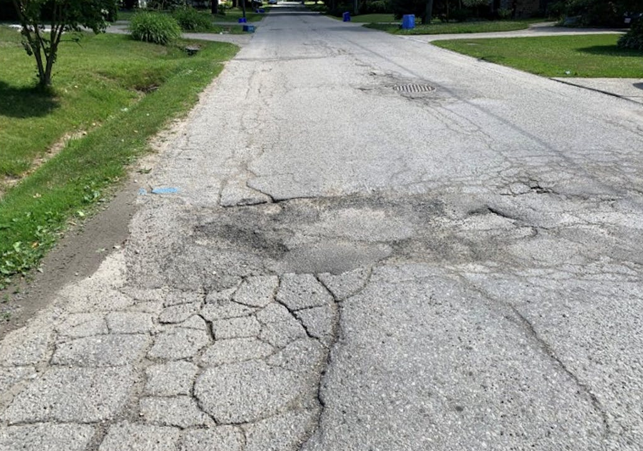
Road Reconstructions
Includes replacement or upgrading of watermains, sanitary sewers, storm sewers, roads, sidewalks, and utilities to ensure Township infrastructure is safe, reliable, and functional
Infrastructure needs are prioritized in accordance with the Township’s Asset Management Plan
Major reconstruction projects planned in 2023 and beyond:
  E. Mill Street – Full Reconstruction Metcalfe Street to Melville Street (2023)
  Beatty Line – Full Reconstruction St. Andrew Street to Millage Lane (2023)
  St. David Street North – Full Reconstruction St. Andrew Street to Edinburgh Avenue (2024/2025)
Notes:
Road reconstructions and the replacement of linear assets are another important focus area for the Engineering Services team.
This work includes replacement or upgrading of watermains, sanitary sewers, storm sewers, roads, sidewalks, and other utilities to ensure Township infrastructure is safe, reliable, and functional.
Similar to bridges, these infrastructure needs are prioritized in accordance with the Asset Management Plan.
Major reconstruction projects planned in 2023 and beyond include:
The full reconstruction of East Mill Street from Metcalfe Street to Melville Street in Elora. Construction on this project is planned to start in 2023.
The full reconstruction of Beatty Line from St. Andrew Street to Millage Lane in Fergus. Construction on this project is also planned to start in 2023.
And the full reconstruction of St. David Street North from St. Andrew Street to Edinburgh Avenue in Fergus. Construction on this project is planned to start in 2024, and continue beyond 2025.

Slide 9
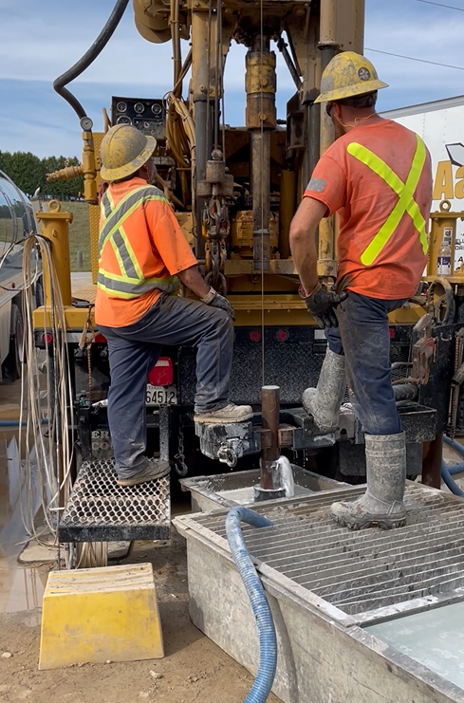
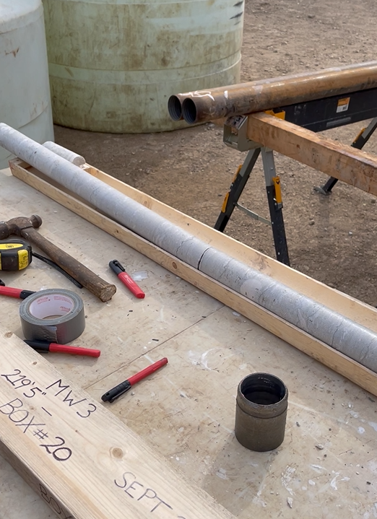
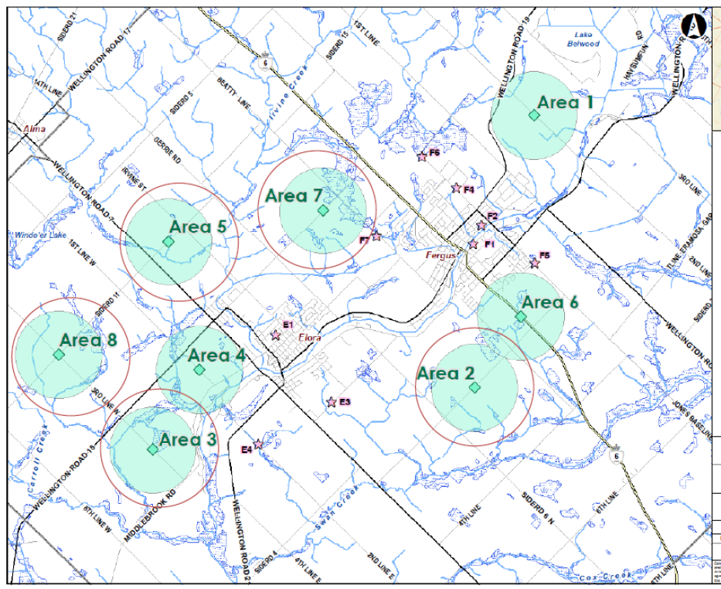
New Water Supply Well Drilling and Exploration
The Township needs to increase water supply to accommodate future growth
Replacement water supply wells have been drilled at the Fergus Well F2 and F5 sites to improve water quality and production from these locations
Drilling of test wells in four new well exploration areas northwest of Fergus, and north/west of Elora is underway
Fergus
Elora
Notes:
New Water Supply Well Drilling and Exploration. As outlined in the Water Supply Master Plan, the Township needs to increase our current water supply to accommodate future growth. To accommodate this, replacement water supply wells have been drilled at the existing Fergus Well F2 and F5 sites to improve water quality and production from these locations.
The Township is also in process of drilling test wells in four new well exploration areas outside of Fergus and Elora, to determine if these areas could be the sites of future water supply wells. The highlighted circles in the displayed map show the locations of these new well exploration areas. The Engineering Services team is overseeing this project.

Slide 10
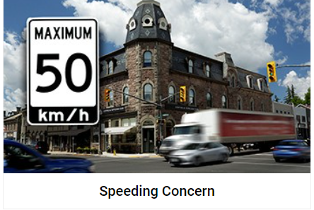
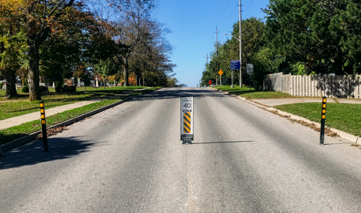
Speeding and Traffic Calming
In 2022, Township Council approved a Speed Limit Policy and Technical Approach for reviewing speed limits, assessing speeding concerns, and implementing effective traffic calming measures in urban and rural areas
Staff review speeding data and resident concerns and prepare a yearly report to Council with recommendations to make our streets safer
Residents can report speeding concerns through the Township’s online reporting form on the “Report It” section of the Township’s website:
  www.centrewellington.ca/en/living-here/speeding-concern.aspx
Notes:
Speeding and traffic calming. In 2022, Township Council approved a Speed Limit Policy and Technical Approach for reviewing speed limits, assessing speeding concerns, and implementing effective traffic calming measures in urban and rural areas. As part of this process, staff in the Engineering Services Group review speeding data and resident concerns and prepare a yearly report to Council with recommendations to make our streets safer. Residents can report speeding concerns through the Township’s online reporting form on the “Report It” section of the Township’s website, which can be accessed through the link displayed on this slide.

Slide 11
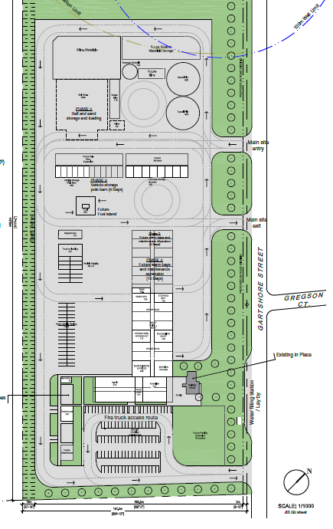
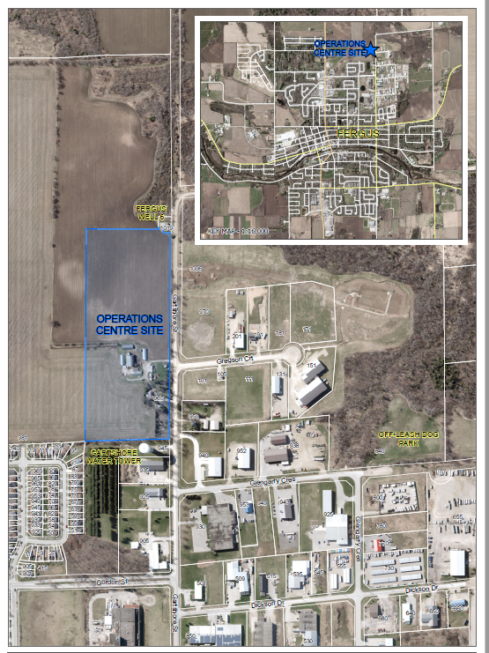
New Township Operations Centre
Existing Township operations facilities are undersized for current and future needs, and many are beyond their useful service life
To maintain levels of service in the community and position the Township for future growth, a New Township Operations Centre is needed
The Township has purchased a 20-acre parcel at 965 Gartshore Street in Fergus for a New Operations Centre, and studies/ designs are underway for the new facility
Per the Draft 2023 Budget, detailed design is planned to start in 2023, and construction is planned to start in 2025
Notes:
Finally, the Engineering Services Team is overseeing the planning, design, and construction of a New Township Operations Centre.
Existing Township operations facilities are undersized for current and future needs, and many are beyond their useful service life. To maintain levels of service in the community and position the Township for future growth, a New Township Operations Centre is needed. The Township has purchased a 20-acre parcel at 965 Gartshore Street in Fergus for a New Operations Centre, and studies and designs are underway for the new facility. Per the Draft 2023 Budget, detailed design for the facility is planned to start in 2023, and construction is planned to start in 2025.

Slide 12
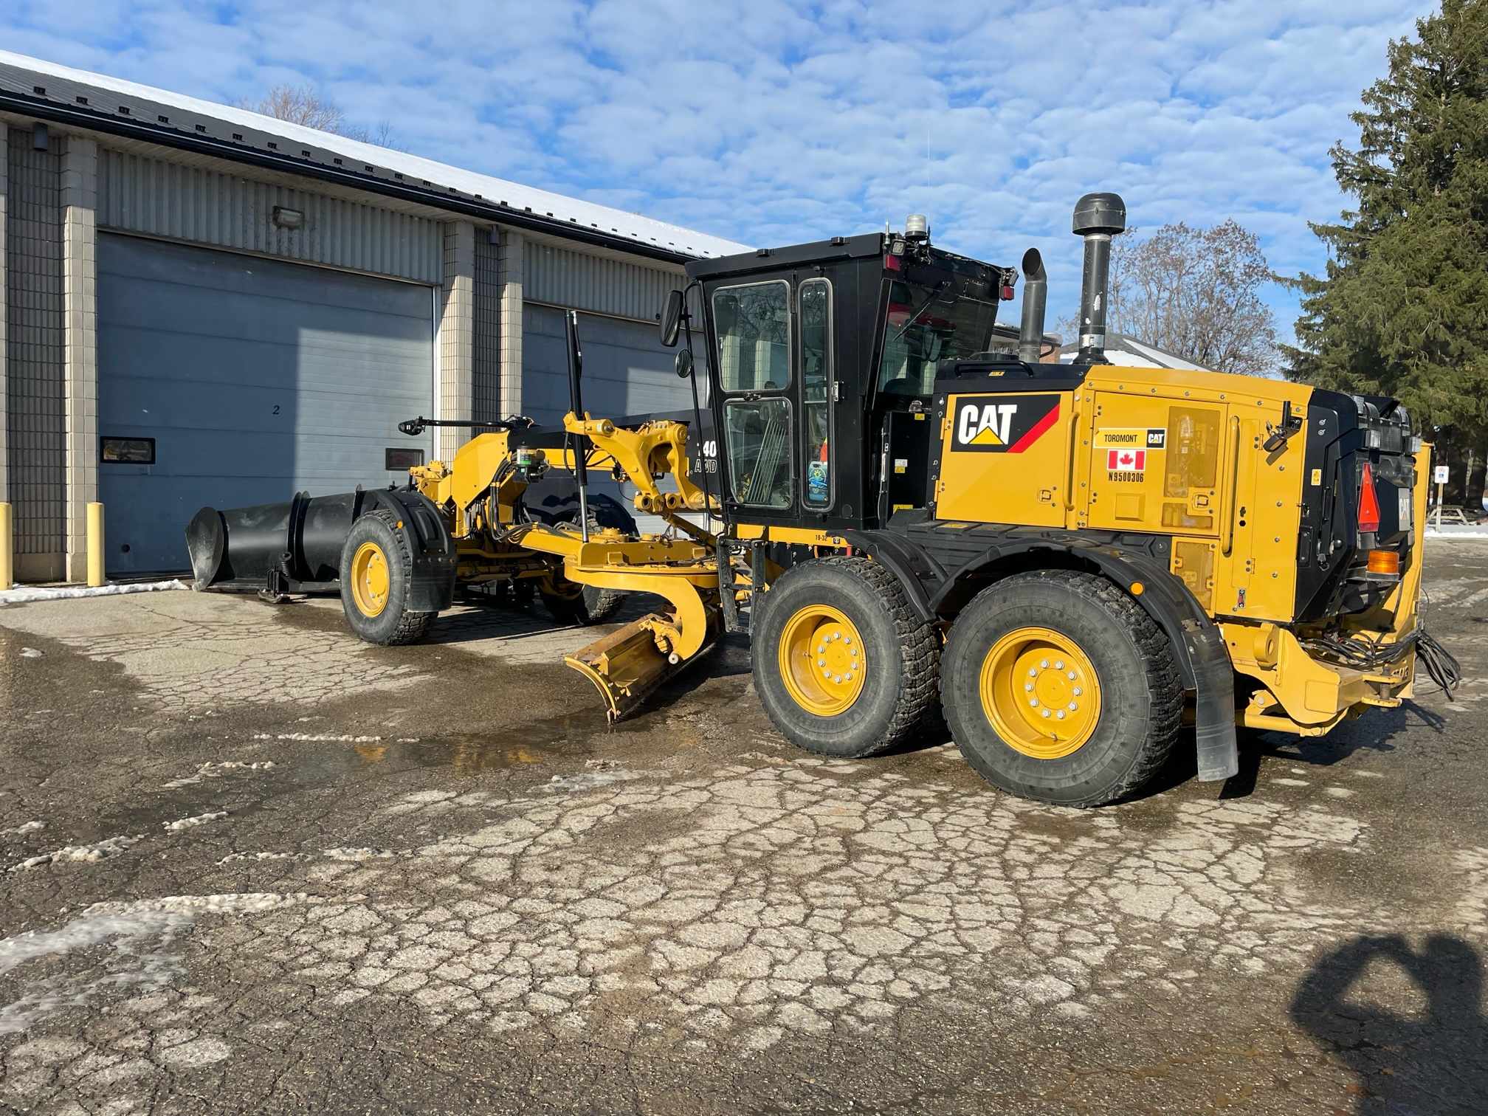
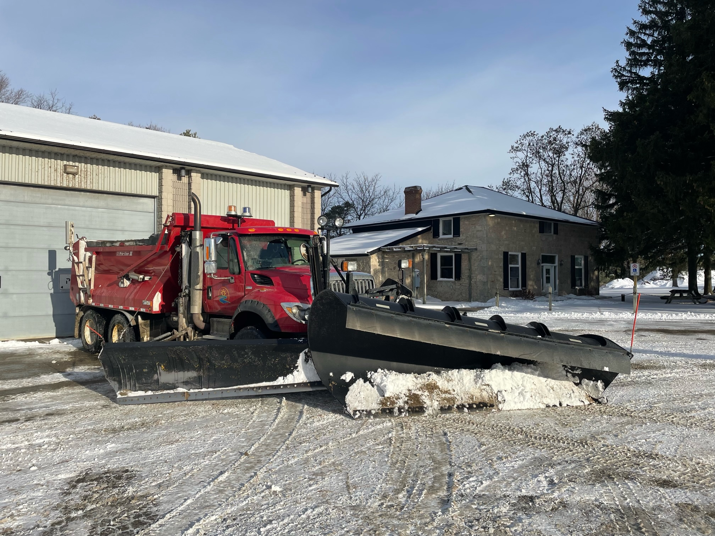
Public Works
Public Works maintains all aspects of Township road allowances to ensure the safe and efficient movement of people and goods in and through our community.
Notes:
Welcome to Public Works.
Public Works is the amazing team that takes care of all aspects of the Township’s road allowances. From snow plowing and filling pot holes in the winter season, to gravel road maintenance and special event road closures in the summer. And let’s not forget maintaining our cemeteries and providing the essential service of burials to our community.
We currently have 17 permanent frontline staff, and another four of us who work on the administrative and supervision side of the operation. Our workforce is supplemented with students in the summer and seasonal winter control operators for the winter season.

Slide 13
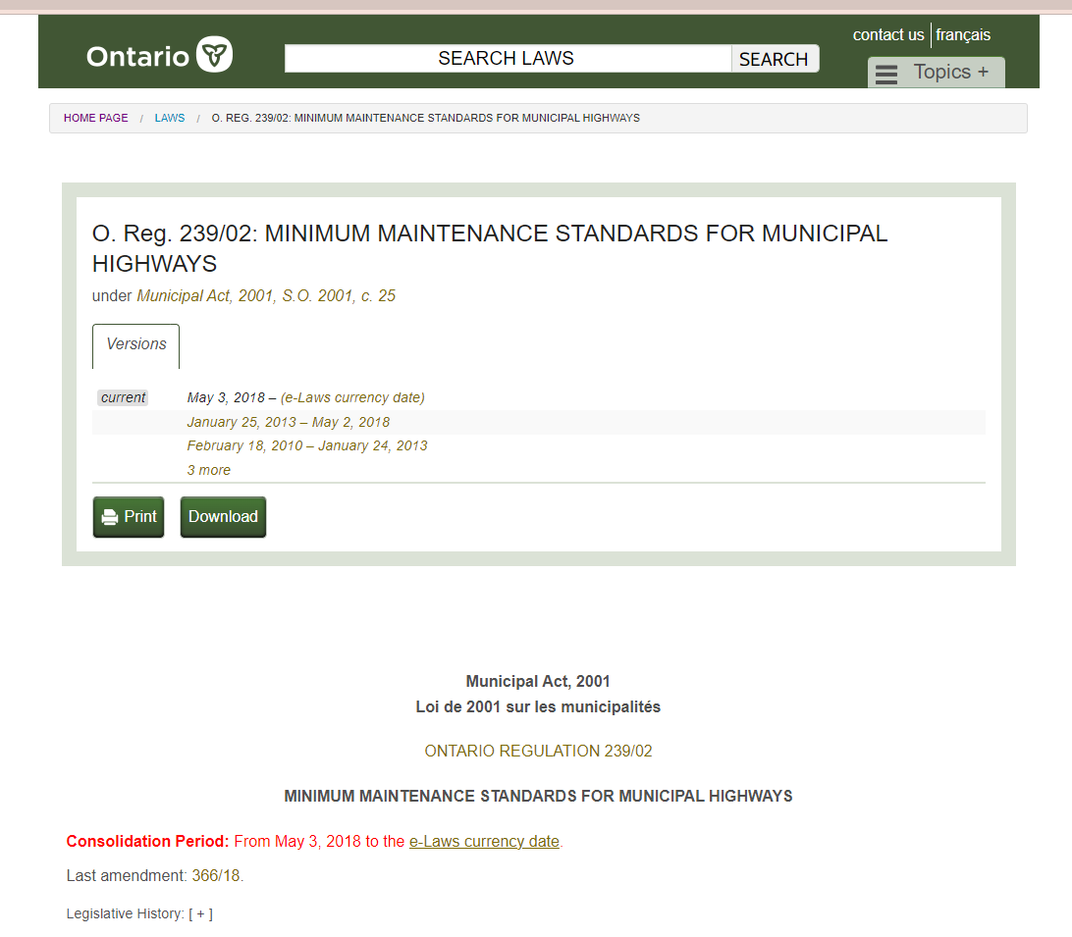
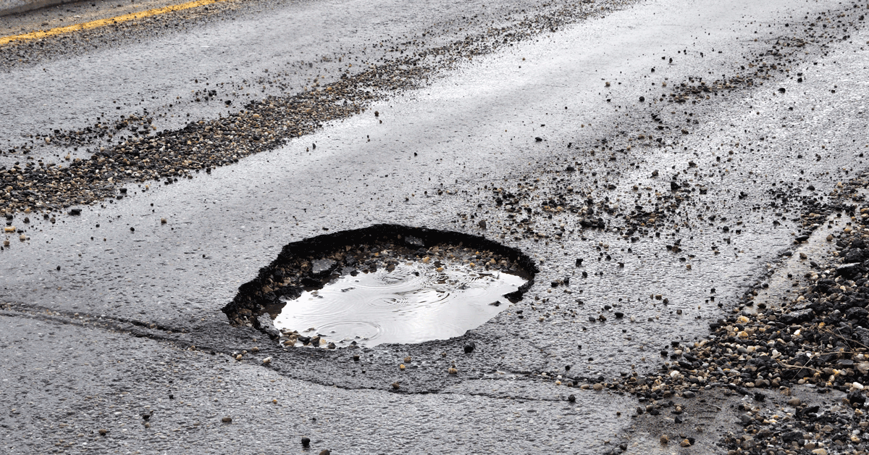
MMS: O.Reg. 239/02 Minimum Maintenance Standards
Provides a legal defense against claims against the Township
  Road classification – based on speed limit and number of vehicles per day
  Patrolling frequency
  Weather monitoring
  Snow accumulation / ice formation
  Significant weather event
  Potholes
  Shoulder drop offs
  Cracks, debris, streetlighting, signs, traffic signals, sidewalk
Defines parameters for defects
Specifies response times for addressing defects
Notes:
Before we get into some of the activities Public Works is responsible for… Let’s talk a little bit about Minimum Maintenance Standards or MMS as we sometimes refer to.
MMS comes from a regulation to the Municipal Act.
While the primary purpose of this regulation is to provide a legal defense for claims against a municipality, it also provides some direction about how to approach road maintenance.
The foundation of these maintenance standards is patrolling and monitoring. Every Township road is patrolled at least once every 7, 14 or 30 days depending on the traffic volume and posted speed limit. Based on these patrols, we document and address defects within prescribed timelines.
During the winter months, we monitor weather forecasts and actual road conditions to make sure we’re keeping our roads and sidewalks cleared adequately. Occasionally, it is necessary to declare a “significant weather event.” Making this declaration does two things. First, it signals to the community that we’re dealing with a good size storm that might take us longer than usual to clean up. And second, it suspends the timeline for response times under the MMS, so the Township is not exposed from a risk and liability perspective.

Slide 14
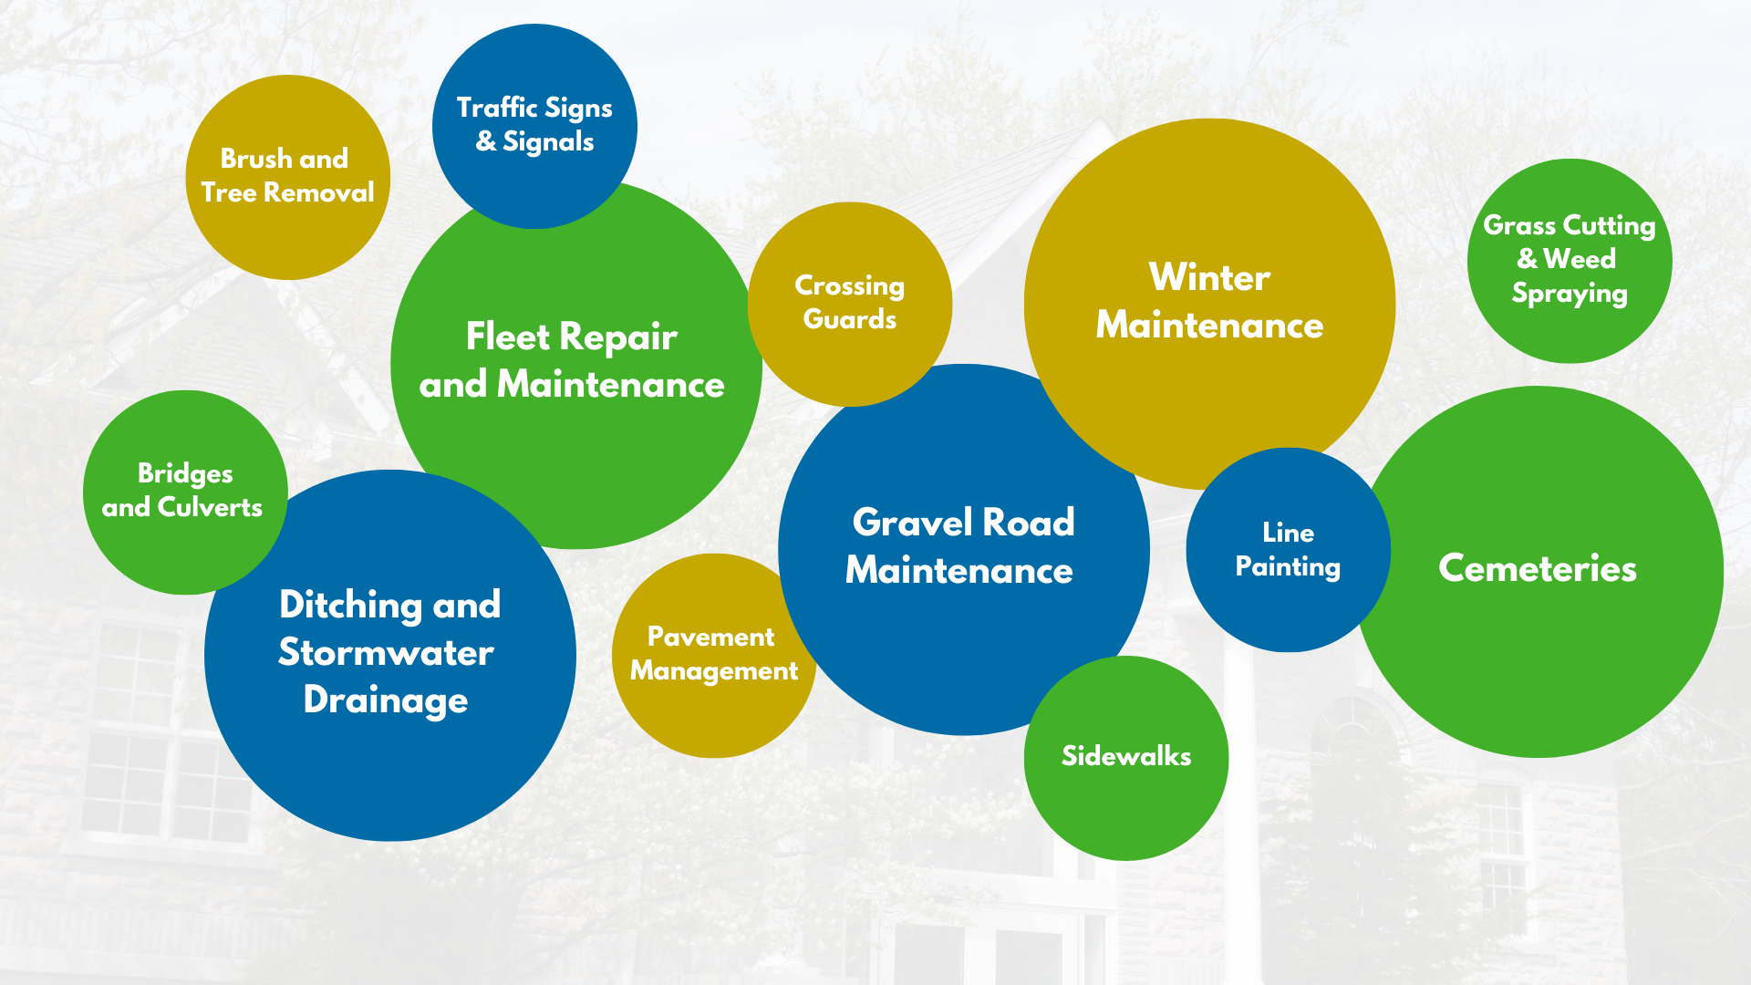
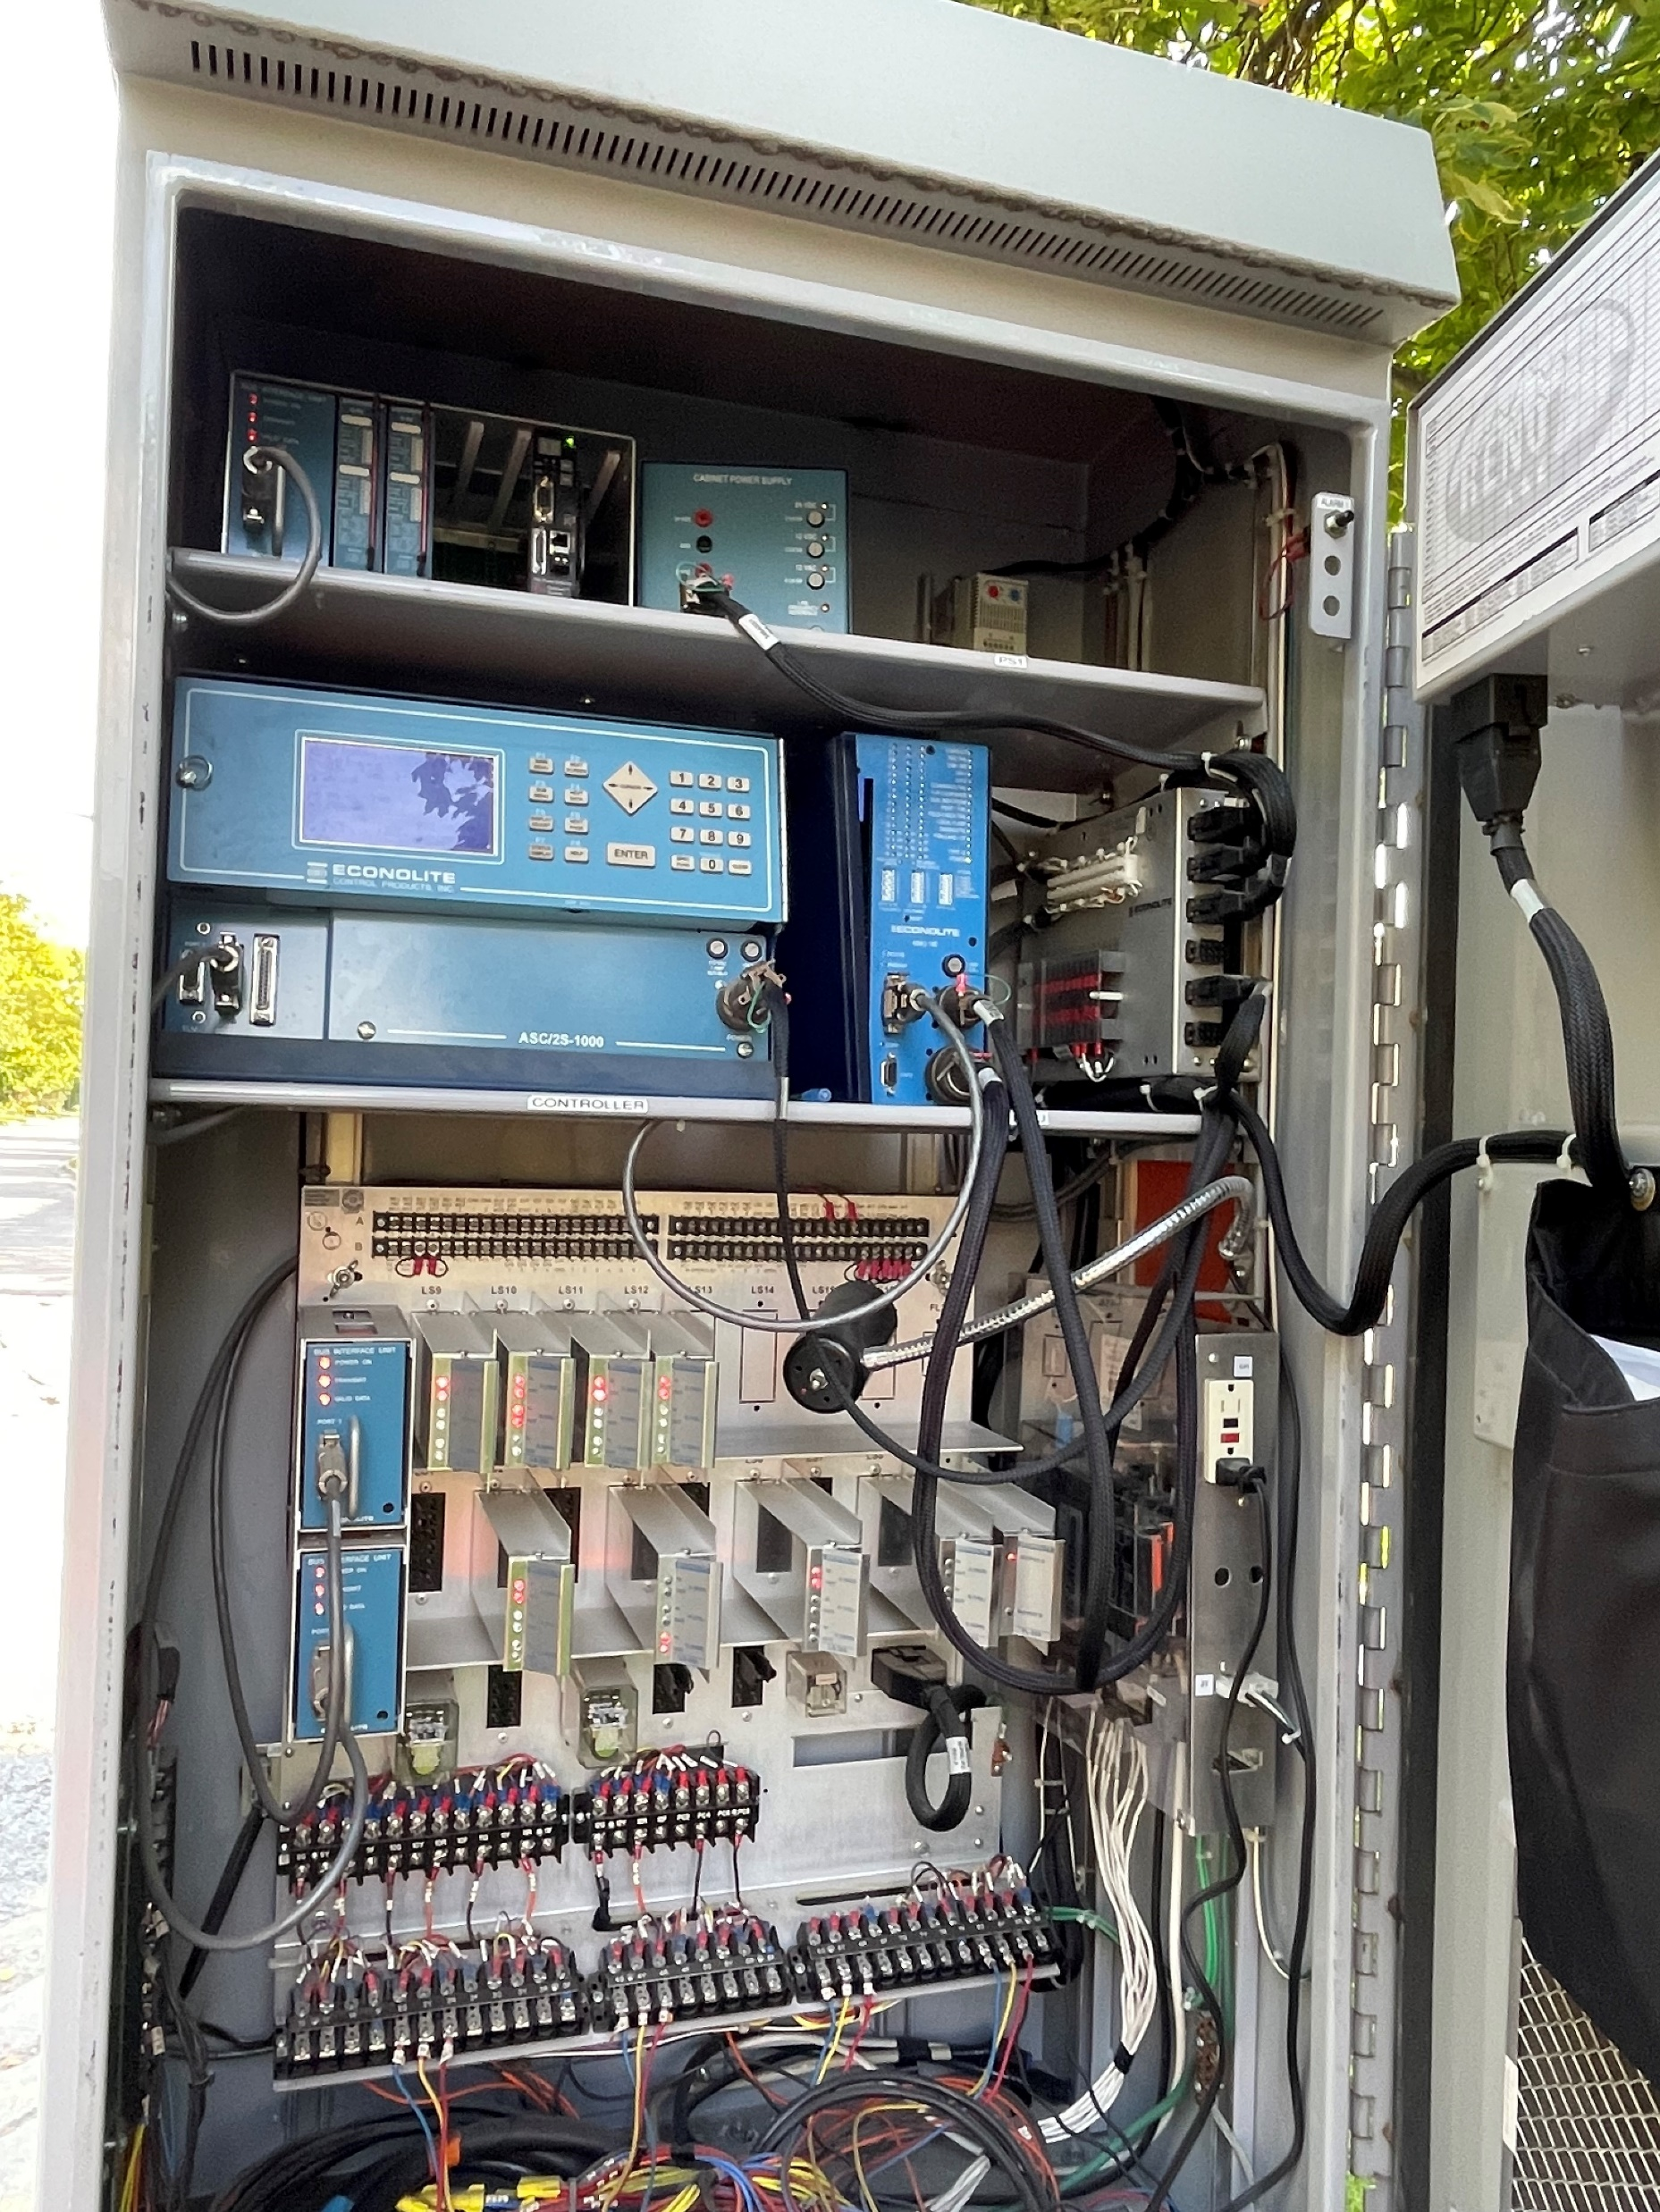
Public Works – Service Areas
Fleet repair and maintenance
Bridges and culverts
Grass cutting and weed spraying
Brush and tree removal
Ditching and Stormwater drainage
Pavement management
Crossing guards
Gravel road maintenance
Winter maintenance
Traffic signs and signals
Line painting
Sidewalks
Cemeteries
Notes:
As you can see, Public Works had a number of responsibilities throughout the year.
In addition to these core activities, we also help with some Engineering Capital projects, Environmental services activities and other various requests that come in from other departments or other partners.
Let’s take a closer look at some of these.

Slide 15
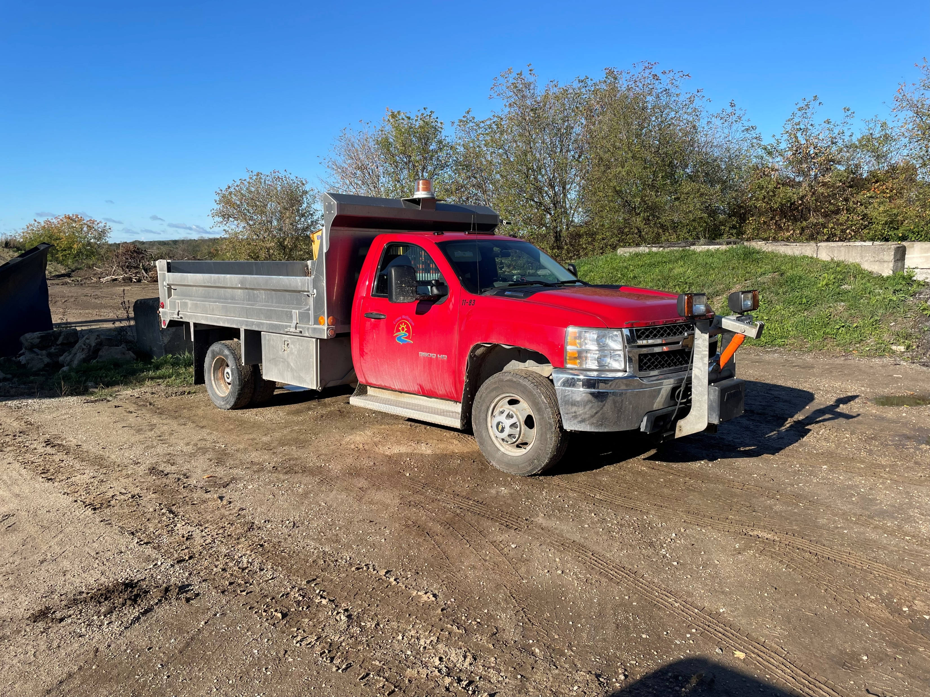
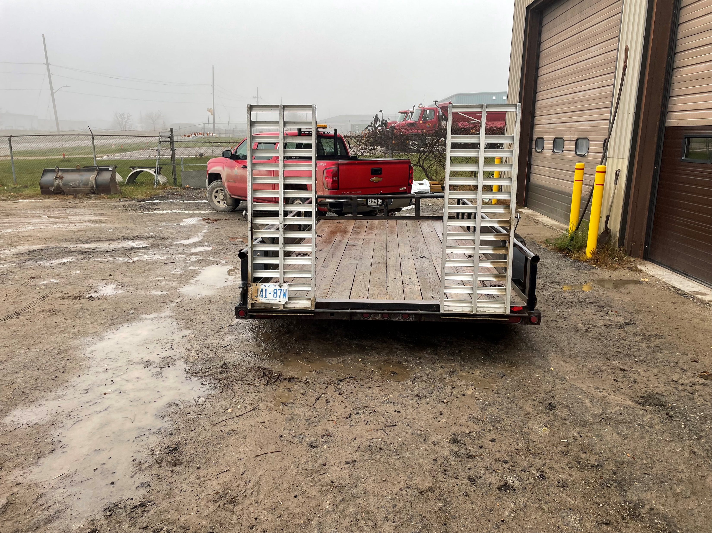
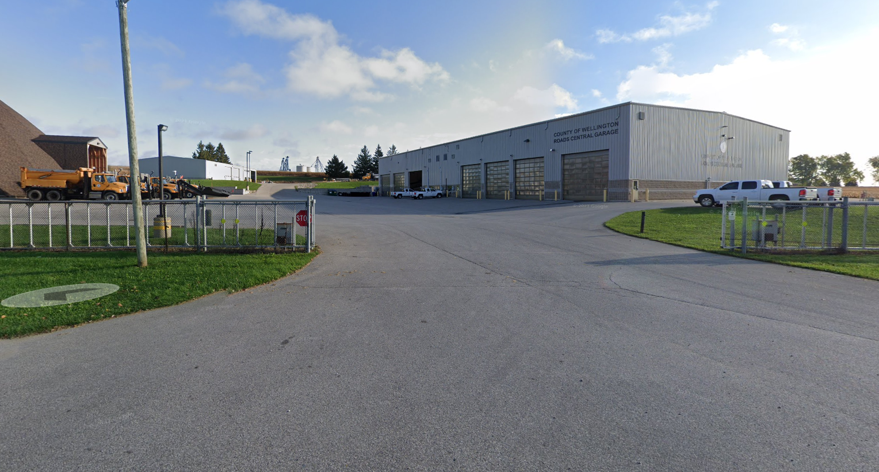
Fleet repair and maintenance
13 plow trucks
4 graders
3 backhoes
1 loader
5 sidewalk tractors
4 riding mowers
2 street sweepers
10 pick up trucks
Assist with other departments vehicles
Shared services agreement with County
Notes:
In order to complete the variety of tasks, we have a wide-range of equipment to get it done.
Plow trucks that haul gravel in the summer. Backhoes might clear snow in parking lots in the morning, and dig a grave in the afternoon.
Our staff do a great job keeping up on maintenance of their equipment. In 2021 we signed a shared services agreement with the County for repairs and annual inspections that require a licensed mechanic. It’s only been a few months with this arrangement, but it’s already proven to be a great resource to have that level of expertise looking at our assets from an owner perspective.

Slide 16
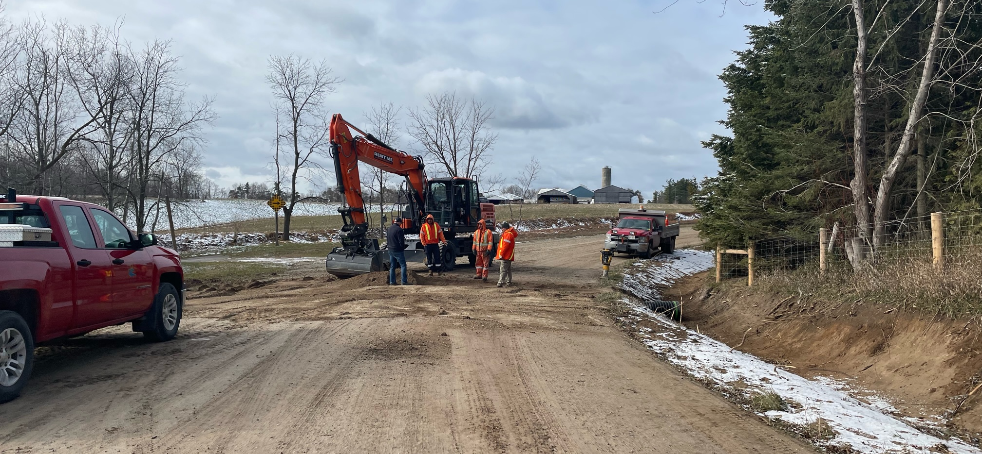
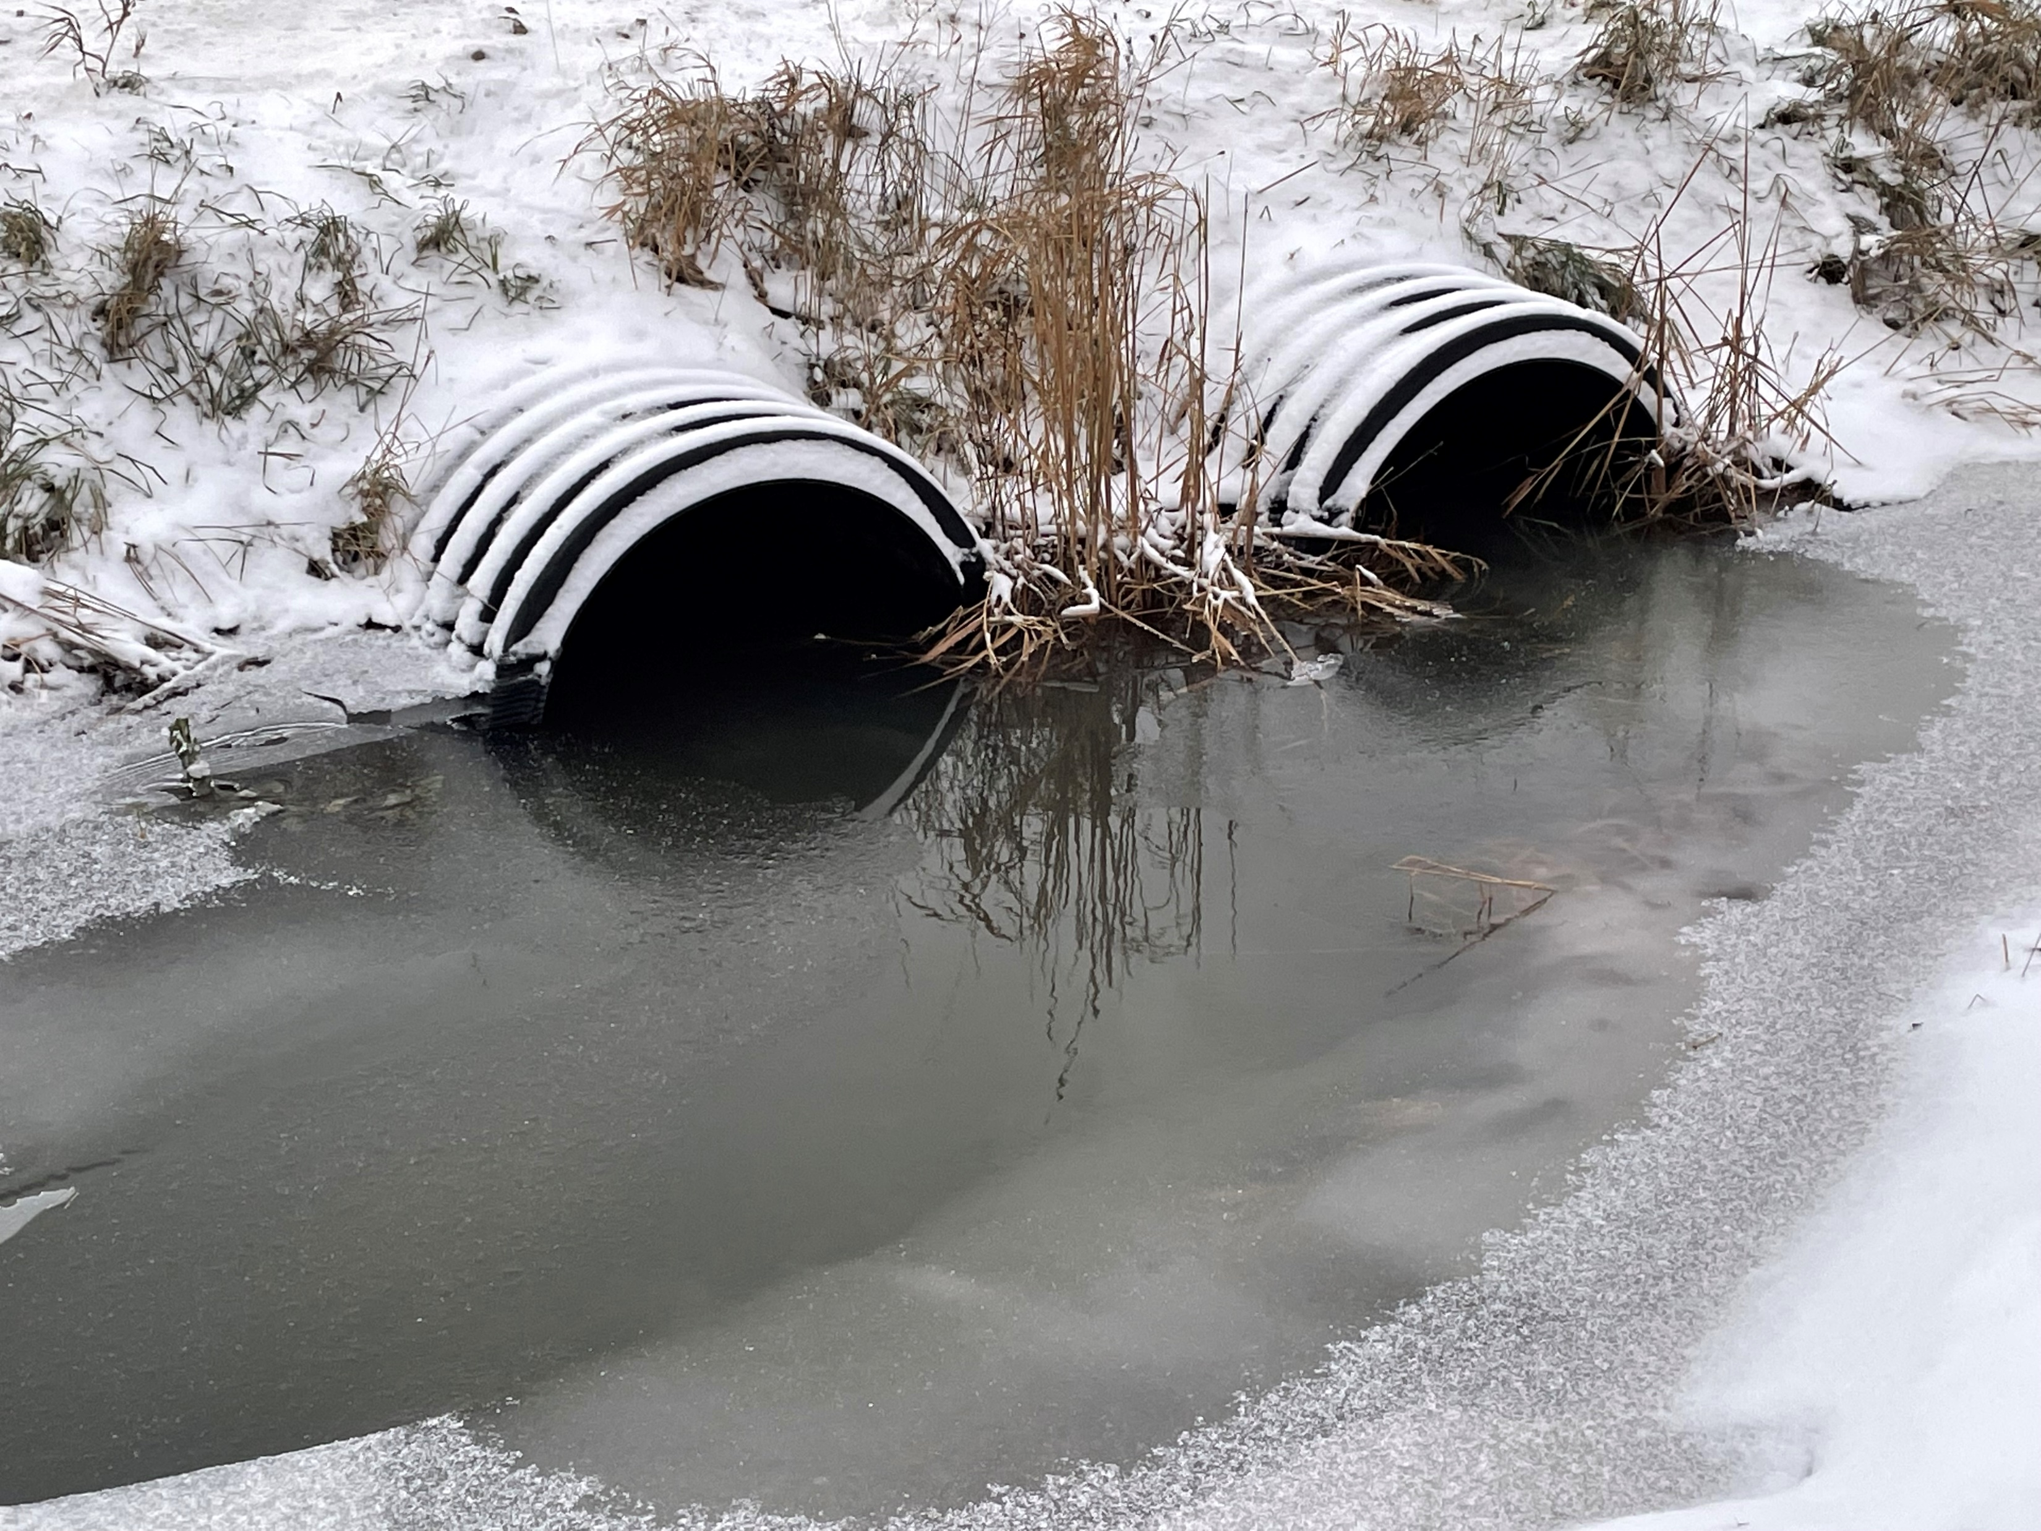
Ditching and stormwater drainage
Annual ditching program to keep water flowing in rural areas
React to new issues arising during spring run off
Replace and upgrade culverts as required
Notes:
In addition to the many major structures such as bridges and large concrete culverts, the Township is responsible for countless other cross-road and driveway culverts that keep water flowing where it needs to go. Proper drainage may be the most critical factor in keeping roads in good condition over their lifetime. When road bases aren’t able to drain it creates all kinds of problems.
Public Works staff clear ditches and replace culverts based on inspections and observations from spring run-off.

Slide 17
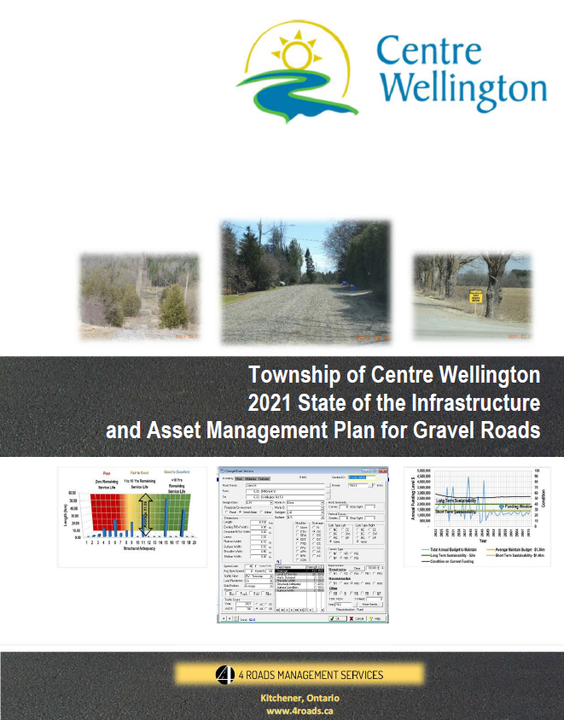
Gravel roads maintenance
2021 report by 4Roads
Treatments
  Annual dust suppressant: Calcium
  Annual maintenance gravel
  Rebuilds
  Conversion to hard surface
  Tar and chip (double surface treatment)
Lifecyle cost higher than asphalt roads
Optimal level of funding for gravel roads: $2M annually
Notes:
In 2021 we received a report identifying the condition and some recommendations for our gravel road network. This helps to inform our approach to keeping our 200 km of gravel roads maintenance as well as possible with the funding available.
Gravel roads require dust suppressant every spring to keep the road in tact and livable for residents. They also required additional gravel every 2 to 4 years depending primarily on the volume of traffic. In some situations it’s also necessary to build up gravel roads. In other circumstances it is beneficial to convert to an asphalt road or apply a surface treatment.
Most people don’t realize that while asphalt roads do cost more for initial construction, gravel roads actually cost more to build and maintain over the lifecycle of the asset. Optimal funding for our gravel roads is about $2M annually.

Slide 18

Winter maintenance
All snow removal
  Some lots are contracted out
24 hours coverage Monday to Friday
Weekend patrol / monitoring
Priority roads based on MMS Classification
Notes:
Public Works is responsible for all snow removal activities, including Township owned parking lots. Some lots, i.e. Sportplex, are contracted out, while other are part of our routes.
Although we’ve been clearing snow for generations, we’re continuously reviewing our operations to find efficiencies and adjust routes for new subdivisions coming online.
As mentioned previously, we monitor weather forecasts and actual road conditions according to the provincial minimum maintenance standards. When there’s snow to deal with, staff typically start early to get a head start on priority roads and sidewalks in school areas.
This is your first formal invitation to come for a ride-along with one of our operators. To get the full experience, I’d recommend a 5 a.m. start, but anytime there’s snow out will give you a brand new appreciation for what our professional drivers encounter.

Slide 19
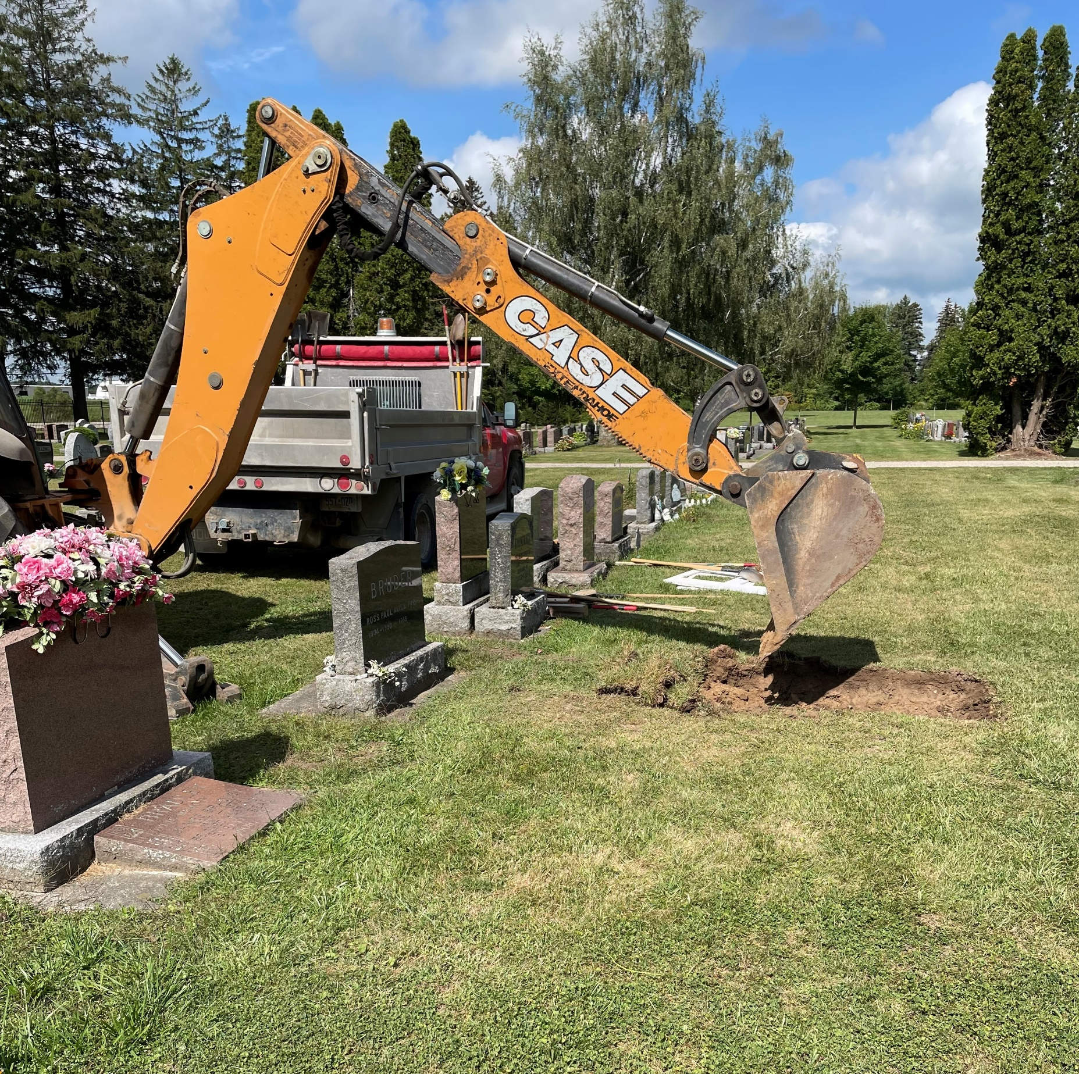
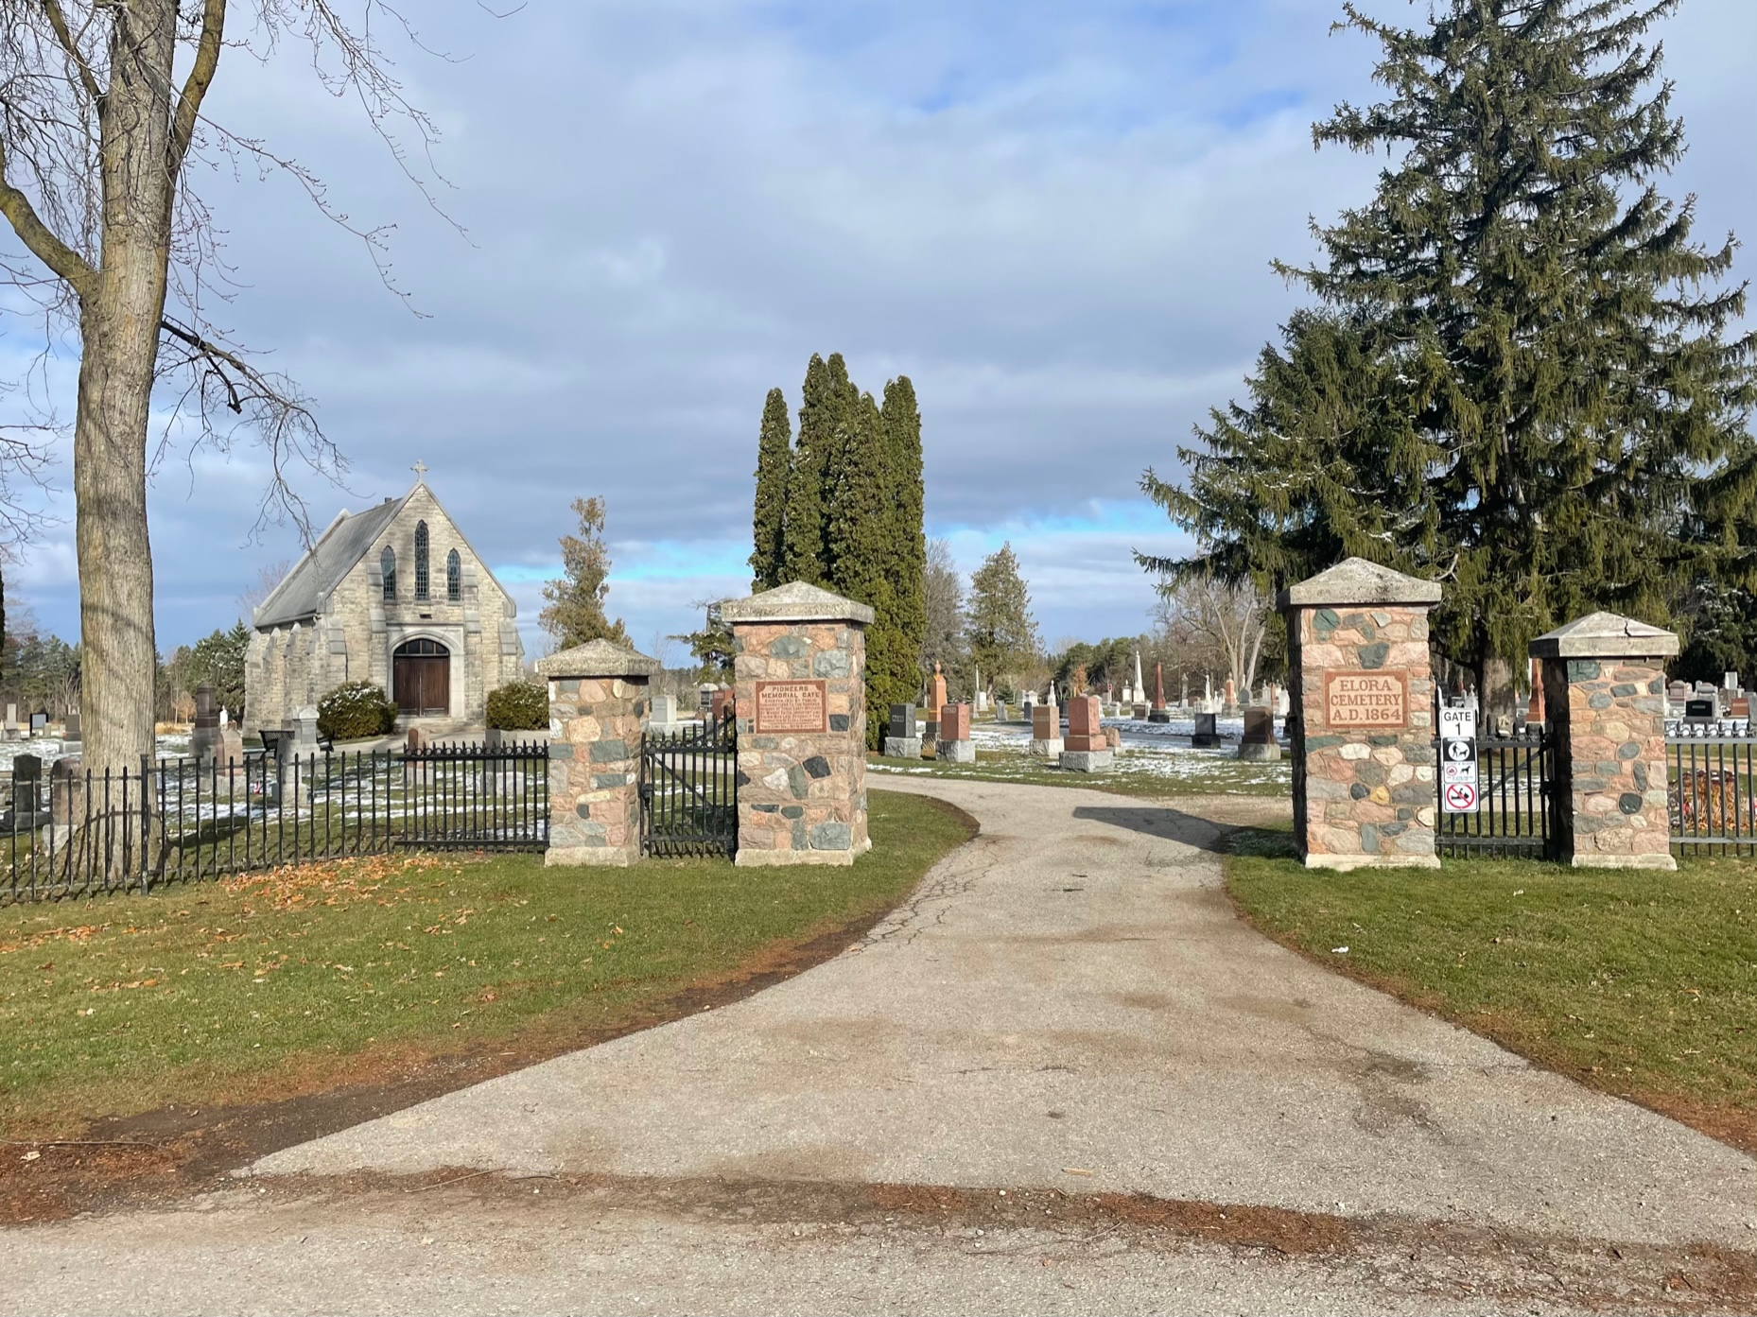
Cemetery Maintenance
Grass cutting / trimming
Burial – full and cremation
Foundation repairs
Belsyde Cemetery
Elora Cemetery
Notes:
In addition to all the other operational activities, our Public Works staff take pride in being there for our community in caring for our cemeteries. Our students keep the grass cut and trimmed, and our full-time staff are there for funerals from full burials to openings in a columbarium.
In addition to Elora and Belsyde Cemeteries, we have a handful of historic rural cemeteries that we maintain.

Slide 20
Thank you!
Questions?
Adam Gilmore, P.Eng., Manager of Engineering
agilmore@centrewellington.ca
519-846-9691 x301
John Gaddye, C.E.T., Manager of Public Works
jgaddye@centrewellington.ca
519-846-9691 x313

