Slide 1
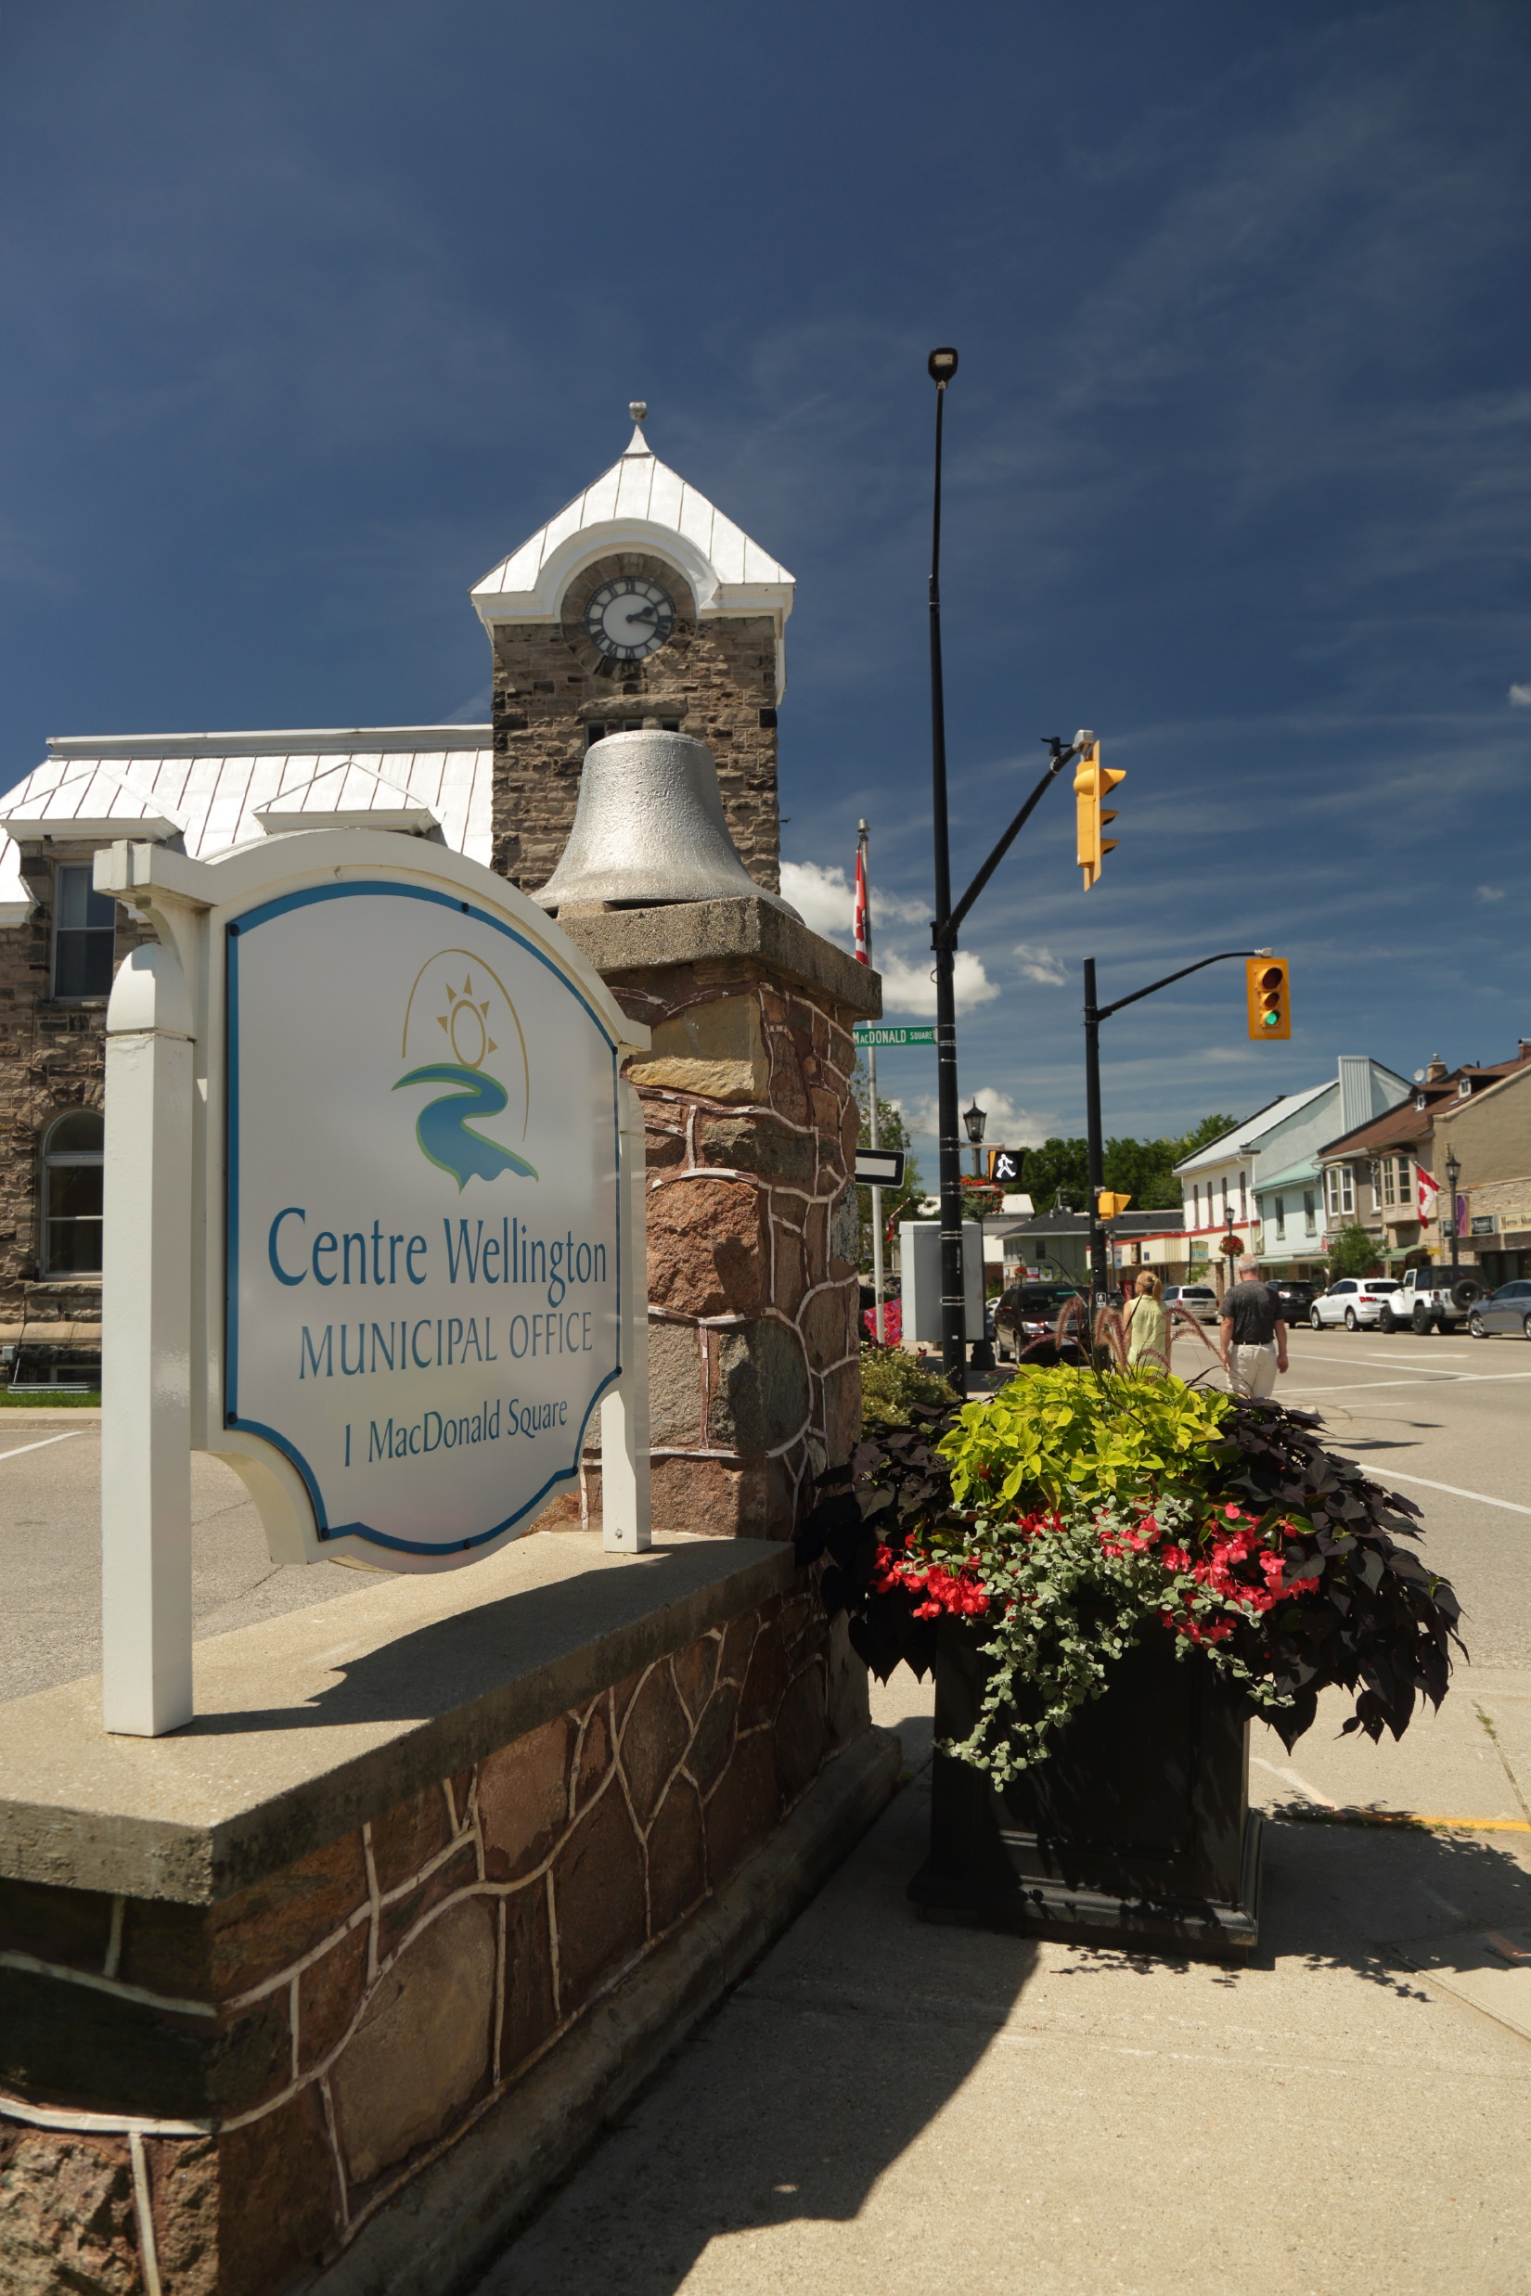

Finance, Purchasing & Risk, and Information Technology (IT)
Council Orientation
Nov.29

Slide 2


Financial Services

Slide 3
Agenda – Financial Services
Meet the Team
Division Overview
Core Services
Current Projects
Other Issues

Slide 4
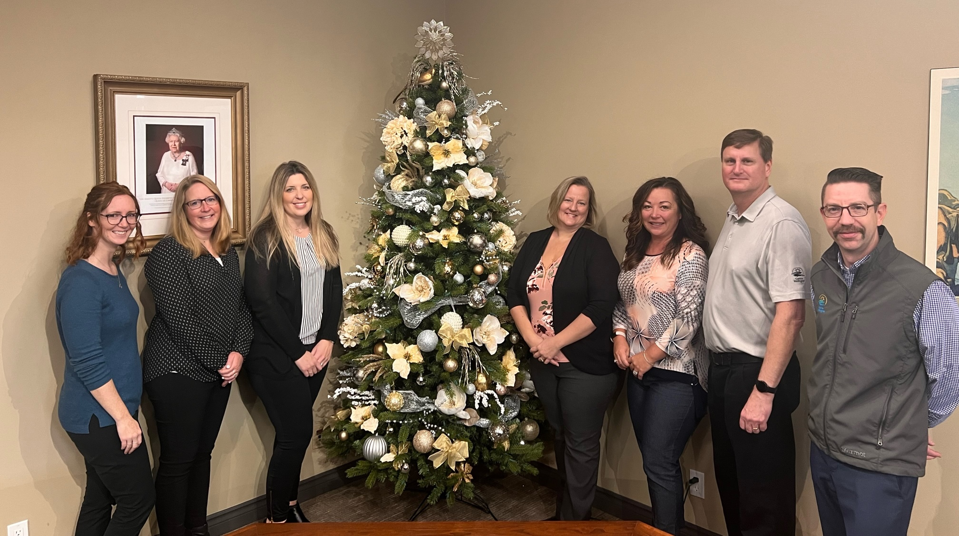
Meet the Team – Financial Services

Slide 5
Division Overview – Financial Services
Financial Services manages the Township’s financial resources in a fiscally responsible manner
  Includes CW Communications a Wholly Owned Subsidiary Corporation
Support other departments with financial expertise
  Budget Process, Council Reports, Studies, Asset Management, Variance Analysis, Grant Funding Applications and Reporting, etc.
Collection of property taxation on behalf of Wellington County, School Boards, and the Township

Slide 6

Core Services – Financial Services
Accounting & Financial Reporting
Annual Budget Process
Property Taxation & Assessment
Asset Management Planning
Investments & Borrowing
Financial Policy Development
Development & Other Securities
Development Charges Administration

Slide 7
Current Projects – Financial Services
2023 Budget Process Underway
Service Delivery Efficiencies
  Expanding EFT for Both Cash Receipts and Payments to Vendors
  Investigating Commercial Tax Due Dates Coinciding with Residential Dates
  Investigating Online Billing for Taxation
Asset Management Planning
  Strategic Asset Management Policy Approved in 2019
  Internally Prepared Asset Management Plan Approved in June 2022
  Continuously Updating the Plan With New Information
Year-end Preparation

Slide 8

Other Issues – Financial Services
Focus on Reducing Pressure on Property Taxation
  Find alternate sources of revenue
Growing and More Complicated Taxation Administration
  County assistance with assessment
Integration of Asset Management Planning
Detailed Budgeting
  Multi-year Capital and Operating Budgets
  Significant Source of Information
  Transparent

Slide 9
Purchasing & Risk

Slide 10
Agenda
Meet the Team
Division Overview
Core Services
Trends
Role of Elected Officials

Slide 11
Meet the Team
Sandi Wiles
Purchasing & Risk Supervisor
over 20 years of experience in municipal government environment – all within legal and/or procurement departments
joined Centre Wellington team in 2016

Slide 12
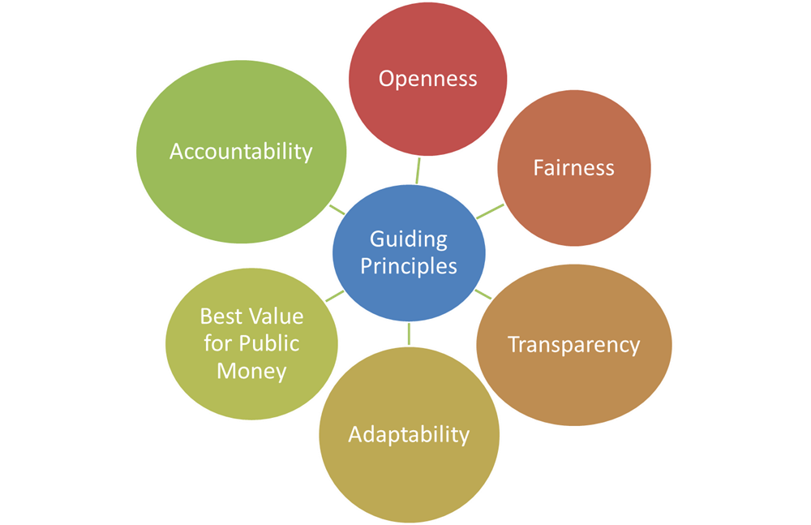
Division Overview
Purchasing
  Centralized Township Procurement – ensures consistent application of purchasing policy across the corporation in accordance with the Principles of Public Procurement
Risk Management
  Placement and administration of all Township Insurance Coverages
  Internal Processing of Claims
    Personal Injury (i.e. slip/trip and fall, motor vehicle accidents)
    Property Damage (i.e. vehicle damage caused by potholes & other road hazards, sewer & water damage)
    Professional Liability claims

Slide 13

Core Services
Purchasing
  Development and maintenance of bid document templates
  Development and review of formal contract documents
  A resource for development of bid specifications
  Assist in determining best procurement method based on type of purchase
  Follow-up with vendors (debriefs, performance evaluations)
  Participation in co-operative purchasing initiatives with other government or broader public sector entities
  Review of case law, industry best practices and state law affecting purchasing
  Administration of Township’s Purchasing Card Program

Slide 14
Trends affecting Purchasing & Risk
Legislation – new legislation and revision of current trade agreements affecting public procurement
ESG (Ethical, Social and Governance) – procurement that includes ESG principles ensuring business with suppliers is conducted in a manner that aligns with corporate social responsibility strategies
Green Procurement - the commitment to the purchase of goods and services with due regard to the preservation of the natural environment and to encourage the use of environmentally friendly products and services
Social Procurement - purchasing that is intentionally directed toward promoting health and safety, local economic development, diverse and minority groups, social enterprises or other measures that improve the well-being of individuals and communities
Non-binding RFPs – process whereby a bid is not binding on either the owner or the bidder but a contractual negotiating framework between the buyer and the owner as they work toward a definitive purchase and sale agreement
Inflation increasing the cost of materials, labour shortages, supply chain delays and shortage of materials is causing significant increase in tendered pricing for all procurements, but especially noticeable in construction procurements
Insurance – increasing costs of general insurance program and availability of other forms of insurance, i.e. cyber insurance

Slide 15
Role of Elected Officials in the Procurement Process
It is the role of Council to adopt a Purchasing & Procurement Policy and to approve expenditures through the Township’s budget process. Through this Policy, Council can delegate to Township staff the authority to make expenditures in accordance with approved policy thresholds, or have staff bring reports to Council for consideration and award.
To avoid the potential appearance of bias or political influence in procurement, members of Council should have no involvement in the Competitive Bid Processes. This includes from the time an opportunity has been initiated until a contract has been entered into with a contractor, except where Council is presented with a recommendation to approve a contract award in accordance with the Policy.
The Township’s procurement activities must be conducted with integrity and in accordance with purchasing ethics, as well as the Municipal Conflict of Interest Act, RSO 1990, cM.50, as amended.

Slide 16
Information Technology

Slide 17
Agenda
Department Structure
Division Overview
Core Services
Current Projects
Trends
Notes:
As we introduce our department today, we will explain our department structure, give an overview of our division, explain the core services we provide to the Township, highlight some of our current projects, and discuss some of the trends our department has encountered over the last few years.

Slide 18

Department Structure – Information Technology
Managing Director of Corporate Services & Treasurer
Manager of IT
Supervisor of IT
System Analyst
Support Technician
Application Support Analyst
Notes:
The Information Technology department is a part of Corporate Services, reporting to the Managing Director of Corporate Services and Treasurer. The IT department has 5 staff members, led by the Manager of IT.
The Manager of IT oversees the day to day operations of the department, and determines the departments strategic objectives, in conjunction with senior management. 4 Staff members report to the Manager of IT:
The Supervisor of IT, who oversees all of the Township IT infrastructure
The Systems Analyst, who provides desktop support for Township staff
The Support Technician, who maintains and supports our Network Infrastructure
The Application Support Analyst, who develops, maintains and supports Township software applications

Slide 19
Division Overview – Information Technology
IT Support for all Township Departments
Protect Township from Cyber Security Threats
Maintain Township Water / Wastewater SCADA Systems
Implement New Technology Projects to Automate Staff Processes and Find Efficiencies
Shared IT Services for the Town of Minto and Centre Wellington Hydro
Technology Training for Township Staff
Notes:
The IT Department provides IT support and Technology training for Township users. We protect Township users and infrastructure from various cybersecurity threats. Throughout the year, we complete many projects to implement new systems that automate existing processes and create efficiencies for Township staff.
The IT department also maintains the Water/WW SCADA system for the Township, and provides Shared IT services for 2 other local, municipal organizations – the Town of Minto and Centre Wellington Hydro.

Slide 20
Core Services – Information Technology
The Information Technology Department provides the following services to the Township:
Hardware and Software Support and Maintenance (Help Desk)
IT Related Training (i.e. application software, cyber security, etc.)
Automation of Township Processes
Effective Information Access, Controls, and Security
Server/Network Management
Telecommunications Management
Assist with Contingencies with respect to Business Continuity and Disaster Recovery
CW Communications – Fibre Network
IT Related Policies, Processes, and Budget Needs
Notes:
Core services provided by the IT department are:
Help desk support for computer issues
IT training for software applications, AV equipment, cybersecurity, mobile devices and more
Server and Network Management
Telecommunications management
Business Continuity and Disaster Recovery
And maintaining the Centre Wellington Communications Fibre Network

Slide 21
Current Projects– Information Technology
Extending the public Wi-Fi Network
Implementing software for additional online resident services such as:
Cyber Security Training Campaign
Teach staff to recognize and defend against phishing emails, business email compromise, ransomware, and other common threats
Online Tax Billing
Online Building Permit Applications
Online Bylaw Complaints
New Intranet site for Township staff
Configuring, deploying and training staff on a new, internal web portal used to collaborate across various departments
SCADA Switch Replacement
Replace aging switch hardware in order increase resiliency of SCADA sites in the Township Water / Waste Water network
Notes:
Current projects underway in the IT department include:
Extending the public Wifi-Fi Network so that residents and visitors can access free public wi-fi in additional Township locations

Slide 22
Trends– Information Technology
In the last few years, the IT department has adapted to meet the following trends, influenced by the Covid pandemic:
Cyber Security
  Increased need for municipal IT departments to focus on protecting themselves from cyber attacks
  End user training – teaching staff to be the “last line of defense” in the Township’s cyber protections
  Protection of endpoints outside the office, as more staff work from home
Work From Home
  Staff need to be able to provide the same level of service to residents at home as at the office.
  This requires secure access to Township systems while staff are working outside of Township networks
  IT configures required hardware, software and security tools to allow staff to successfully work from home
Providing Online Services to Residents
  Residents expect to be able to access more Township services online, replacing the need for in person visits to Township offices.

Slide 23
Thank you!
Notes:
We hope you enjoyed your introduction to the IT department -

