Slide 1
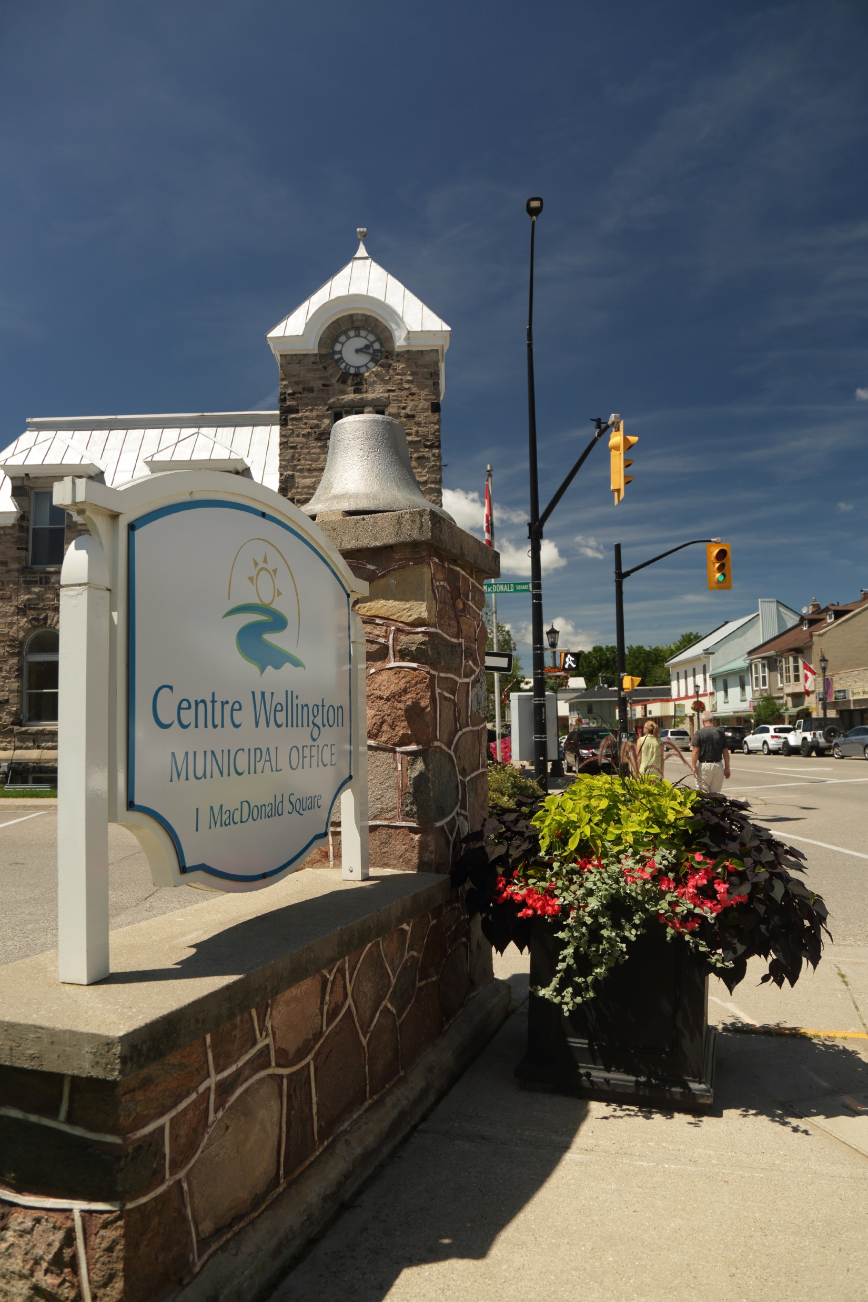


Planning & Development

Slide 2
Agenda
What does the Planning Department do?
What role does Heritage Conservation play?
What does the Building Department do?
What role does Economic Development play?

Slide 3

Planning Department

Slide 4



WHAT IS PLANNING?
Managing change and promoting efficient land use and development to achieve:
Healthy, strong, communities
Protection of the environment
Promote and facilitate economic growth

Slide 5
OUR RESPONSIBILITIES
Manage the review of development applications
Creation of Policies
Official Plan Amendments
Zoning Bylaw Amendments
Minor Variances
Site Plans
Part lot control
Land Severances (Consents)
Subdivisions
Condominiums
Official Plan Policies
Zoning Bylaws
Development Standards
Design Guidelines

Slide 6


ROLES IN PLANNING
GOVERNMENT
PUBLIC
APPLICANTS
Provincial government passes legislation, policies, plans, and forecasts for upper/lower tier municipalities
Attend public consultations to stay informed on any changes coming to their communities
Submit planning applications to different tiers of government for development proposals

Slide 7
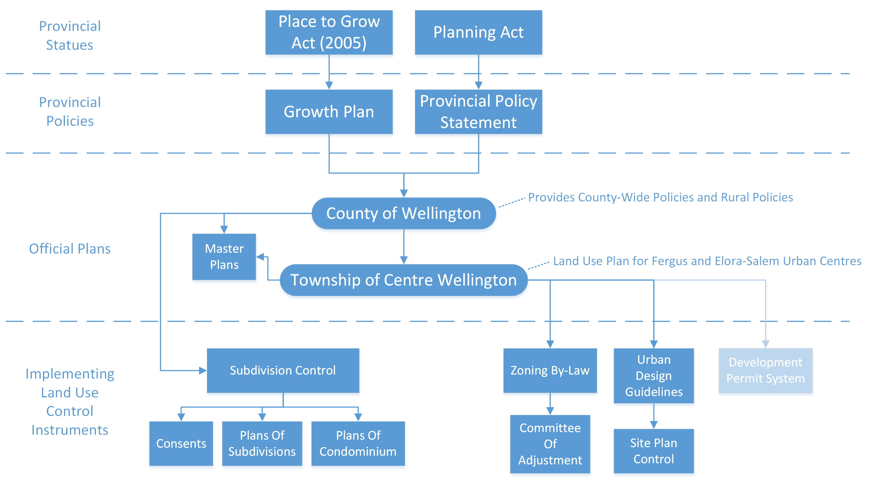
PLANNING FLOWCHART
Framework for land use planning in Ontario
Provides policy direction on matters of provincial interests related to land use planning
Land Use Plan for Fergus and
Elora-Salem Urban Centres

Slide 8
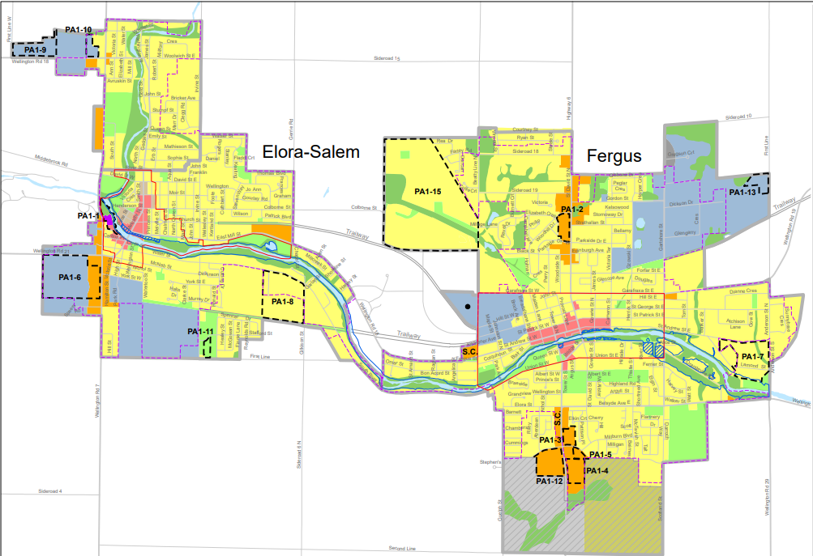

WHAT IS AN OFFICIAL PLAN?
Contains policies on how land in your community should be used
Prepared with input from the community
Adopted by council

Slide 9
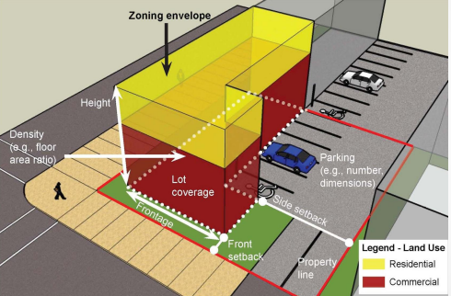
WHAT IS A ZONING BY-LAW?
Implements the policies of the Official Plan
Regulates: land use, location of structures, permitted uses, dimensions, parking requirements, setbacks, building heights, etc.
Amending a Zoning By-law
Zoning Bylaw Amendment
Minor Variance
Proposal to use or develop the property in a way that is not allowed by the zoning by-law
Proposal doesn’t conform exactly to the zoning by-law, but follows the general intent
Council
Committee of Adjustment

Slide 10

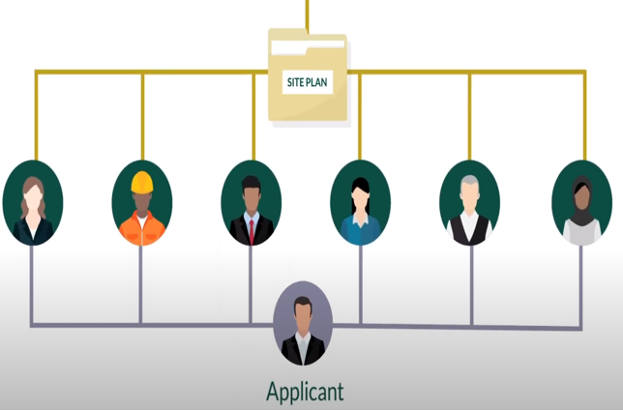
WHAT IS SITE PLAN CONTROL?
Council
Technical review process that looks at the design of a proposed development
Reviews Urban Design Guidelines
Reviews Zoning By-law Compliance
Reviews Transportation, Source Water, Services, etc.
Approval
Delegated
to Staff
Staff

Slide 11
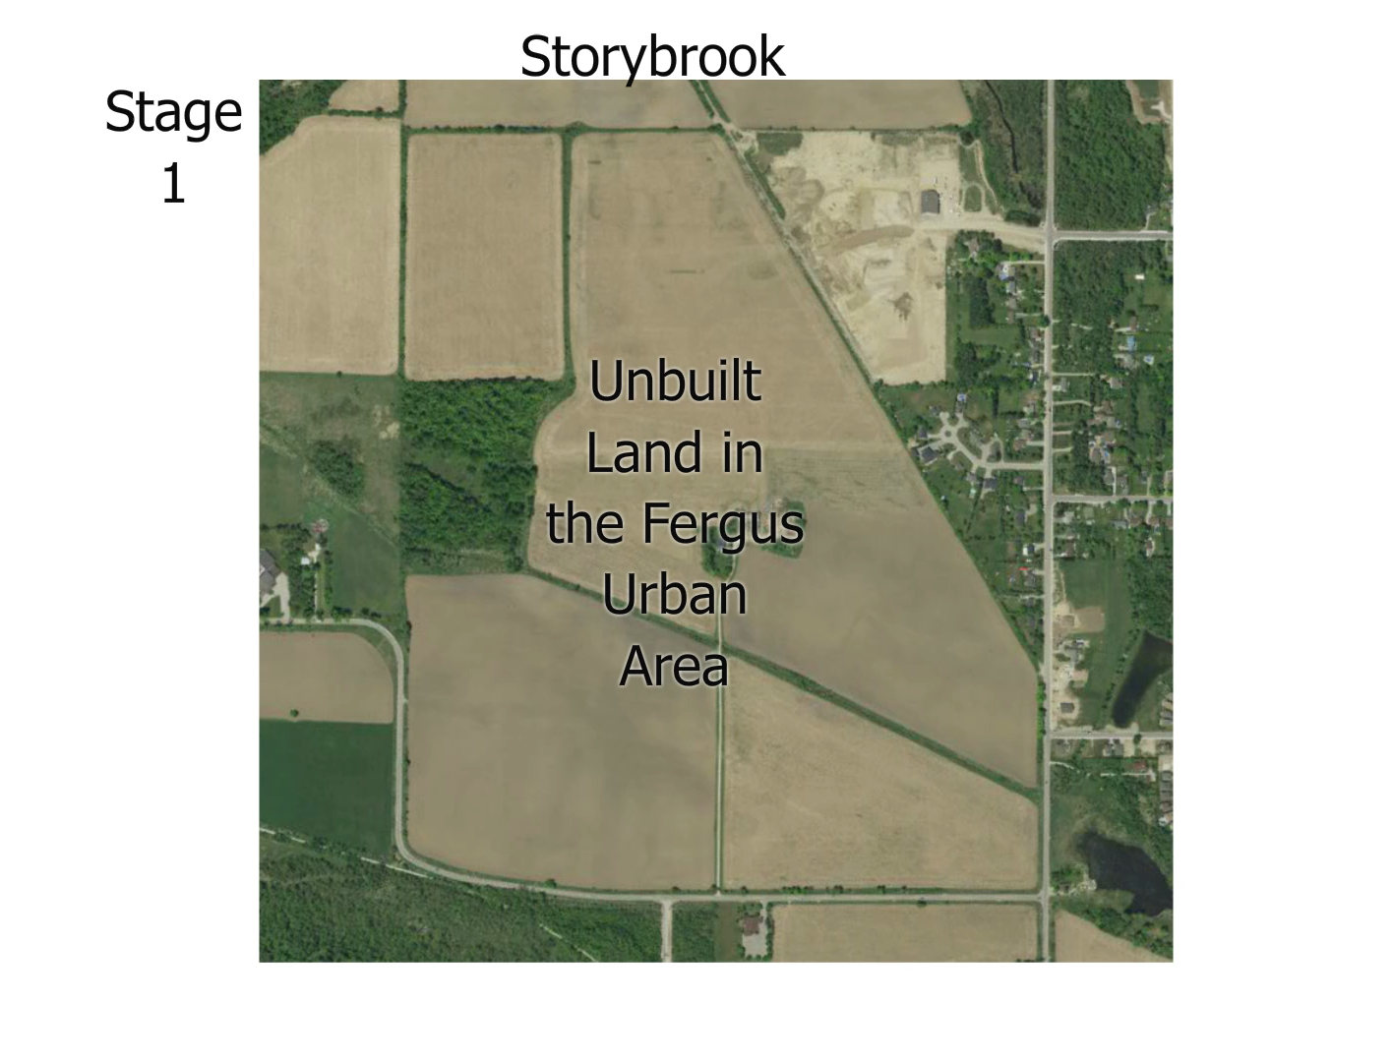
AN EXAMPLE OF THE PLANNING PROCESS FOR A SUBDIVISION

Slide 12
Heritage Conservation

Slide 13
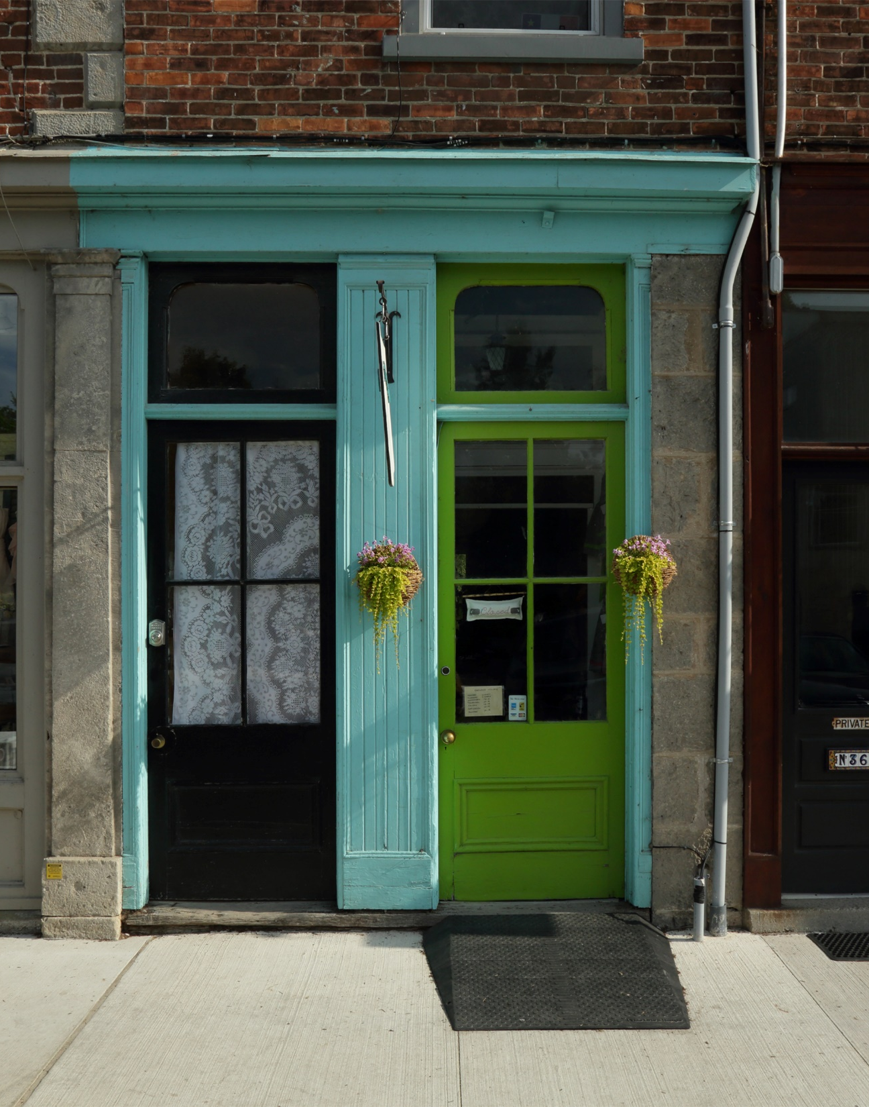
HERITAGE CONSERVATION
Why Conserve?
Local/National Identity and Community Impact
Tourism
Jobs and Economic Vitality
Sustainability and Climate Change

Slide 14
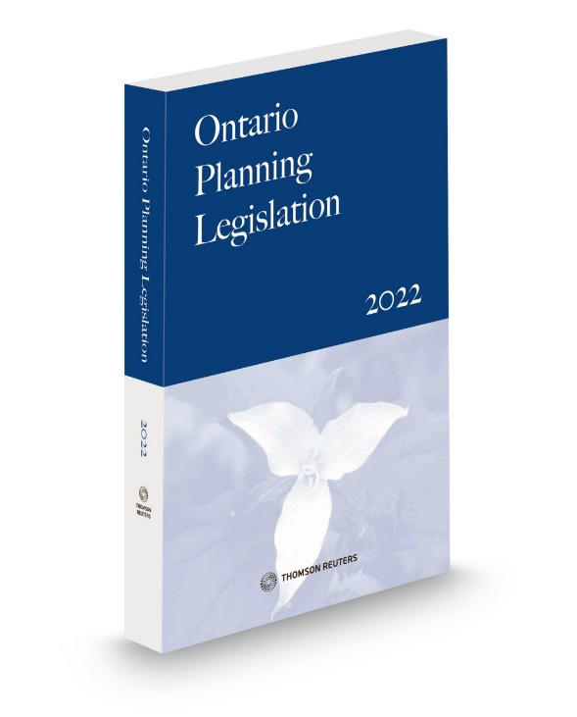
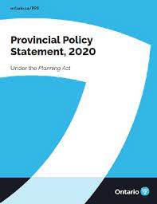
HERITAGE CONSERVATION
Provincial Heritage Mandate
Planning Act states council “shall have regard to”:
  the conservation of features of significant architectural, cultural, historical, archaeological or scientific interest
Provincial Policy Statement (PPS 2020) encourages heritage protection:
  “Significant built heritage resources and significant cultural heritage landscapes shall be conserved” (PPS 2020)

Slide 15
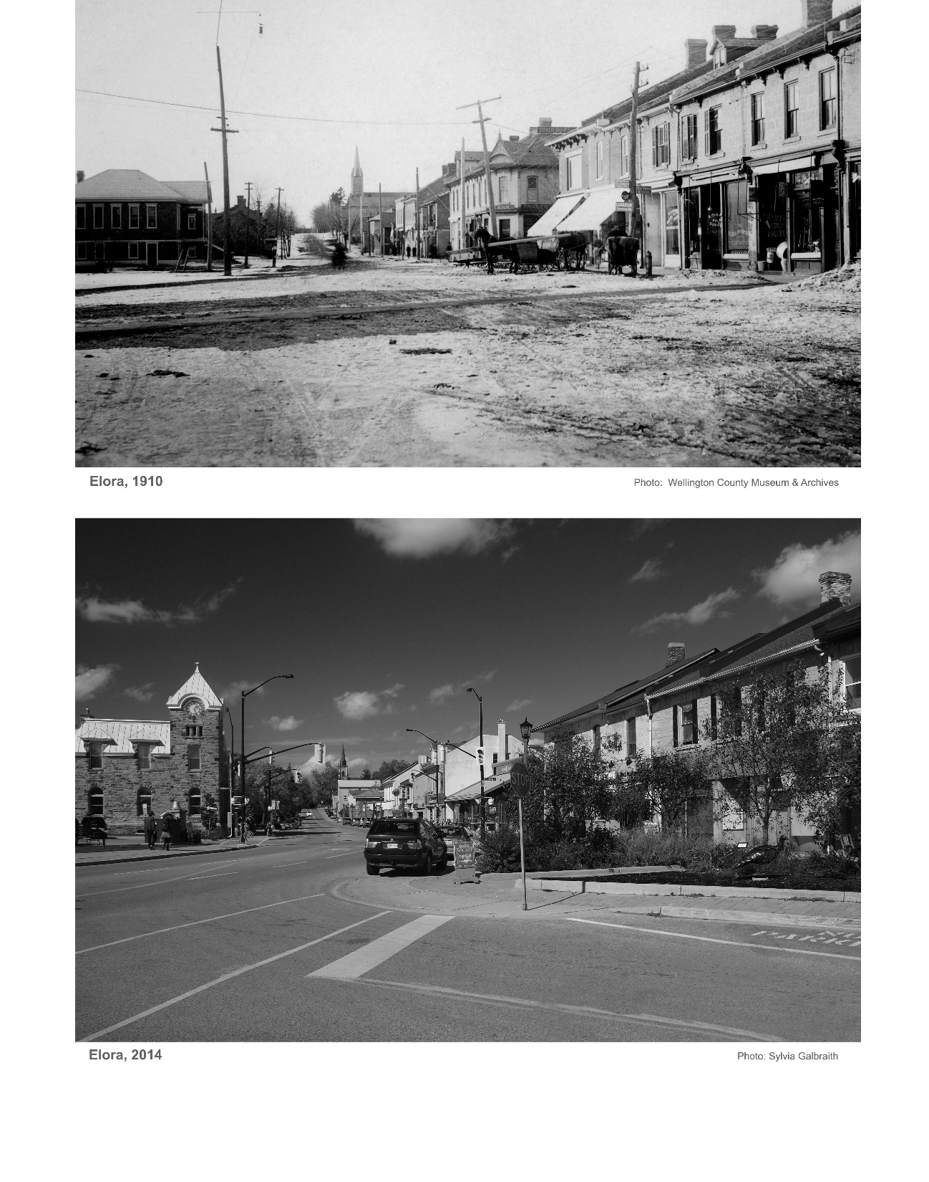
HERITAGE CONSERVATION
Heritage Conservation Planning
Managing change to historic places guided by well-established core principles and practices
Planning for the identification, protection and promotion of the heritage resources that we value

Slide 16
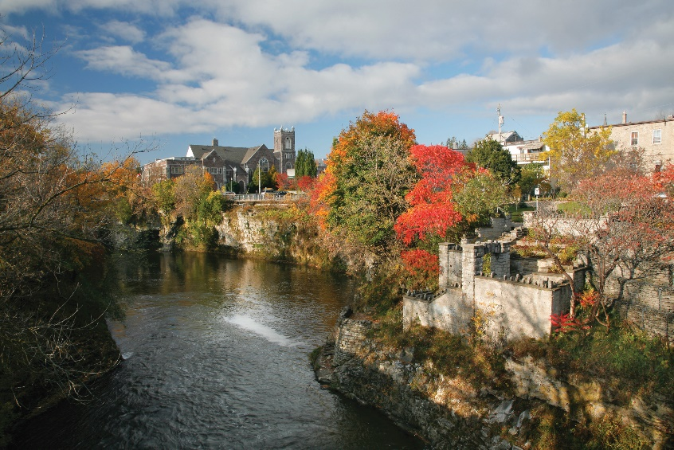
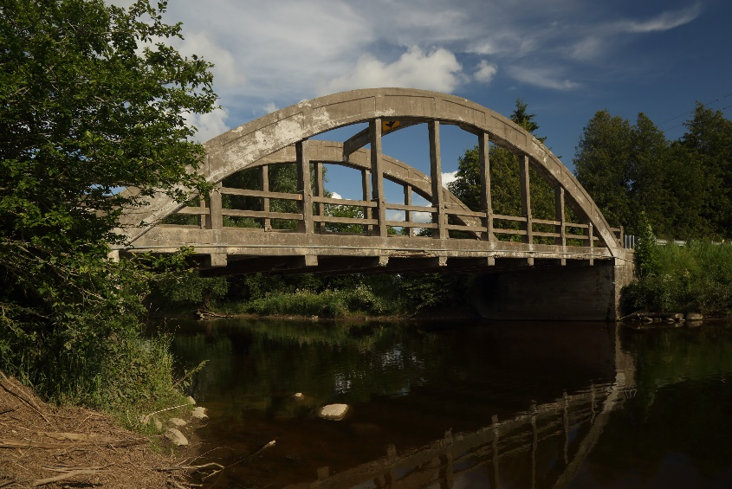
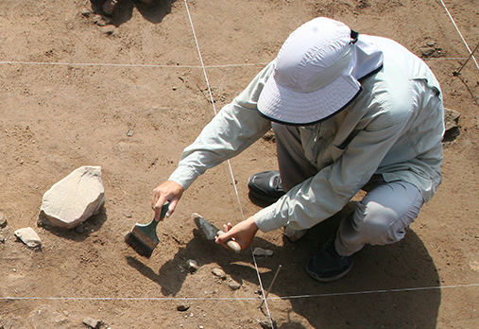
HERITAGE CONSERVATION
Ontario Heritage Act
  Give councils the power to protect:
    Individual properties
    Heritage conservation districts
    Archaeological resources
  Provides criteria for establishing heritage value and significance
  Provides rules for protection
  Establishes “Register”
  Establishes heritage committee

Slide 17
Building
Department

Slide 18
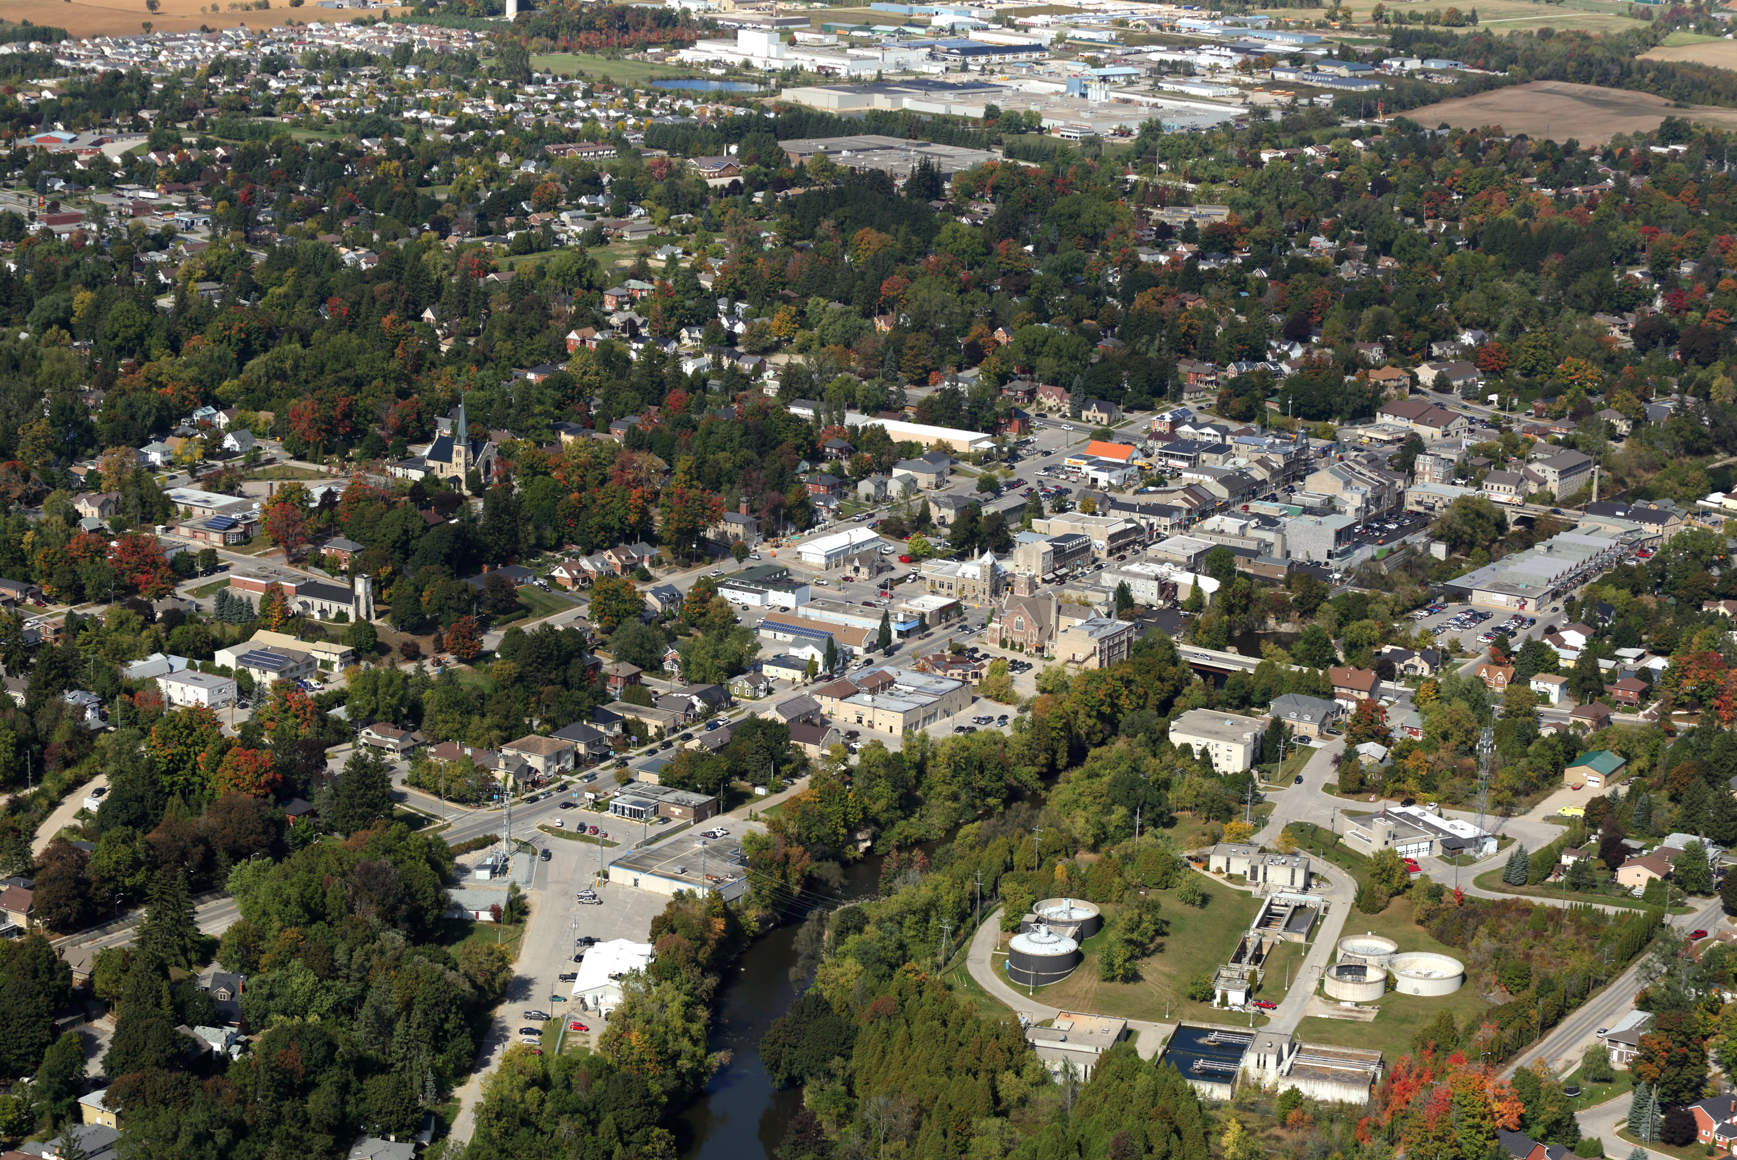
WHAT DOES THE BUILDING DEPARTMENT DO?
Enforces the Ontario Building Code by issuing permits for new buildings, renovations and changes of use
Other permits: pools, site alteration and signage
Provide information and guidance to the public
Investigate complaints of construction without a permit or unsafe conditions
Compliance enforcement

Slide 19
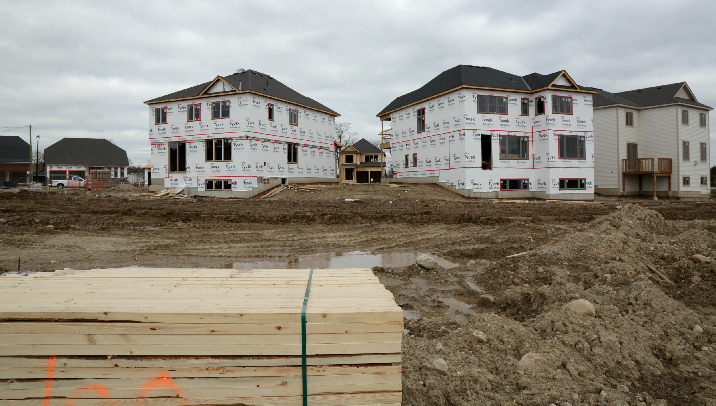
WHAT DOES THE BUILDING DEPARTMENT DO?
Periodic inspections of construction to ultimately ensure buildings are safe and accessible
Review of sewage and plumbing systems
Review of site plan applications
Enforces the Township’s Property Standards By-Law

Slide 20
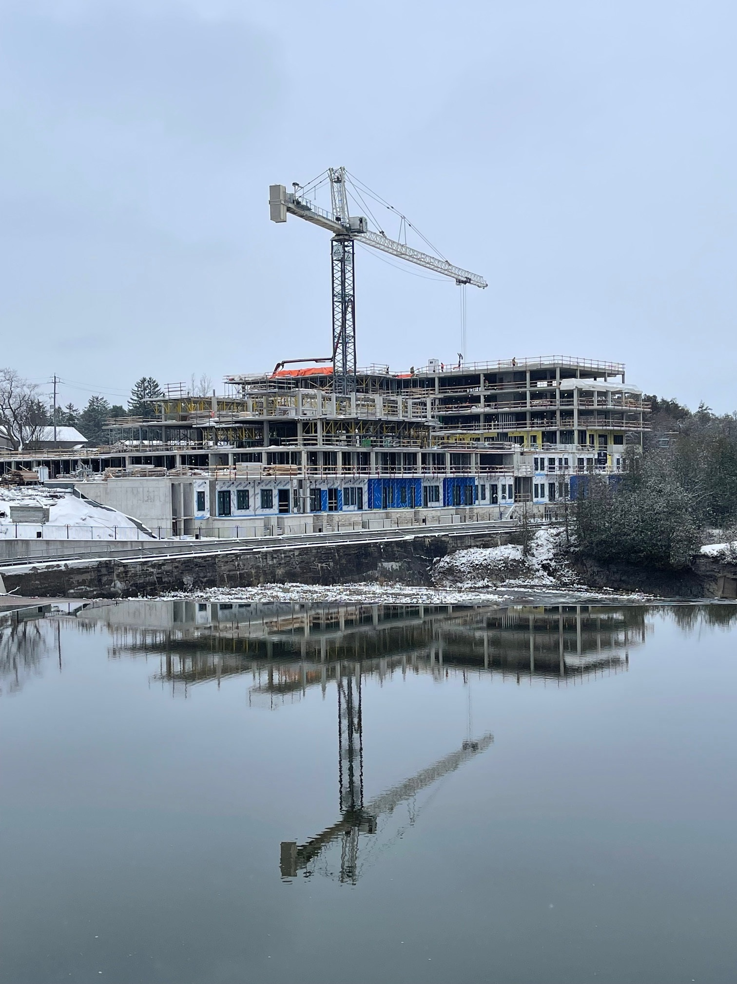
CURRENT PROJECTS
131 unit condominium (Pearle Hospitality) project in Elora
New 579,120 sq ft. industrial building in Elora
New University of Guelph Swine Research facility at the Elora Research Station
Implementing new City View Online Permitting Portal
Updating public information through handouts and website

Slide 21
Economic
Development

Slide 22
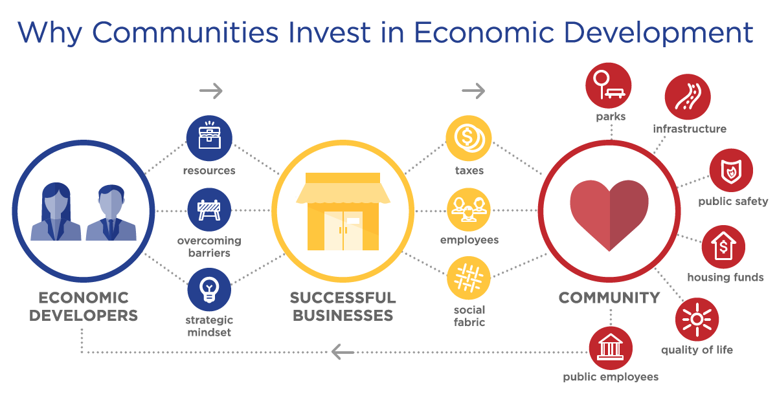
WHAT IS ECONOMIC DEVELOPMENT?

Slide 23
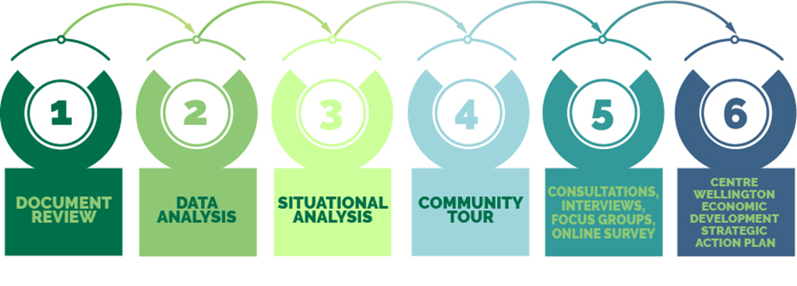
THE STRATEGIC ACTION PLAN PROCESS

Slide 24

KEY ACTIONS
Shop local
Business park
Available properties/buildings
Community improvement plan
Revamp Website
Community Profile
Fast Facts
Agriculture Zoning By-Law Amendment

Slide 25
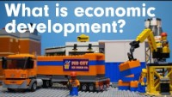
ECONOMIC DEVELOPMENT

Slide 26
Thank You

