Slide 1
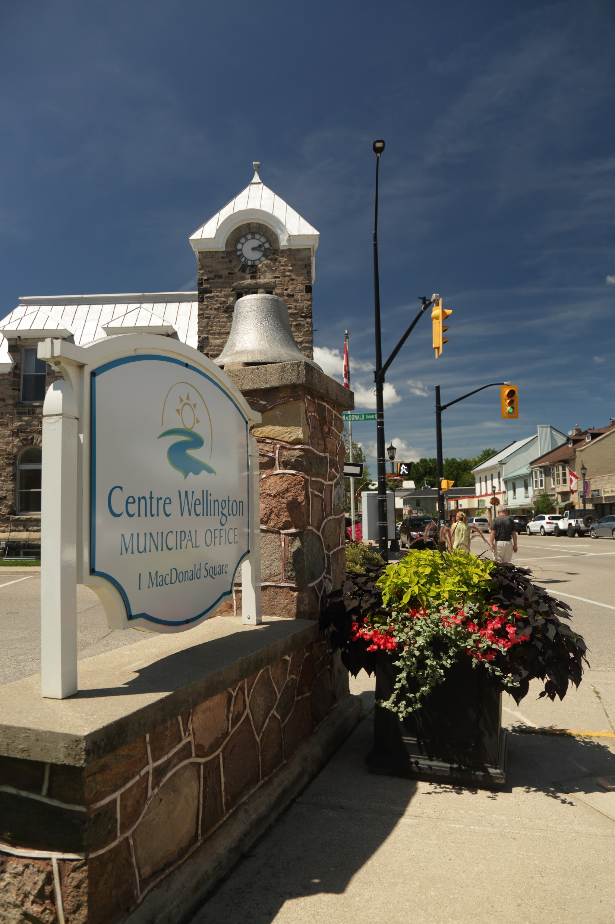

Council Orientation – Environmental Services and Source Water Protection
Kyle Davis and Dino Masiero
November 29, 2022

Slide 2

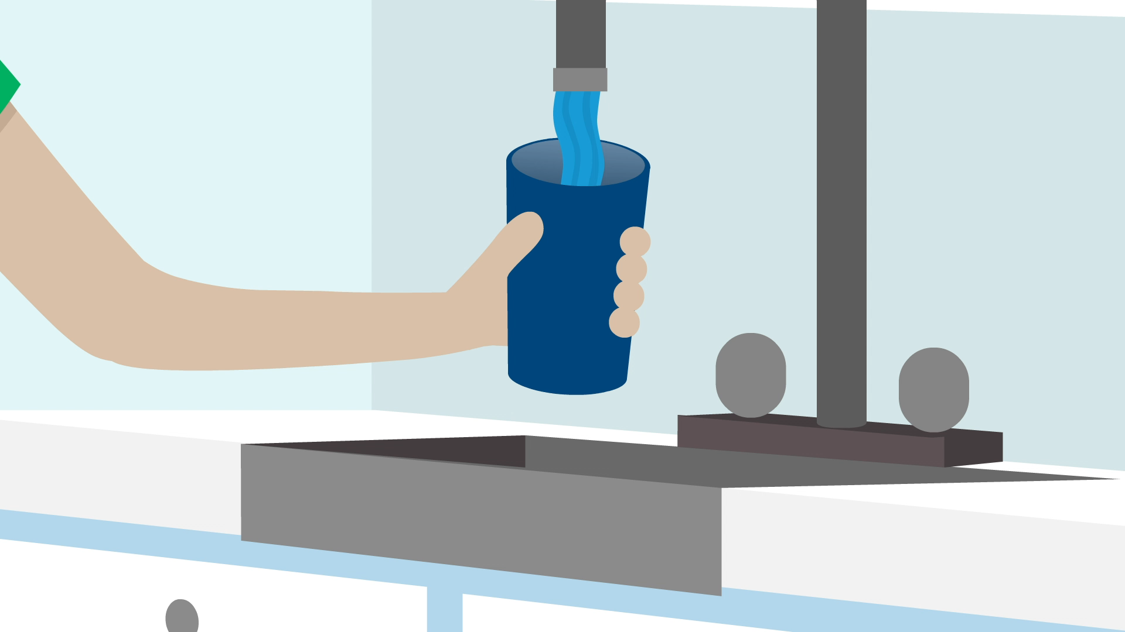
Source Water Protection

Slide 3
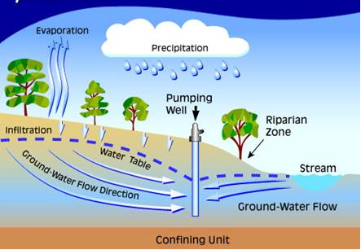
Where does our Drinking Water Come From?
Centre Wellington’s drinking water comes from groundwater.
Residents either have municipal water or their own private wells.
In both cases, this water is groundwater.
Source Protection’s goal is to protect the quality and quantity of that groundwater

Slide 4




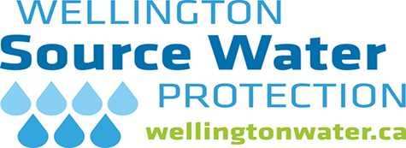




Source Water Protection in Wellington County and in Centre Wellington
Source Water Protection in Wellington County is implemented by Wellington Source Water Protection.
Wellington Source Water Protection is a shared service unit, based in the Township of Centre Wellington but appointed and serving all County municipalities.
This unit is funded by the County of Wellington with contributions from each of the local municipalities.

Slide 5
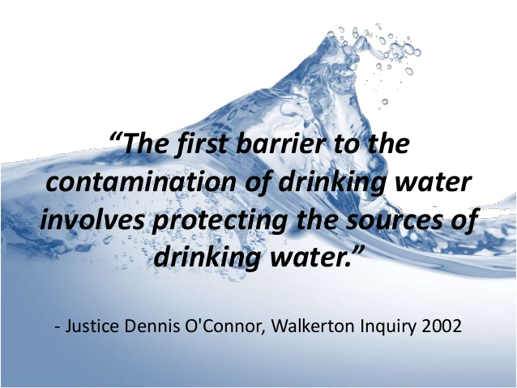
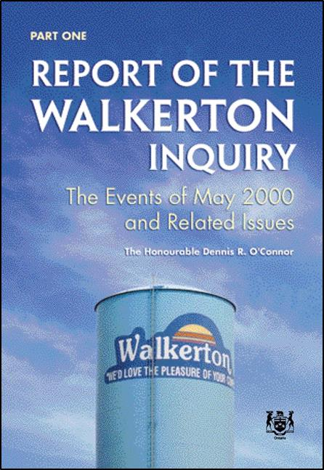
What Source Protection Staff Do . . .
We implement and enforce the Clean Water Act, associated regulations and the watershed based Source Protection Plans.
We review development applications, inspect, negotiate, manage environmental risk, help and work with residents, educate, write policy, complete technical projects and many other duties
This is legal requirement for municipalities and is part of Council’s Statutory Standard of Care.
This is a result of the Walkerton tragedy and inquiry

Slide 6
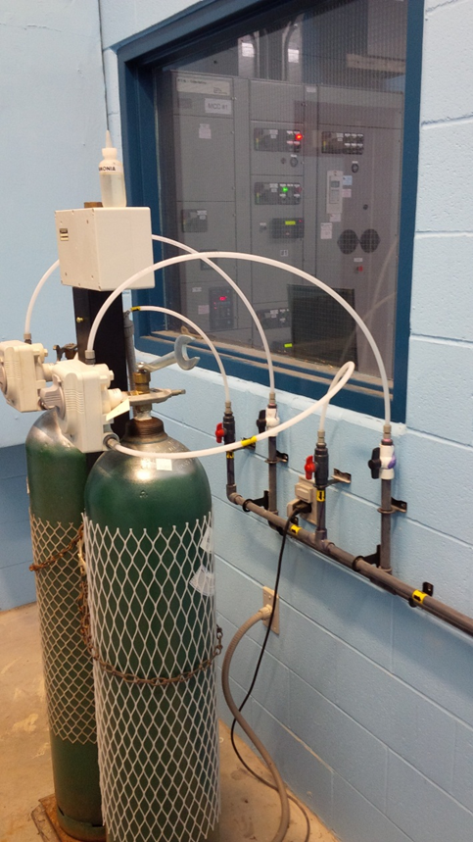

Water Supply & Treatment Overview
Water Supply and Treatment
Groundwater sourced system consisting of 9 well sites [F1, F2 (offline), F4, F5 (offline), F6, F7, E1, E3, and E4].
Water is treated with chlorine gas prior to entering the distribution system.
Additional treatment includes:
Water softening system at FPH1 to address hardness
Air stripper at F1 to remove an industrial solvent trichloroethylene (TCE)
Greensand filter at F4 to remove Iron and Manganese
Advanced oxidation filter at F7 to remove Iron and Manganese (commissioning expected in March, 2023)

Slide 7
Water Storage and Distribution System Overview
    STORAGE: Four Elevated Storage tanks with a combined capacity of 11,820 m³ (11.8 ML)
      Daniel Crescent, Elora
      Bridge Street, Elora
      Gartshore Street, Fergus
      Scotland Street, Fergus
    DISTRIBUTION: Infrastructure consisting of:
      1,265 water valves
      771 fire hydrants
      126 km of watermain
      4,100 curb stops
      Three pressure zones: 2 in Fergus, 1 in Elora
    AND:
    Booster Pumping Station connecting the two communities water systems
    Belwood Community Well services Hall, St. John’s United Church, residence and Maple Park Playground.

Slide 8
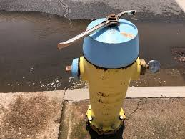
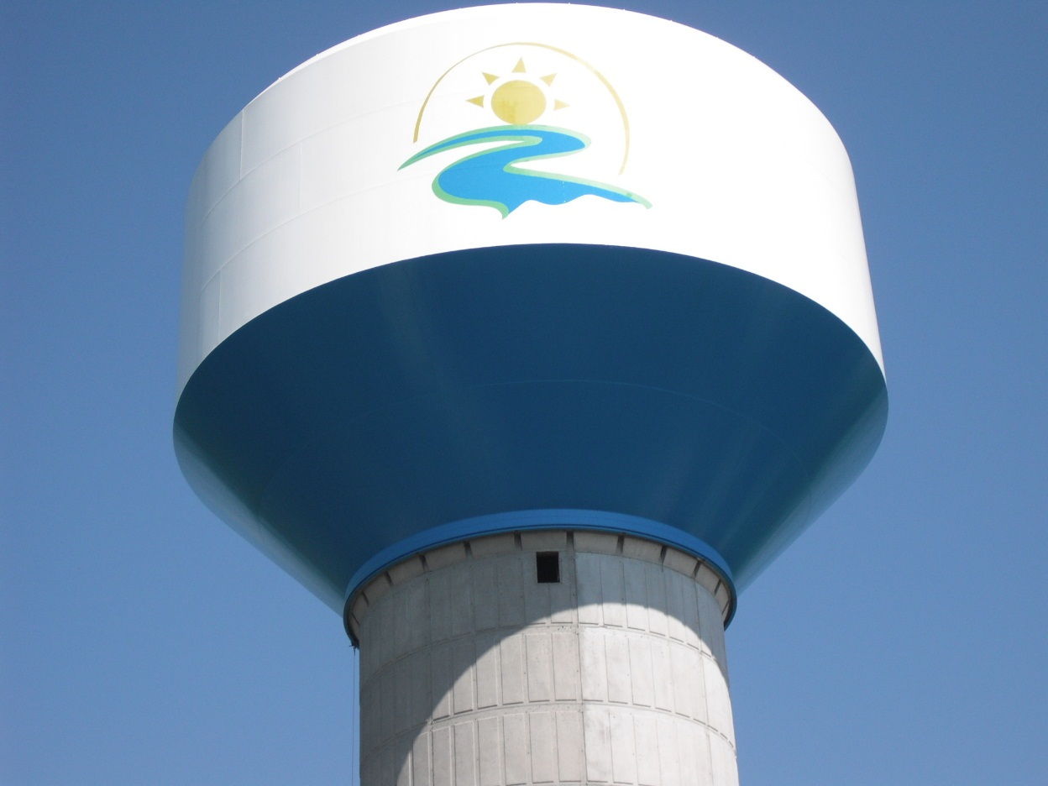
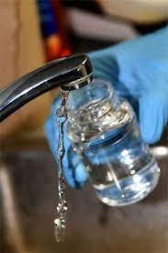
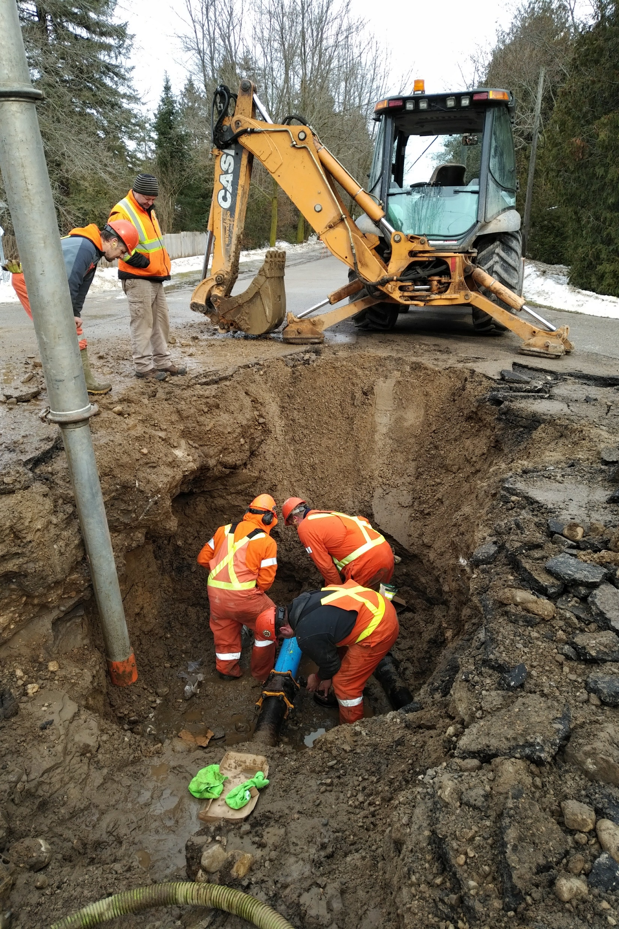
Water Services
Water Services Responsibilities include:
Water treatment and supply
Well operation and maintenance, well checks
Well pump house operation and maintenance
Water quality assurance (sample and testing)
Hydrant maintenance and repairs
Valve and curb stop repair and maintenance
Watermain break repairs
Watermain flushing
Water tower operation, inspection and maintenance
8 | Infrastructure Services – Environmental Services

Slide 9

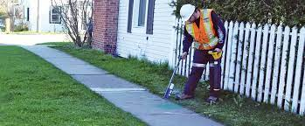
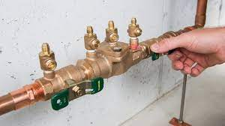
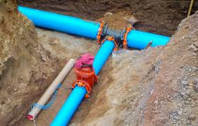
Special Projects and Customer Services
Special Projects and Customer Services Responsibilities include:
Small Capital Project Management
Utility locates
Water meter program
Backflow prevention program
New development and infrastructure construction monitoring, inspection, sampling and commissioning
9 | Infrastructure Services – Environmental Services

Slide 10
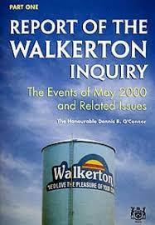
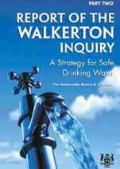
Walkerton Tragedy
May 2000 – Seven people died and thousand became ill due to water contaminated by e.coli bacteria
Justice Dennis O’Connor, 2002, Report of the Walkerton Inquiry
  121 Recommendations to safeguard public health through the provision of Safe Drinking Water including 22 recommendations related to Source Water Protection
Water supply, treatment and distribution is
heavily regulated and subject to annual inspections
by the Ministry of the Environment, Conservation
and Parks (MECP).
10 | Infrastructure Services – Environmental Services

Slide 11
Duties of Owners and Operating Authorities
Who is the Owner of the Drinking Water System?
  Members of Council and Municipal Officials who provide oversight and exercise decision making
  They must ensure the municipality meets all its regulatory requirements
As an Owner and member of Municipal Council, you are encouraged to
  Ask Questions
  Be Informed
  Be Vigilant
Who is the Operating Authority?
  The people who are responsible for the day to day operation of the drinking water system, namely staff of Environmental Services
11 | Infrastructure Services – Environmental Services

Slide 12
Drinking Water Quality Management System
The Walkerton Inquiry recommended a quality management system for municipal drinking water systems. The DWQMS approach emphasizes the importance of:
a proactive and preventative approach to management strategies that identify and manage risks to public health
establishing and documenting management procedures
clearly identifying roles and responsibilities
continual improvement of your management system
Further information and training on the Township DWQMS will be presented to Council in future Committee of the Whole meetings.
12 | Infrastructure Services – Environmental Services

Slide 13
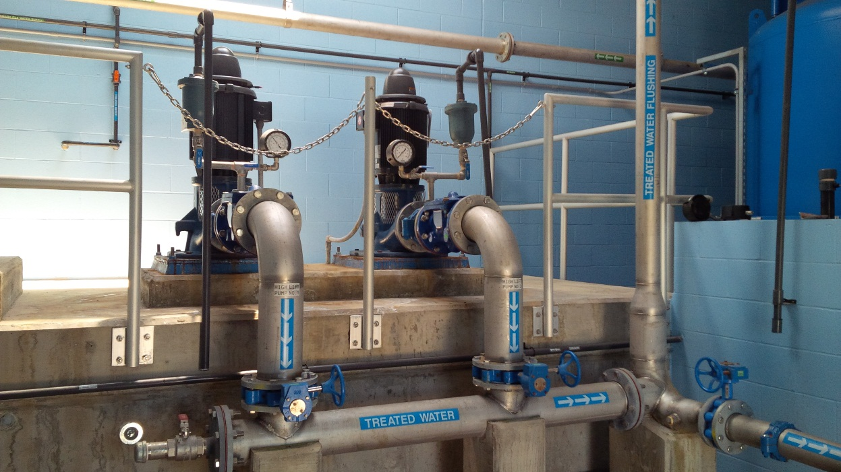
Safe Drinking Water Act
  Owners of drinking water systems must ensure the operating authority is complying with the SDWA, and in cases where it is not, take reasonable steps to ensure they do.
How?
  Exercise care and diligence
  Act honestly, competently and with integrity
  Attend Statutory Standard of Care training
  Review and understand Quality Management System Communication
13 | Infrastructure Services – Environmental Services

Slide 14
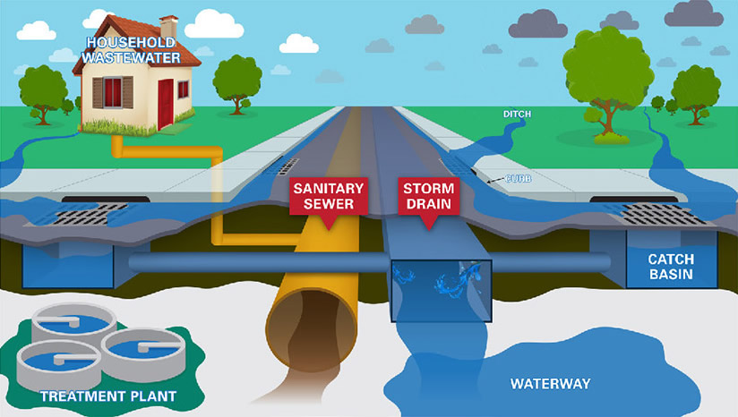
Wastewater (Sanitary) and Storm Water Systems
14 | Infrastructure Services – Environmental Services

Slide 15
Wastewater System Overview – Sanitary
  Two wastewater treatment plants (WWTPs)
    Fergus WWTP
    Elora WWTP
  Wastewater (sanitary) collection systems
    Elora & Fergus
    117 km of gravity sewer
    6 Sewage Pumping Stations (plus 2 operating agreements)
    2.1 km of Sewage Pumping Station forcemain
    Salem Low Pressure Sanitary System (LPS)
    200+ Grinder Pumps in Salem
    8.0 km of LPS forcemain
15 | Infrastructure Services – Environmental Services

Slide 16
Fergus Wastewater Treatment Plant
The original facility was built in 1961, with a major expansion in 1989 and minor upgrades in 2000
Design flow (avg. daily) = 8,000 m3/day
Average Daily actual is 4,000 m3/day
Treatment is achieved through conventional processes comprised of:
  Preliminary treatment mechanical bar screening and aerated grit removal.
  Primary treatment of two primary clarifiers with raw sludge and scum removal.
  Secondary treatment through two aeration tanks and two secondary clarifiers.
  Tertiary treatment from two sand filters.
  Seasonal disinfection (May 1 to September 30) by an ultraviolet light system (U/V).
  Treated water is discharged to the Grand River.
16 | Infrastructure Services – Environmental Services

Slide 17
Fergus Wastewater Treatment Plant
Residual (sludge) management is completed through a primary and secondary digester which processes residual to an acceptable state and volume that can be then land applied under the Nutrient Management Act. There are three biosolids tanks to provide storage when land application is not possible (December 1st to April 1st)
A by-product of the digestion process is methane gas. The new digester roof captures methane gas to be redirected to a boiler. This energy recovery is used to heat filter and digester buildings. It also is used to heat wastewater residual (sludge) to aid in the final stage of process.
17 | Infrastructure Services – Environmental Services

Slide 18
Elora Wastewater Treatment Plant
The original plant was built in 1963 and a major expansion commissioned in 2014.
  Rated capacity = 5,000 m3/day , average plant flow = 2,000 m3/day
Treatment is achieved through extended aeration process:
preliminary treatment through a mechanical bar screen, a rag auger and aerated grit classification.
Primary treatment is achieved through two aeration trains.
Secondary treatment is achieved through three secondary clarifiers.
Tertiary treatment is achieved through two sand gravity filters and ultraviolet (UV) disinfection.
Treated water is discharged to the Grand River.
18 | Infrastructure Services – Environmental Services

Slide 19
Elora Wastewater Treatment Plant
Residual (sludge) management is completed through a Lystek treatment system.
  Sludge is processed through a combination of heat, chemical addition and high shear mixing.
  The final product is a fertilizer (LysteGro) that is certified through the Canadian Food Inspection Agency which is land applied.
BIOREM odour control process treats air exhausted from the influent building and the biosolids storage tanks.
  BIOREM uses a synthetic filter media and carbon adsorption units.
19 | Infrastructure Services – Environmental Services

Slide 20
Wastewater (Sanitary) Collection System
The Township owns and operates collections systems servicing both Fergus and Elora. The system in comprised of:
117 km of wastewater (sewer) main
1,643 maintenance holes
8.0 km of LPS forcemain
8 sewage pumping stations
Typical operation and maintenance performed by Wastewater Services includes:
  Sanitary sewer flushing.
  CCTV inspection (sewer camera).
  Maintenance hole inspection and repairs.
  Sanitary lateral and sewer main blockages/repairs.
  Flow monitoring.
  Sewer use bylaw monitoring.
20 | Infrastructure Services – Environmental Services

Slide 21
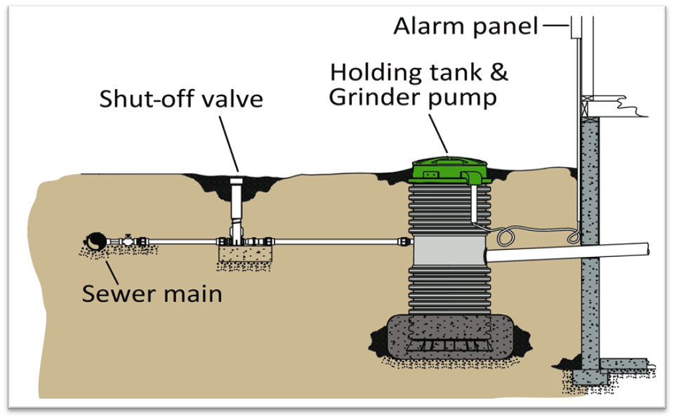
Wastewater (Sanitary) Collection System
Salem is serviced through a Low Pressure Sanitary System (LPS).
The LPSS uses a small grinder pump located at each house to move wastewater through the sewage system.
200+ grinder pumps conveys wastewater to the Elora WWTP.
The LPSS has been used by the Township for over 40 years.
This system is installed where gravity sewers are not cost effective or feasible.
21 | Infrastructure Services – Environmental Services

Slide 22
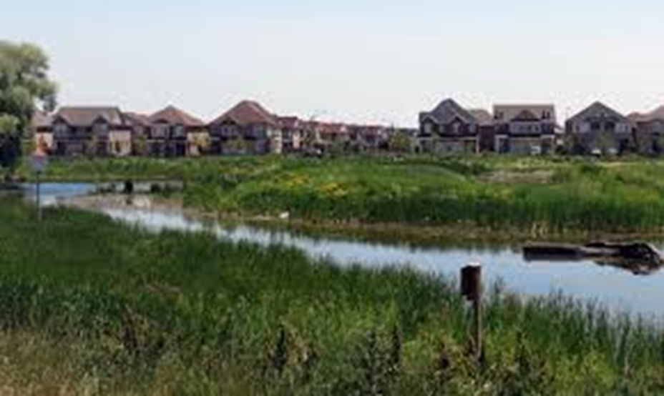
Storm Water System Overview
147 km of Storm Main
26 Stormwater Management Areas
33 Retention Ponds
4,331 Catch Basins
801 Storm Maintenance Holes
218 Inlet/Outlets
60 Outfalls
14 Oil-Grit Separators
22 | Infrastructure Services – Environmental Services

Slide 23
Wastewater Sanitary Collection System
Trends of Note for the Sewage Collection Systems:
New and updated Sewer Use Bylaw program development and implementation.
  The new updated Sewer Use Bylaw was passed by Council in 2022.
  Updates and consolidates older bylaws and requirements.
  Introduces industry standards recommended by the Canadian Council of Environmental Ministers.
Consolidated Linear Infrastructure Environmental Compliance and Approval (CLI ECA)
  a new regulatory structure introduced and governed by the Ministry of Environment, Conservation, and Parks (MECP)
  Staff continues to assess requirements and timing of newly introduced regulation.
23 | Infrastructure Services – Environmental Services

Slide 24
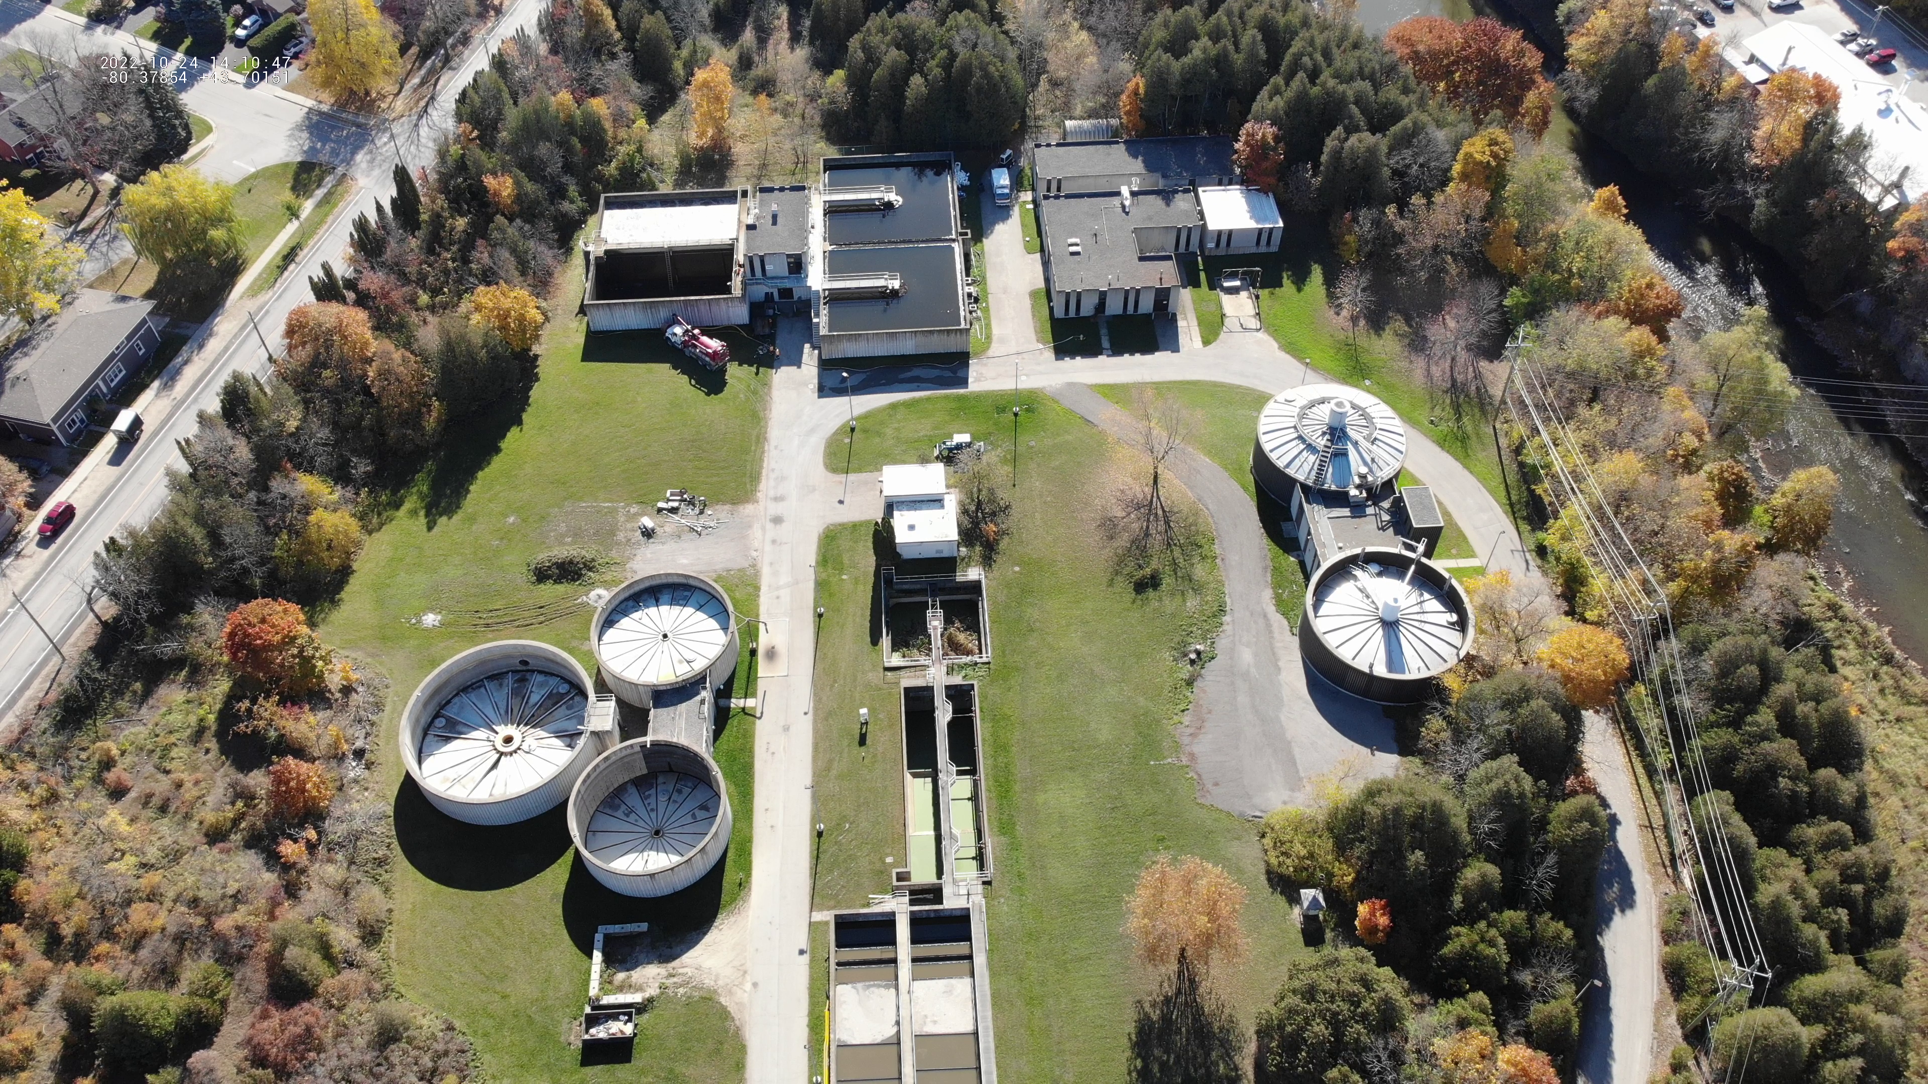
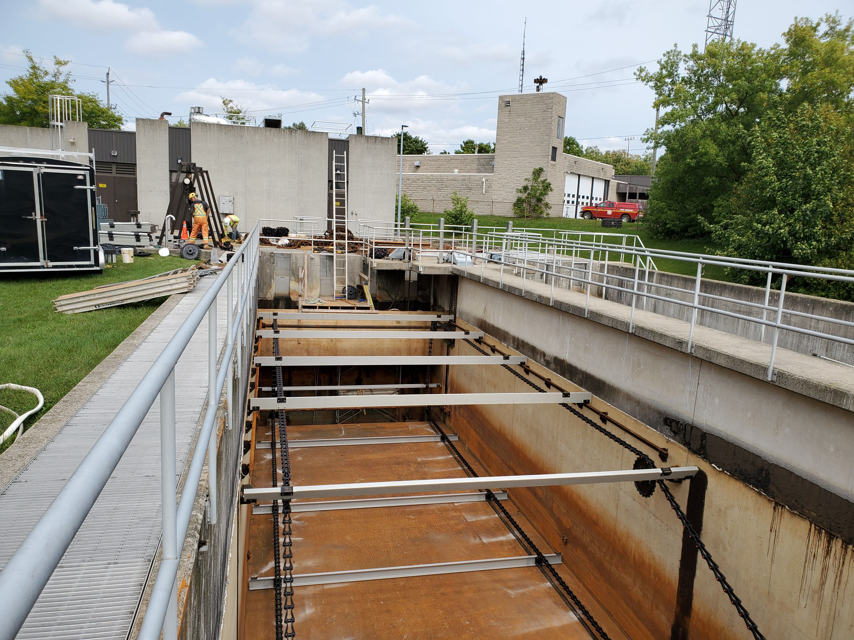
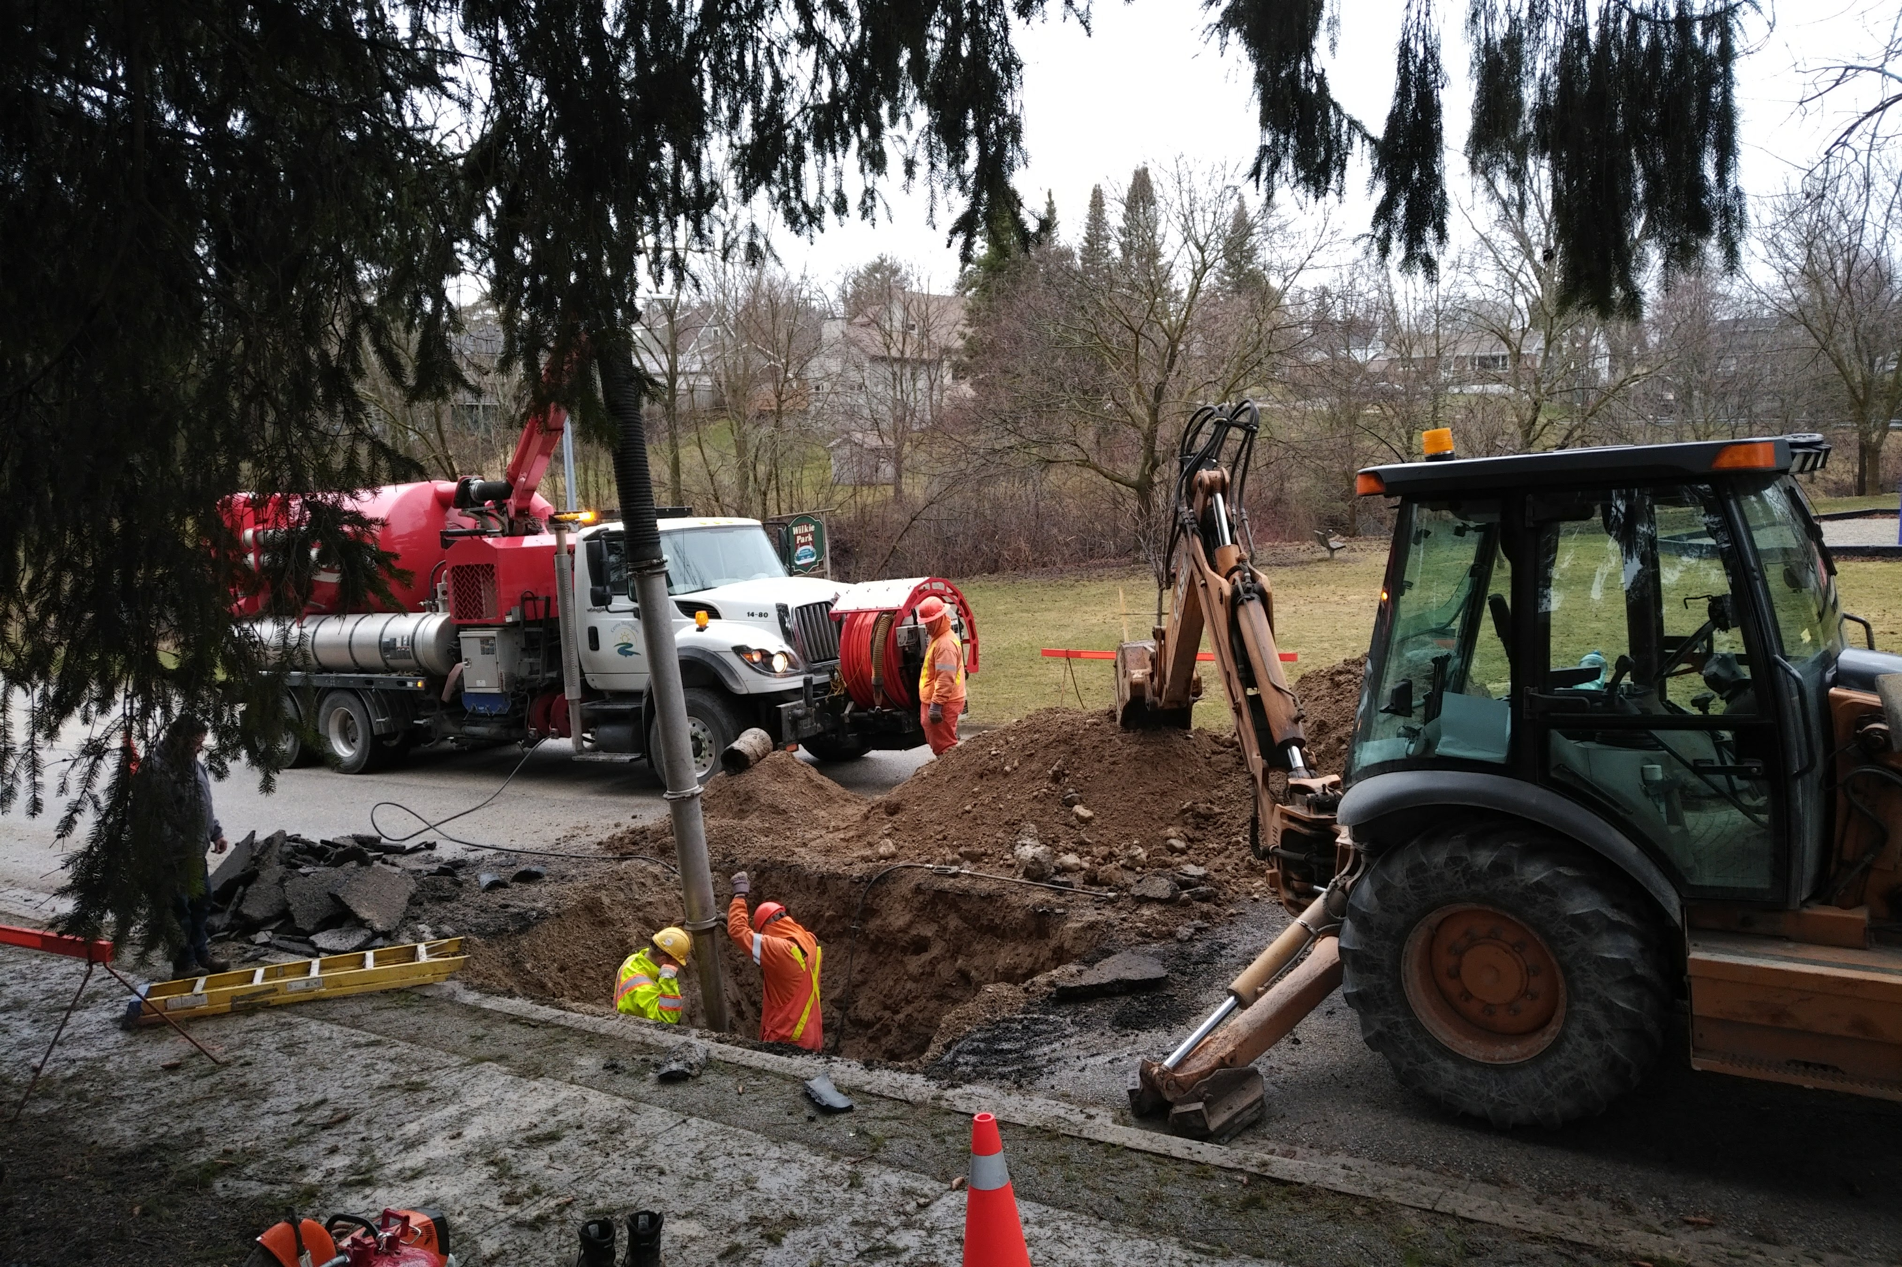
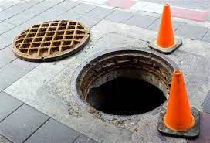
Wastewater Services
Wastewater Services Responsibilities include:
Operation and maintenance of the wastewater collection systems
Operation and maintenance of the wastewater treatment plants
Effluent water quality assurance (sample and testing)
Maintenance hole and catchbasin maintenance and repairs
LPSS maintenance and repair
Wastewater main and lateral break repairs
Wastewater main flushing
24 | Infrastructure Services – Environmental Services

