Slide 1
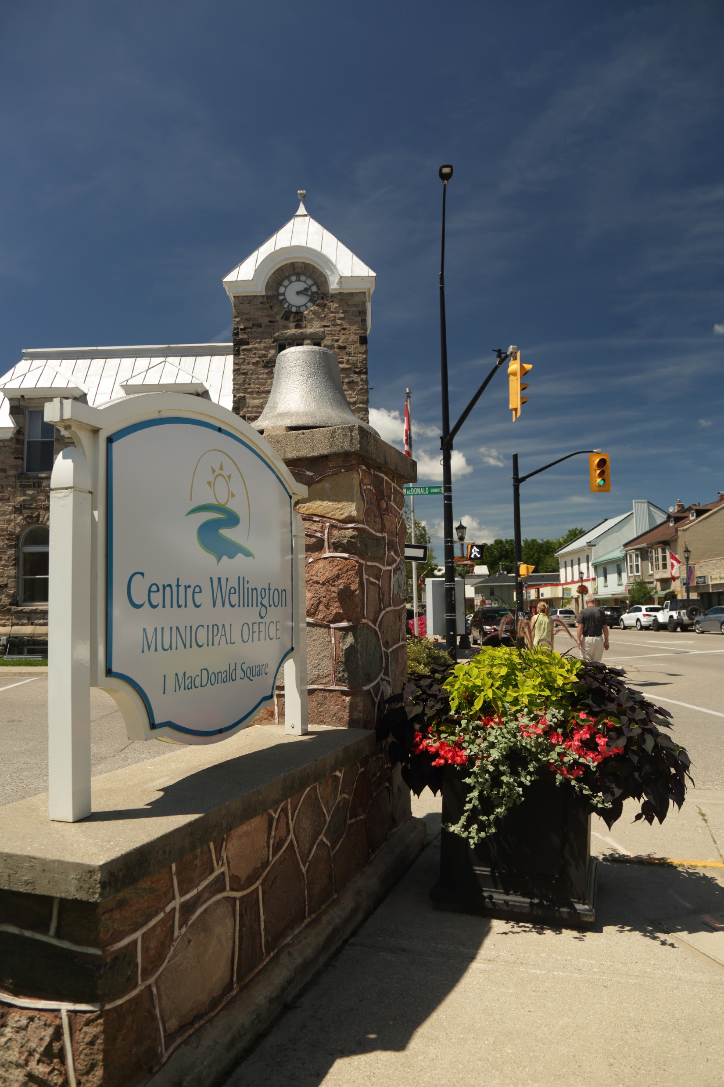

Chief Administration Officer, Corporate Communications, and Human Resources
Council Orientation
November 29, 2022

Slide 2

Organizational Structure
Mayor & Council
Chief Administrative Officer
Dan Wilson
Corporate Services
Adam McNabb
Human Resources
Rashid Hasan
Infrastructure Services
Colin Baker
Community Services
Pat Newson
Planning & Development
Brett Salmon
Financial Services
Legislative Services
Customer Service
Municipal Law Enforcement
Cemeteries Administration
Vital Statistics
Purchasing & Risk
Information Technology
Records Management
Roads & Transportation
Engineering Services
Water Supply & Distribution
Wastewater Collection & Treatment
Cemeteries Operations
Source Water Protection
Recreation Facilities Operations
Recreation Programming
Parks & Open Spaces
Fire Services
Cultural Services
Tourism
Volunteer Coordination
Land Use Development Planning
Official Plan & Zoning
Building Services
Heritage
GIS Mapping
Economic Development
Employee Relations
Talent Management
Learning & Development
Compensation & Benefits
Health & Safety
HR Management & Compliance
Communications & Strategic Initiatives
Kendra Martin

Slide 3
The Community, Council, and Administration
The Community:
Receives various services from Administration
Pays property taxation and other user fees
Elects Council every 4 years
Council:
Elected by the Community
Provides oversight, policy setting, and direction to Administration
Administration:
The CAO is Council’s only employee
The CAO is responsible for Township Administration
Provides various services to the Community based on direction provided by Council
Community
Administration
Council

Slide 4
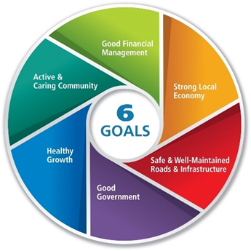
Council: Setting Policy & Direction
Mayor & Council
Strategic Plan
Annual Budget
Master Plans
Council Resolutions
Water Supply
Transportation
Parks, Recreation & Culture
Trails
Fire
Termite Management
DEI Committee
Health Care Professional Recruitment
Active Transportation Committee
Operating
Capital
Long term Forecast
Debt, Reserves & Cash Flow
Operational Implementation: CAO & Senior Management Team

Slide 5
Ongoing Projects & Initiatives
Council Orientation
Strategic Plan (2023 to 2026)
Parking Strategy
2023 Budget
Customer Service Strategy
Asset Management
Implementation
Attainable and Affordable Housing
Inter-Government Relations
Operations Centre
Centre Wellington Business Park
Community & Staff Engagement

Slide 6
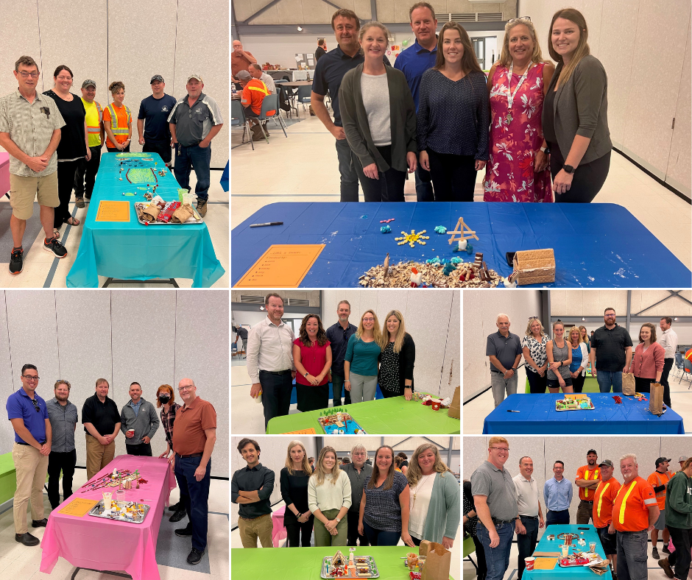
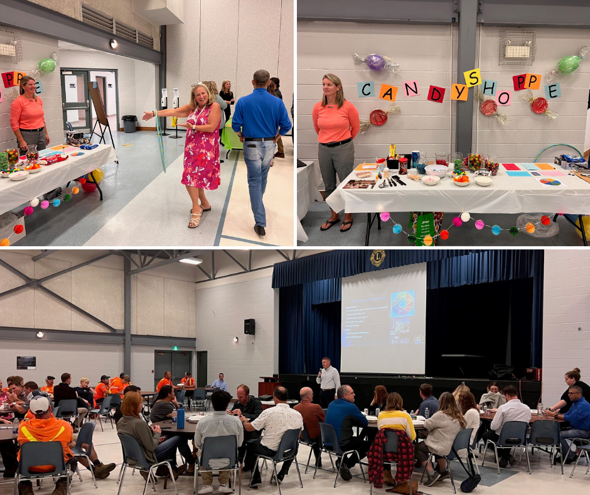
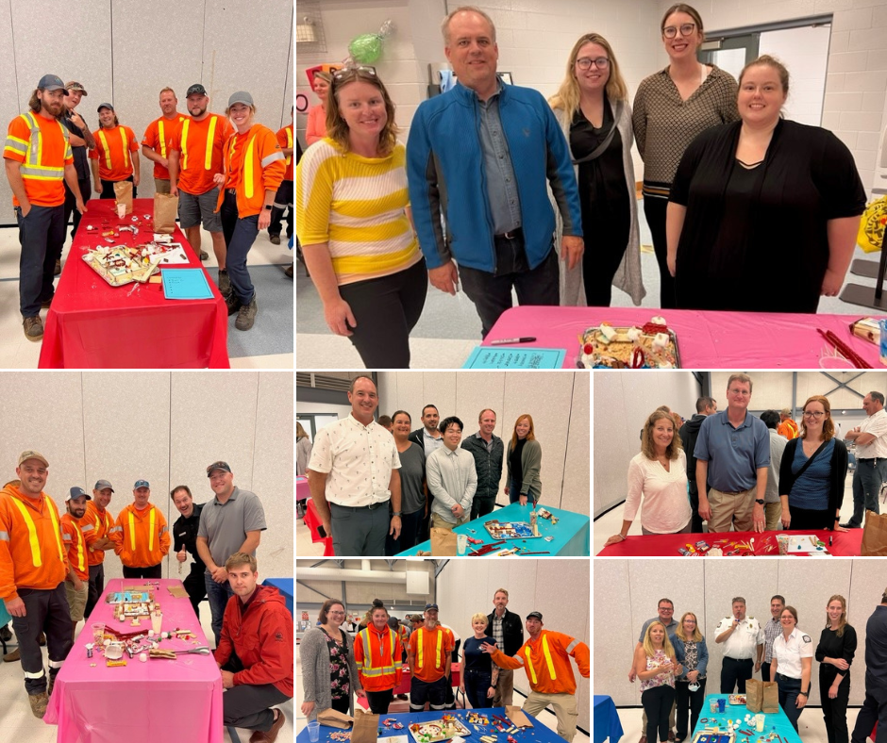
CAO Wellness Town Hall
2 CAO Town Halls / Year
1 Combined with a Staff Appreciation Lunch and Wellness Event

Slide 7




Responsibilities of Corporate Communications
The Township of Centre Wellington maintains open and honest communications with its residents and its employees. We engage citizens with transparency and passion. We are committed to providing relevant and accurate information in ways that are accessible, creative, and timely. We perform four essential functions:
We manage the reputation of the organization
We inform residents
We participate in two-way engagement with our residents
We increase the awareness and understanding of government services

Slide 8
Corporate Communications Team
Kendra Martin | Communications and Strategic Initiatives Specialist
Responsible to oversee all communications efforts, including website and social media, print material, public relations point person, press releases, corporate advertising, branding, marketing, internal communications, public consultation, civic engagement, and emergency communications information.
Hannah Barclay | Digital Media Associate
The Digital Media Associate plays an integral role in providing advice and direction in the execution of digital strategy, promotion, and day-to-day digital operations for the Township of Centre Wellington, specifically Elora Fergus Tourism.
This position is also responsible for oversight and coordination of strategic planning initiatives from initiation through completion. Works with all departments on strategic planning progress and timelines, including strategic priority setting. Supports the CAO and Senior Management Team by coordinating all cross-departmental strategic initiatives, plans and projects.
The Digital Media Associate implements daily social media content creation and management of all digital assets for the destination.
The Digital Media Associate provides customer service to residents, businesses and tourists who contact the Township through our social media platforms. Responsibilities include updating the website and posting to social media. The position also supports internal customers, creating digital pieces to support programs and services across the corporation.

Slide 9


Strategic Communications & Community Engagement
Strategic Communications
Community Engagement
Provide integrated and strategic communications that are externally focused and address the needs of internal and external stakeholders.
Develop and manage Corporate Communications governance documents including manuals, policies, and guidelines.
Lead community engagement opportunities about Township services, programs, and initiatives; support Township staff in their efforts to keep community members informed and ensure opportunity for all to participate in engagement opportunities.
Celebrate and communicate good news stories of Centre Wellington (Township and community partner good news, community achievements, and celebrating municipal government).

Slide 10




Corporate Communications Responsibilities
Websites
Social Media
Media Relations
Corporate Identity
We manage:
Manage the Township’s corporate social media channels, including content and creative on Twitter, Facebook, LinkedIn, and YouTube.
Provide strategic direction and governance for the Township’s audience-specific social media accounts.
Manage media relations including media events, media materials, and media monitoring.
Manage corporate identity/brands
Corporate Communications should sign off on anything before it goes to print or out to the public to ensure brand management and corporate identity.
www.centrewellington.ca (corporate)
www.connectcw.ca (community engagement)
www.elorafergus.ca (tourism)

Slide 11






Ensuring Meaningful Communication & Branding
Ensure all staff understand the importance of internal and external communications. Assist staff in their communication efforts from start, to finish.
Support the delivery of Council’s Strategic Priorities.
Increase community engagement. Meaningful community engagement is about having representation from the whole community, not just a small voice. Examples – Public Engagement workshops, Key Township Open House etc.
Create ongoing conversation that allows staff and our residents help define and shape the Township’s future.
Develop and launch a survey on the role of communications in our community to residents (How do they communicate with us? Questions about the ease of use of centrewellington.ca. How does the community feel about the Township? Do they like to work, live and play in CW? Etc.)
Complete a branding and visual identity document that will assist Corporate Communications in ensuring there is a proper use of visual graphics (logos etc.). And that we are communicating a consistent message to our community.
Our Focus

Slide 12
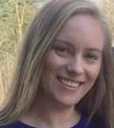
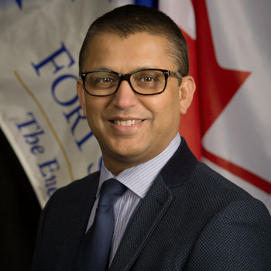
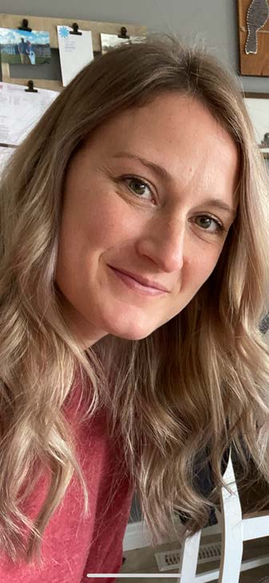
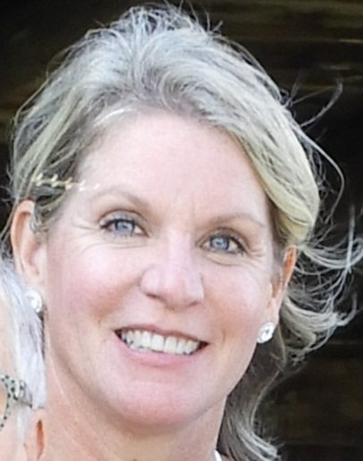
Human Resources Organizational Chart
SHANNON KOESTNER
Human Resources & Payroll Coordinator
RASHID HASAN
Chief Human Resources Officer
JESS FURHMAN
Human Resources Generalist
MANDY LEE
Health, Safety and Wellness Manager
Notes:
The Human Resources team has evolved with the addition of the Health, Safety and Wellness manager position.
Under the leadership of the Chief Human Resources Officer, the HR department includes HR, Payroll, and Health and Safety functions.

Slide 13








Human Resources Department Services
Talent Management
Strategic Management
Health & Safety
Compensation & Benefits
Learning & Development
Compliance
HR Management
Employee Relations
Recruitment
Attraction
Selection
Retention
Succession
Employer Brand
KPI’s
Workforce Planning
Policy Development
Advising Leadership
Business Partnership
Contingency Planning
Organization Design
Alignment of HR Strategy with Business
Health Management
Safety Program Development
Training
Records
Wellness
Mental Health
Disability Management
Return to Work
Accommodation
KPI’s
Management Compensation
Council Remuneration
Staff Salary Administration
HRIS
Compensation Philosophy
Pay for Performance
Benefits Administration
Payroll
Corporate Program Development
Organizational Development
Supervisory Training Program
Management Training Program
Leadership Development Program
Legislation
Policy Development
Labour Law
Health & Safety Legislation and Regulation
Diversity & Inclusion
Performance Management
Performance Coaching
Mentorship
Advice
Discipline
Grievances
Litigation
Bargaining
Interpretation of Agreements
Harassment Investigations
Conflict Resolution
Code of Conduct Matters
Terminations
KPI’s
Notes:
The HR services required for successful operations of the Township business include seven major areas. Those areas are: Talent Management, Strategic Management, Health Safety and Wellness, Compensation and Benefits, Learning and Development, Compliance, Human Resources Management and Employee Relations.

Slide 14






Human Resources Strategic Intentions
PERFORMANCE ENHANCEMENT
CUSTOMER SERVICE IMPROVEMENTS
CREATING A LEARNING ORGANIZATION
MANAGEMENT & EMPLOYEE SKILLS ENHANCEMENT
NEXT LEVEL HUMAN RESOURCES
TALENT MANAGEMENT
Notes:
Several major HR Strategic Intentions, as approved by the Senior Management Team, provide the direction for HR business:
Performance enhancements – on both individual and organizational levels
Customer service improvements
Staff investment as a learning organization
Management and employee skills enhancement
Talent management, which includes succession planning
And next level HR, which sets HR as a “strategic and business partner” in alignment with Council and Senior Management’s strategic goals, and to provide enhanced “transactional services”

Slide 15
Health, Safety & Wellness Philosophy
Philosophy
Safety is Everyone’s Responsibility
Transformational Leadership
Behavior Based Safety
Person-Centered
Programs and Systems
Health & Safety Culture
Notes:
Safety is the responsibility of everyone, everywhere. All jobs have hazards so in order to make the workplace safe and prevent hazards, both the employer and employees must work together to promote safety. Health and safety is black and white which is to say that cutting corners or to turn a blind eye, puts safety into the grey and that is where accidents happen.
The style of leadership needed, however is not aimed at telling people what to do. It is about empowering employees, encouraging them to grow and inspiring them to do their work well. This is the most effective method of a health and safety management system and mirrors a lot of what behavior based safety is about.
It is not so much the technical side of safety but the personal side that is important.
As a subject matter expert you are interpreting what the departments/operations are doing and giving them advice on how they could be doing it better to meet the legal requirements and to decrease accidents.
It is developing health and safety programs and supporting managers and employees to be the leaders and coaches. To be the cheerleader to build that health and safety culture where we say “it’s the way we do things”.
At the Township of Centre Wellington, all departments – finance, operations, community services, HR – are equal and not one can exist without the other. Safety affects all departments and when safety is the focus and part of every decision, we all reap the benefits.

Slide 16
Recruitment and Selection
1. Preparing
2. Sourcing
3. Screening
4. Selecting
5. Hiring
6. Onboarding
1
Preparing a job description and posting for advertisement.
2
Sourcing qualified candidates through advertisements with relevant organizations, associations, websites, etc.
3
Screening qualified candidates by HR, Supervisor, and/or Manager.
4
Selecting qualified candidates from a shortlist for interviews.
5
Hiring the successful candidate with an offer from Human Resources.
6
Onboarding of the new hire involves attending orientation during the first week and ongoing onboarding throughout employment (training, mentoring, development, etc).
Notes:
Recruitment and selection activities are an important part of Human Resources services that require a majority of the team’s efforts. From preparing the position’s details through to the orientation of the new hire.

Slide 17
Employee Relations
Staff Associations Partnership
Labour Relations Meeting
Discipline & Grievances
Interpretation of Memorandum Agreements
Harassment Investigations
Conflict Resolution
Code of Conduct Matters
Terminations
Notes:
HR is responsible for negotiations with three Staff Associations for wages, benefits and terms and conditions of employment.
HR proactively provides services to support a healthy labour relations environment to all Township staff.

Slide 18
Learning and Development Program
Speaker Series
Available to all employees
External presenters providing a motivational talk with relevance for all employees
General Training
Available to all employees
Individual courses offering training on a variety of topics relevant to various functions throughout the organization.
Supervisor Training Program
Available to current supervisors and those employees identified as potential future supervisors (employees showing the desire to be a supervisor and/or through succession planning).
Future Ready Leadership Essentials course offered through Mohawk College Enterprise (MCE).
Manager Training Program
Available to current managers and those employees identified as potential future managers (through succession planning).
Future Ready Leadership 1 and 2 courses offered through Mohawk College Enterprise (MCE).
Leadership Development Program
Available to senior-level managers (Managing Directors) and those employees who have been identified as future senior management (through succession planning).
Future Ready Leadership Acceleration course offered through Mohawk College Enterprise (MCE).
Notes:
The Township recently incorporated a new function under HR services -- a learning and development program available to all staff.
There are five major areas of Learning and Development opportunities.
Speaker Series are external presenters providing motivational topics relevant to all employees.
There will be a general training calendar will be made available on a variety of topics.
The Supervisor Training program will start in 2023 for existing and upcoming supervisors. Our aim is to grow our own talent for future leaders.
The Manager Training program – Future Ready Leadership 1, in collaboration with Mohawk College Enterprise has been launched in Nov 2022 and offered enrollment to our County and other lower tier partners.
A Leadership Development program is to be considered for senior management in the future.

Slide 19




Human Resource Services - Council
Council Remuneration Management
Health Care Spending Account
Compensation for Attending Extra Meetings
Compensation for Conferences, Seminars, Workshops
T4 Statement Remuneration
Council Remuneration Market Survey/Review
CAO Recruitment Coordination & Performance Review Coordination
Notes:
As to the HR services offered to the Council, we provide the following services:
[read slide]

Slide 20

Questions
Questions?
Notes:
Questions – play our The Game of Worklife to learn more about the various services the Human Resources team provides

