Slide 1
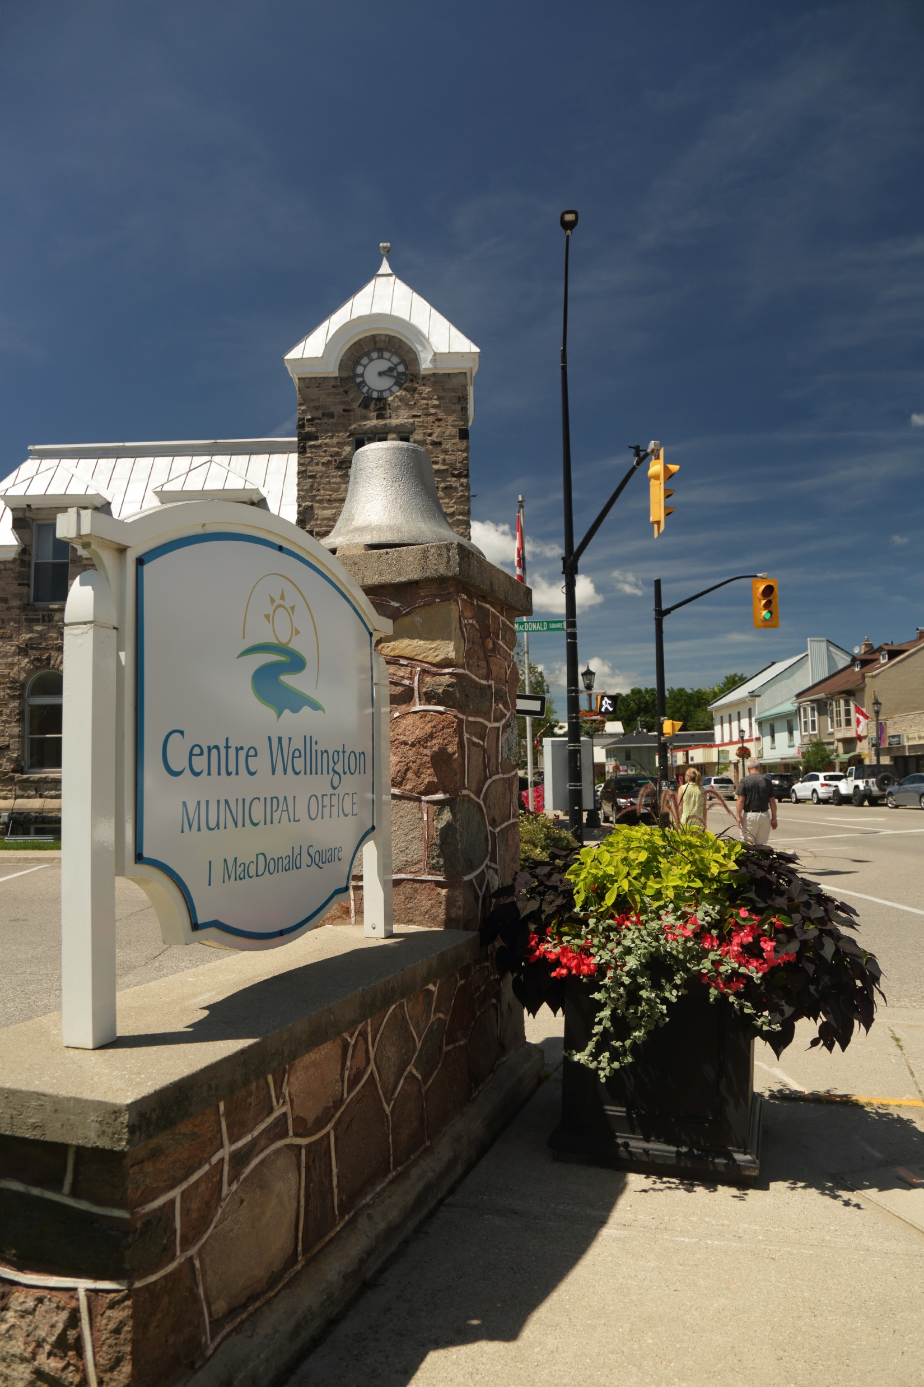

Legislative Services
Legislative Services Team
11.29.2022

Slide 2
Agenda
Division Overview
Core Services
Members of the Legislative Services Team

Slide 3

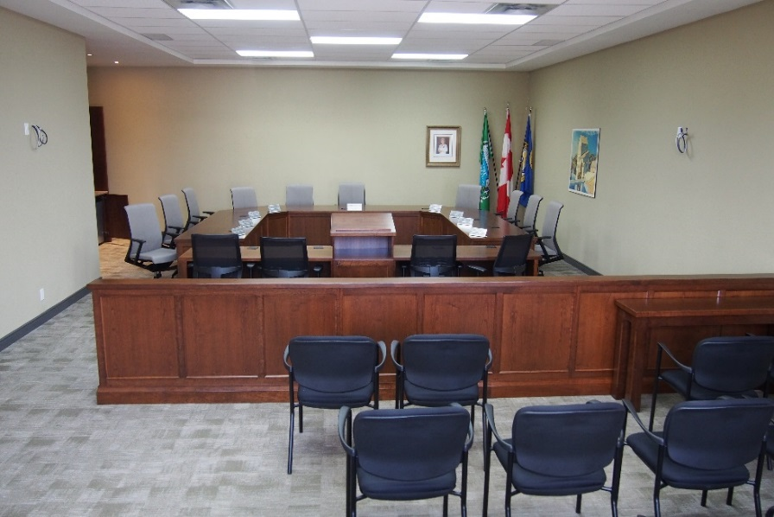
Division Overview – Legislative Services
Legislative Services is the link between Township Council, the Administration and the Community
Supports Council's governance framework and decision-making processes
Acts as the primary contact regarding Township Council business
Ensures compliance with applicable legislation and Township By-laws
Provides services directly to the public

Slide 4
Core Services – Legislative Services
Council and Committee Business Support and Administration
Policy and Report Development
Access to Information & Protection of Privacy
Records Retention and Management
By-law Enforcement
Cemetery Administration
Civil Marriage Ceremonies and Marriage Licenses
Animal Control
Lottery, Vendor and Kennel Licensing
Fence Viewers and Livestock Investigations
Municipal Drains and Tile Drain Loans
Accessibility
Customer Service (Tax Support & General Inquiries)
Municipal and School Board Elections

Slide 5
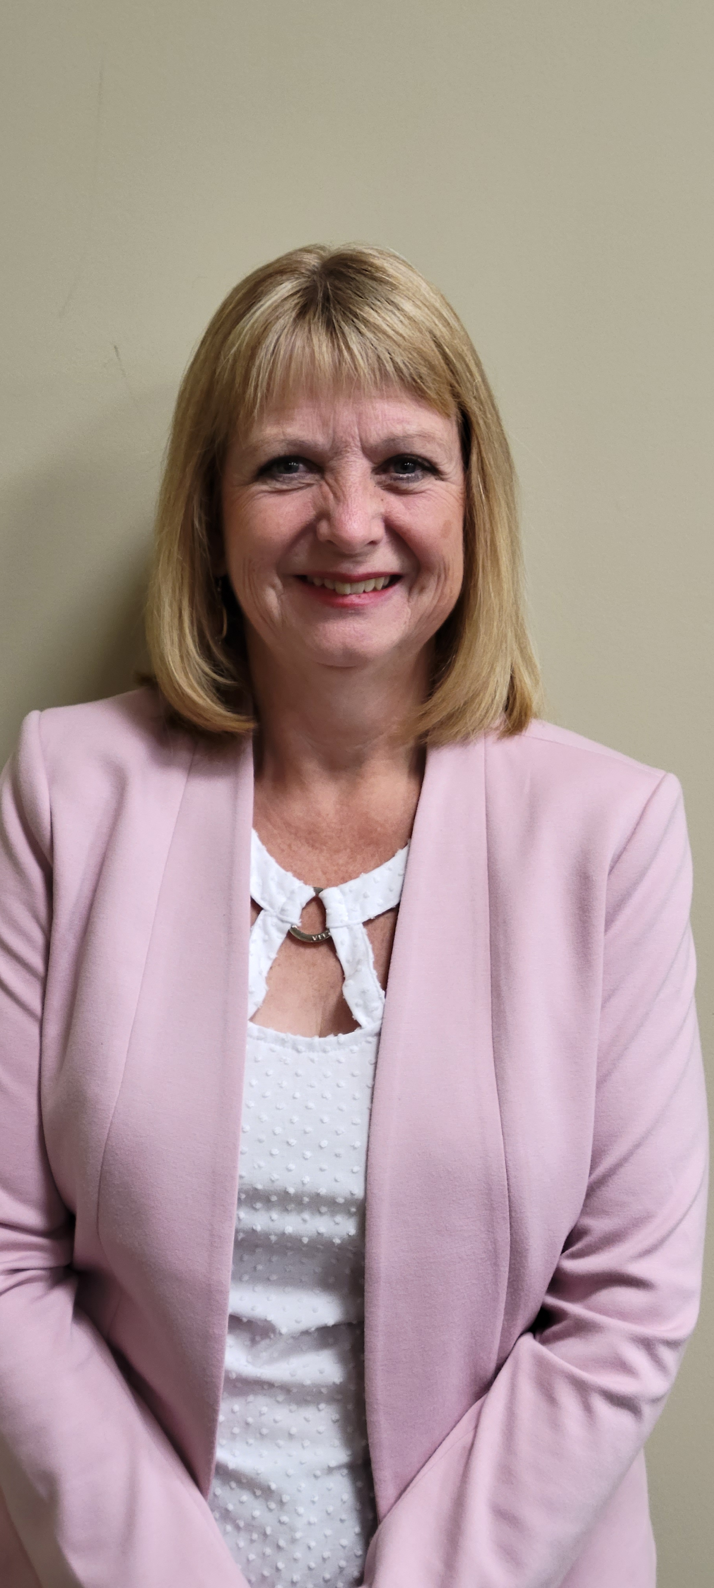

Customer Service Associates
Brenda Smeltzer
Erin Tosh

Slide 6
Legislative Services - Customer Service
Responds to tax inquiries, customer service inquiries and accepts payment for taxation, licenses, permits, commissioning, etc.
Provides information regarding Township services, programs and facilities and refers detailed or special requests to appropriate departments, staff or agencies.
Deputy returning officers during Municipal and School Board elections
Establishes, updates and maintains file systems, both computerized and manual, for Corporate Services Department in accordance with records management policies and procedures.
Makes necessary conference and workshop arrangements for department staff and Members of Council.

Slide 7
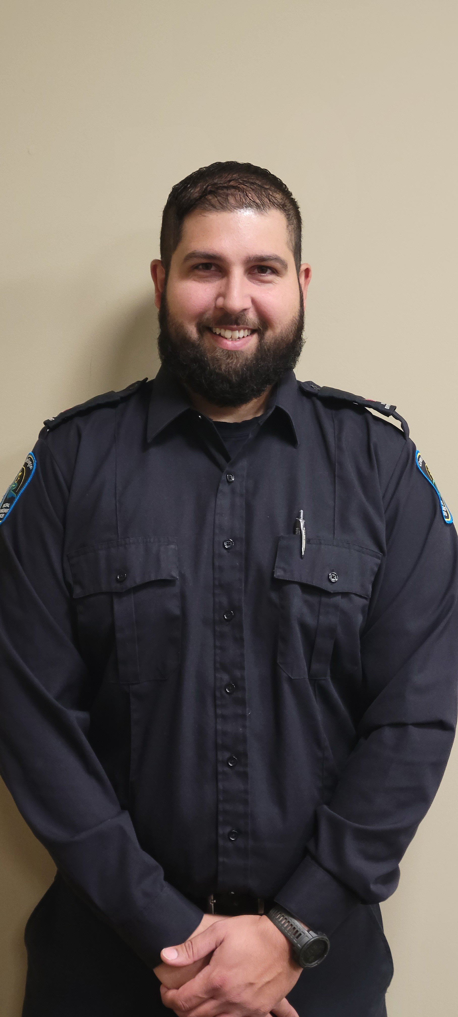
Municipal Law Enforcement Officer
Satnam Chauhan

Slide 8
Legislative Services – By-law Enforcement
Responsible for upholding the Townships municipal by-laws and utilizing discretion to determine the appropriate course of action;
Provides awareness, community outreach and education of Township By-laws,
Responds to complaints pertaining to by-laws, including zoning, property standards, licensing, fencing, signs, etc., ensuring the appropriate action is taken to resolve the matter or to enforce compliance with Township policies and procedures and applicable legislation;
Interprets by-laws and relevant legislation to determine non-compliance;
Conducts inspections or investigations, represents the Township at Provincial Offences Court;
Achieves voluntary compliance wherever possible, issues warnings, and applies penalties, when necessary;
Drafting by-laws, establishing processes, and conducting roundtable discussions with management, colleagues, and various external entities.

Slide 9

Legislative Coordinator
Devlin Schellenberger

Slide 10
Legislative Services – Legislative Coordinator
Prepares agendas, minutes, reports and correspondence for Council, Committee of the Whole and Advisory Committees;
Attends Council and Committee meetings to provide support for the related technology components, prepares minutes and interface with staff and the public to ensure meetings run efficiently and effectively;
Provides procedural advice, routine guidance, explanations and interpretations to staff, Members of Council, BIA’s and the public related to closed meeting protocol, the procedural by-law, parliamentary procedures, Municipal Act, etc.;
Manages recruitment and appointments to the Advisory Committees, Boards and Special Purpose bodies, including review and amendments to the Terms of Reference, preparation of the recruitment advertisement and arranging for advertisement of vacancies, receipt and distribution of the applications;
Researches historical Council reports and by-laws;
Backfills the duties of the Cemetery and Licensing Coordinator.

Slide 11
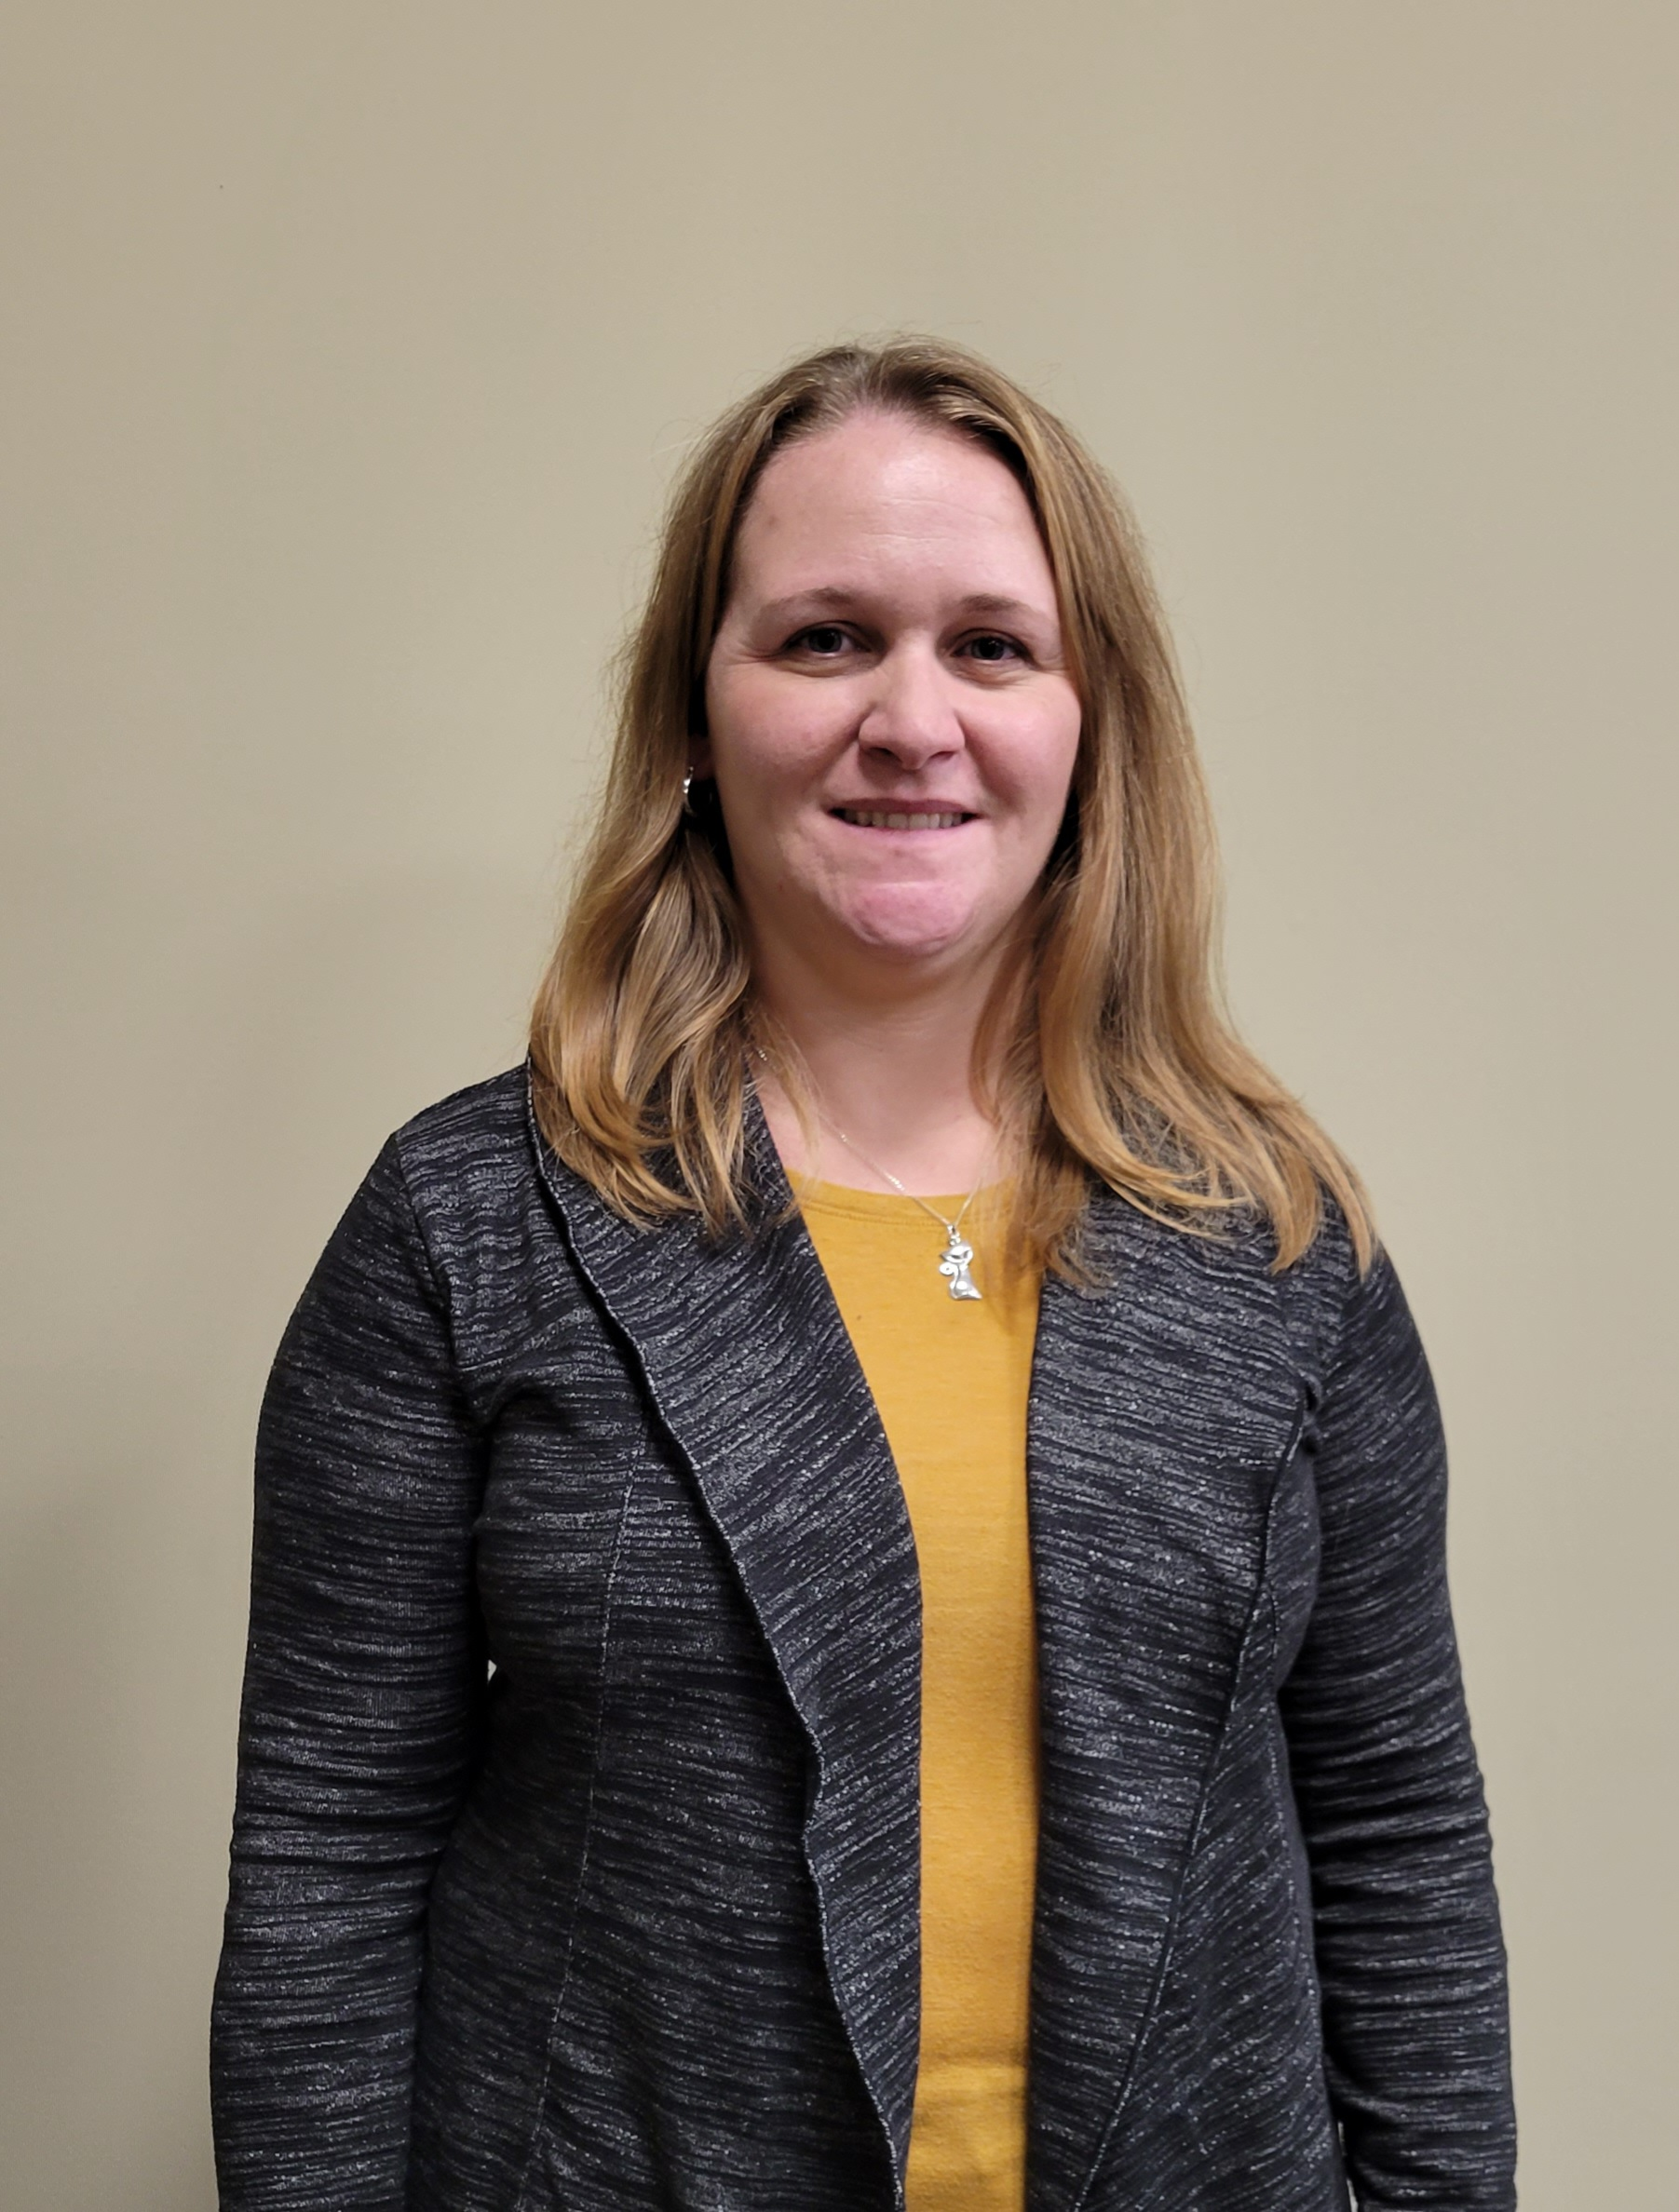
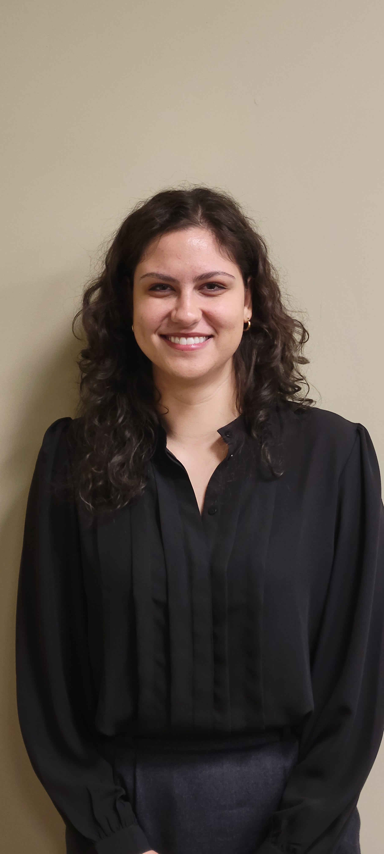
Cemetery Administrator & Licensing Officer
Constance Redmond
Amy van der Merwe

Slide 12
Legislative Services – Cemetery Administrator & Licensing Officer
Coordinates interment right sales and interments for Belsyde & Elora cemeteries with Infrastructure Services and the family and/or funeral homes. Prepares and executes legal contracts;
Calculates fees, prepares and generates invoices, issues receipts, collects and processes fees for all cemetery sales and activities. Maintains financial records for annual reconciliation and reporting to the Province;
Documents and maintains all cemetery activity in Cityview Cemetery Database;
Administers all functions related to lottery and vendor licences including receiving applications, reviewing for completeness, approving/rejecting and issuing;
Appointed as Deputy Division Registrar and Deputy Marriage Licence Issuer under the Vital Statistics Act by the Office of the Registrar General;
Assists with records management functions, including retrieval, annual purge and destruction functions;

Slide 13
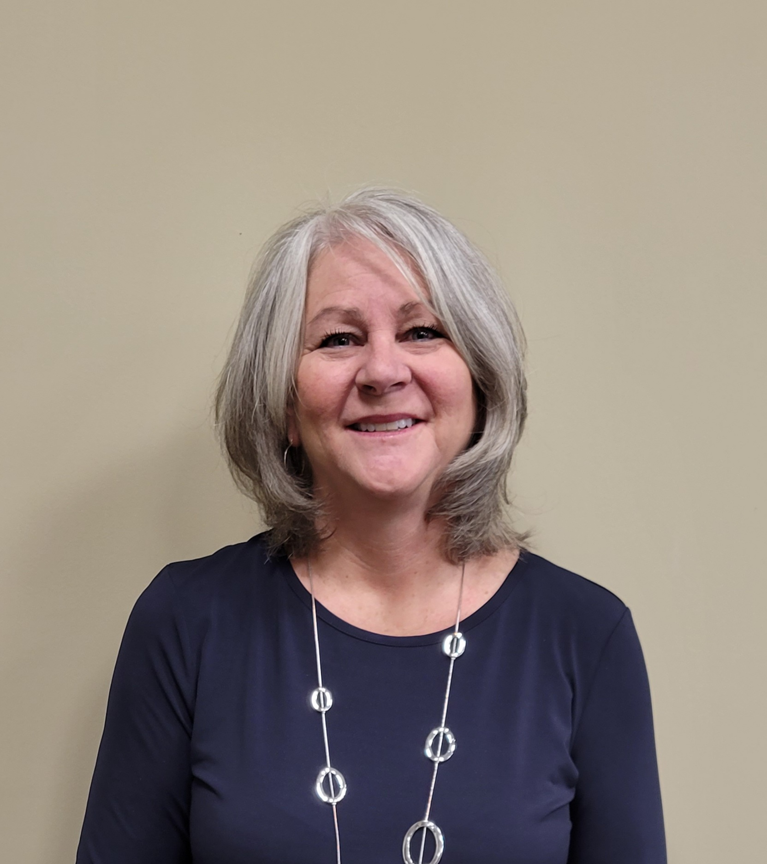
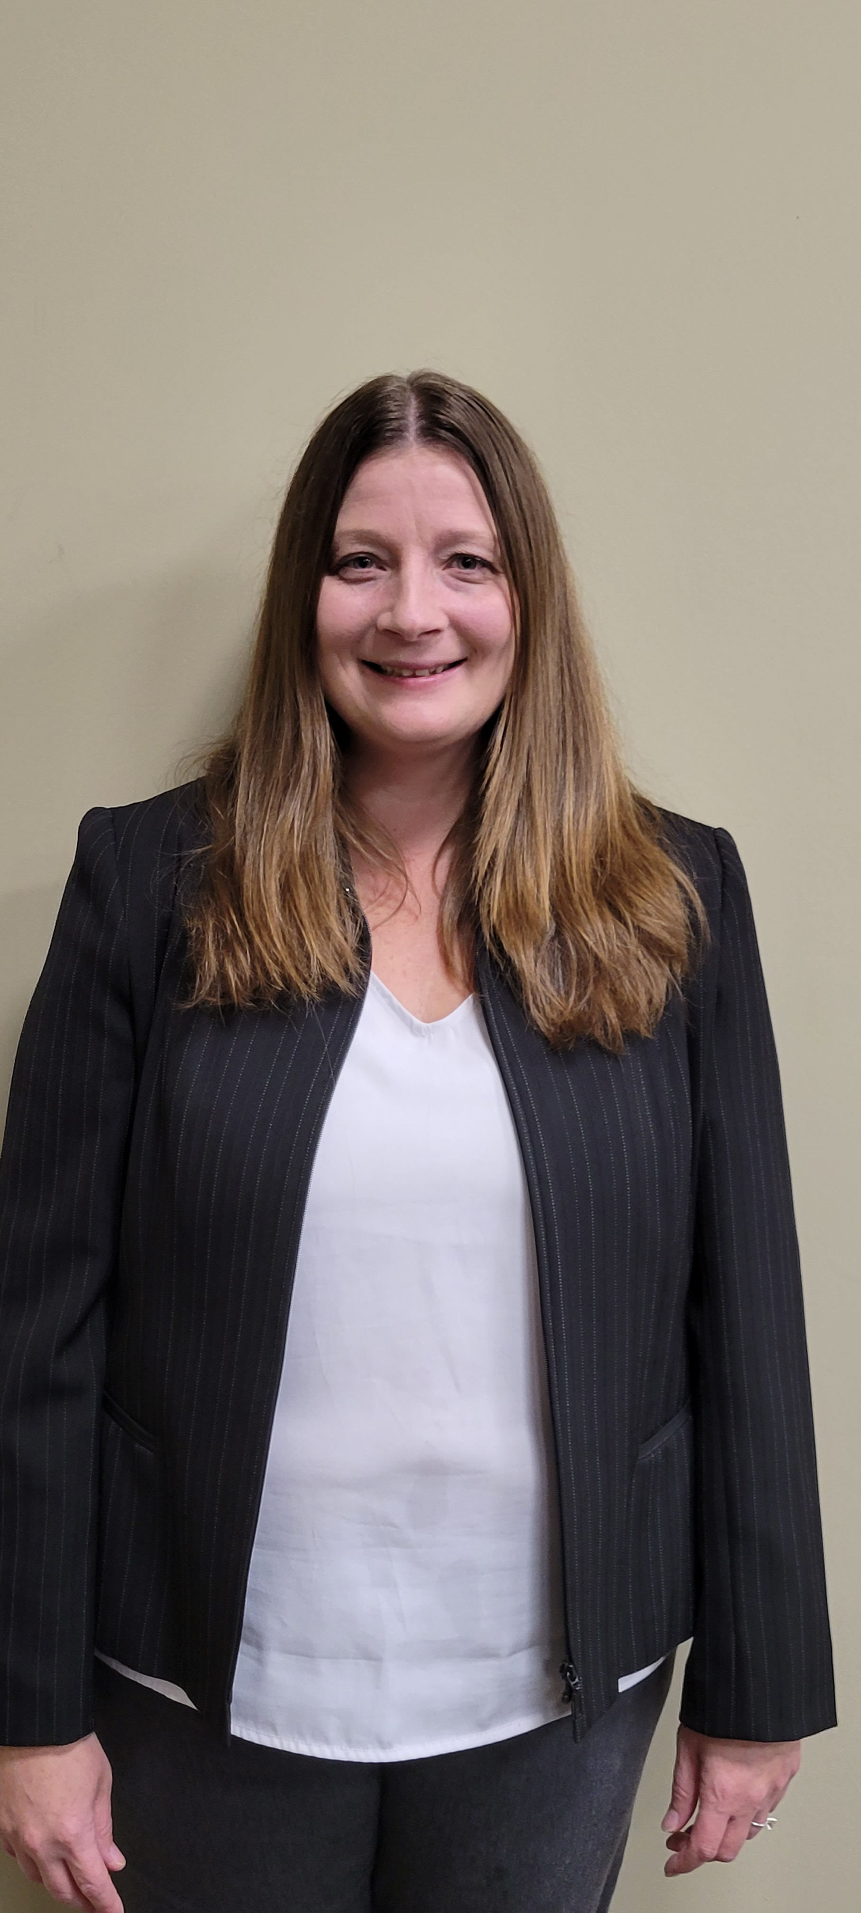
Kerri O’Kane
Municipal Clerk
Lisa Miller
Deputy Municipal Clerk

Slide 14
Legislative Services –
Manager of Legislative Services / Municipal Clerk & Deputy Municipal Clerk
Municipal Clerk
Responsible for fulfilling all the statutory obligations and duties of the Clerk as prescribed in the Municipal Act, the Municipal Elections Act, the Planning Act and other legislation. Responsible for the management of all operational functions of the Legislative Services and By-law Enforcement Divisions within Corporate Services.
Deputy Municipal Clerk
Oversees the day-to-day operations of the Legislative Services Division, records management system and all Access to Information requests. Acts in the official capacity of the Municipal Clerk.
Together we:
Organize and oversee preparation of all Council and Committee agendas, minutes and follow up. Attend all regular and special meetings of Council, Committee of the Whole and Advisory Committees as required;
Issue marriage licenses and perform Civil marriage ceremonies;
Animal Control services;

Slide 15
Legislative Services - Municipal Clerk & Municipal Deputy Clerk
Administration of the Belsyde and Elora cemeteries;
Municipal and School Board Elections;
Responsible for the development and delivery of professional development material, training and orientation for Council and Committees;
Records management;
Municipal Freedom of Information and Protection of Privacy Act (MFIPPA) requests, ensuring compliance with legislation;
Accessibility Coordinator, ensuring the Township complies with its obligations under the Accessibility for Ontarians with Disabilities Act;
Responsible for the administration of the Township’s Municipal Drain and Tile Drainage program;
Manage and oversee By-law enforcement, management and compliance.

